Slide 1
Principal Component Analysis.
t-distributed Stochastic Neighbor Embedding.
Radu Ionescu, Prof. PhD.
raducu.ionescu@gmail.com
Faculty of Mathematics and Computer Science
University of Bucharest

Slide 2
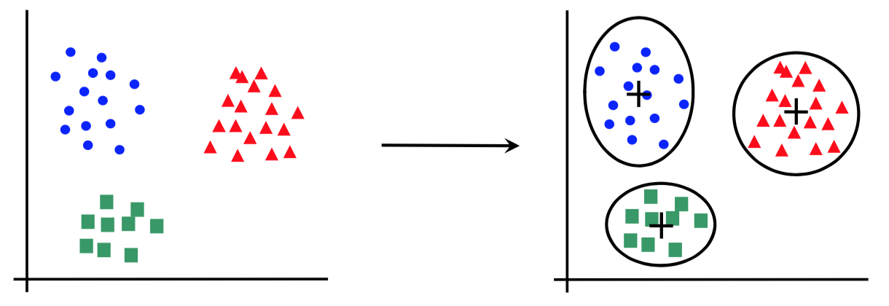
Canonical forms of unsupervised learning problems
Clustering
Dimensionality Reduction
K-means
DBScan
Hierarchical Clustering
…
Principal Component Analysis
t-SNE
…

Slide 3
Principal Component Analysis

Slide 4
Intuition
What can we do to get a better view of this data set?

Slide 5
Intuition
What can we do to get a better view of this data set?
We can try to rotate the axes until we find the best angle to view the data

Slide 6
Intuition
What can we do to get a better view of this data set?
We can try to rotate the axes until we find the best angle to view the data

Slide 7
Intuition
What can we do to get a better view of this data set?
We can try to rotate the axes until we find the best angle to view the data

Slide 8
Intuition
What can we do to get a better view of this data set?
We can try to rotate the axes until we find the best angle to view the data

Slide 9
Intuition
What can we do to get a better view of this data set?
We can try to rotate the axes until we find the best angle to view the data
We get a better understanding of the data by looking from this angle than from our original perspective

Slide 10
Intuition
Rotating the axes is equivalent to changing the coordinate system (or rotating the data)
The axes that give the best view of the data are called principal components
These are the directions in which the data varies the most!
$$x^{′}=0.56x−0.25y−0.79z$$
$$y^{′}=−0.75x+0.25y−0.61z$$
$$z^{′}=0.35x+0.94y−0.04z$$
We also compute how much variance is explained by each component:
$x′$ explains ~75%, $y′$ explains ~25%, $z′$ explains <1%

Slide 11
Intuition
Rotating the axes is equivalent to changing the coordinate system (or rotating the data)
The axes that give the best view of the data are called principal components
These are the directions in which the data varies the most!
$$x^{′}=0.56x−0.25y−0.79z$$
$$y^{′}=−0.75x+0.25y−0.61z$$
$$z^{′}=0.35x+0.94y−0.04z$$
We also compute how much variance is explained by each component:
$x′$ explains ~75%, $y′$ explains ~25%, $z′$ explains <1%
We can discard components that explain too little variance!

Slide 12
Mathematical Preliminaries

Slide 13
Random variable
A random variable is a variable whose possible values are outcomes of a random phenomenon, e.g. rolling a die
The source of uncertainty in a random variable can be either:
objective – the result of a random process
subjective – the results of incomplete knowledge
A random variable has a probability distribution that specifies the probability of its value falling in any given interval
A random variate is a particular outcome of a random variable
It is the result of sampling from the probability distribution
The expected value $E$ (or mean) of a random variable is the long-run average of its random variates
For the discrete case, it is the probability-weighted average of all possible outcomes
$$E\left[ \right]=3.5$$
The variance $σ^{2}$ is a measure of the dispersion of random variates around the expected value
$σ$is the standard deviation

Slide 14
Random variable
Let $X=\{x_{1},x_{2},…,x_{n}\}$and $Y=\{y_{1},y_{2},…,y_{n}\}$ be two sets of random variates sampled together from two random variables, i.e. $x_{i}$ is sampled at the same time as $y_{i}$
$X$ and $Y$ are just subsets of the whole (potentially infinite) population
Then, the sample mean and the sample variance are just estimates of the true mean and variance values:
$$Mean\left(X\right)=E\left[X\right]=μ_{X}=\frac{1}{n}\sum_{i=1}^{n}{x_{i}}$$
$$Var\left(X\right)=σ_{X}^{2}=\frac{1}{n}\sum_{i=1}^{n}{{\left(x_{i}−μ_{X}\right)}^{2}}$$

Slide 15
Random variable
Let $X=\{x_{1},x_{2},…,x_{n}\}$and $Y=\{y_{1},y_{2},…,y_{n}\}$ be two sets of random variates sampled together from two random variables, i.e. $x_{i}$ is sampled at the same time as $y_{i}$
$X$ and $Y$ are just subsets of the whole (potentially infinite) population
Then, the sample mean and the sample variance are just estimates of the true mean and variance values:
$$Mean\left(X\right)=E\left[X\right]=μ_{X}=\frac{1}{n}\sum_{i=1}^{n}{x_{i}}$$
$$Var\left(X\right)=σ_{X}^{2}=\frac{1}{n−1}\sum_{i=1}^{n}{{\left(x_{i}−μ_{X}\right)}^{2}}$$
Covariance measures the joint variability of two random variables, e.g. if larger values of X correspond to larger values of Y and smaller values of X to smaller values of Y:
$$Cov\left(X,Y\right)=σ_{X,Y}^{2}=\frac{1}{n−1}\sum_{i=1}^{n}{\left(x_{i}−μ_{X}\right)∙\left(y_{i}−μ_{Y}\right)}$$
$n−1$ instead of $n$ is Bessel’s correction that accounts for the biased estimation of the mean

Slide 16
Features as random variables
Consider a data set $X∈ℝ^{m×n}$ with $m$ examples and $n$ features:
$$X=\left(\begin{aligned}\begin{matrix}\begin{matrix}x_{1,1} & x_{1,2}\end{matrix} & \begin{matrix}⋯ & x_{1,n}\end{matrix}\end{matrix} \\ \begin{matrix}\begin{matrix}x_{2,1} & x_{2,2}\end{matrix} & \begin{matrix}⋯ & x_{2,n}\end{matrix}\end{matrix} \\ \begin{matrix}\begin{matrix}⋮ & ⋮\end{matrix} & \begin{matrix} ⋱ & ⋮\end{matrix}\end{matrix} \\ \begin{matrix}\begin{matrix}x_{m,1} & x_{m,2}\end{matrix} & \begin{matrix}⋯ & x_{m,n}\end{matrix}\end{matrix}\end{aligned}\right)$$
Each row represents an example (vector of $n$ features)
Each column represents the same feature of all examples
We can regard each feature (column) as a random variable
This means that $x_{i,j}$ (feature $j$ of example $i$) is a random variate
Examples are made up of $n$ random variables that are sampled together
This makes $X$ a set of $m$ sampling events of $n$ random variables
We can compute the sample mean, variance, covariance

Slide 17
Centering the data set
$$X=\left(\begin{aligned}\begin{matrix}\begin{matrix}x_{1,1} & x_{1,2}\end{matrix} & \begin{matrix}⋯ & x_{1,n}\end{matrix}\end{matrix} \\ \begin{matrix}\begin{matrix}x_{2,1} & x_{2,2}\end{matrix} & \begin{matrix}⋯ & x_{2,n}\end{matrix}\end{matrix} \\ \begin{matrix}\begin{matrix}⋮ & ⋮\end{matrix} & \begin{matrix} ⋱ & ⋮\end{matrix}\end{matrix} \\ \begin{matrix}\begin{matrix}x_{m,1} & x_{m,2}\end{matrix} & \begin{matrix}⋯ & x_{m,n}\end{matrix}\end{matrix}\end{aligned}\right)$$
$$μ_{X}=\left(\begin{matrix}\begin{matrix}μ_{1} & μ_{2}\end{matrix} & \begin{matrix}⋯ & μ_{n}\end{matrix}\end{matrix}\right)=\frac{1}{m}\left(\begin{matrix}\begin{matrix}\sum_{i=1}^{m}{x_{i,1}} & \sum_{i=1}^{m}{x_{i,2}}\end{matrix} & \begin{matrix}⋯ & \sum_{i=1}^{m}{x_{i,n}}\end{matrix}\end{matrix}\right)$$
$$\overline{X}=\left(\begin{aligned}\begin{matrix}\begin{matrix}x_{1,1}−μ_{1} & x_{1,2}−μ_{2}\end{matrix} & \begin{matrix}⋯ & x_{1,n}−μ_{n}\end{matrix}\end{matrix} \\ \begin{matrix}\begin{matrix}x_{2,1}−μ_{1} & x_{2,2}\end{matrix}−μ_{2} & \begin{matrix}⋯ & x_{2,n}−μ_{n}\end{matrix}\end{matrix} \\ \begin{matrix}\begin{matrix}⋮ & ⋮\end{matrix} & \begin{matrix} ⋱ & ⋮ \end{matrix}\end{matrix} \\ \begin{matrix}\begin{matrix}x_{m,1}−μ_{1} & x_{m,2}\end{matrix}−μ_{2} & \begin{matrix}⋯ & x_{m,n}−μ_{n}\end{matrix}\end{matrix}\end{aligned}\right)=X−I_{m×1}∙μ_{X}$$
Centered version of $X$

Slide 18
Computing the covariance of the data set
$$\overline{X}=\left(\begin{aligned}\begin{matrix}\begin{matrix}x_{1,1}−μ_{1} & x_{1,2}−μ_{2}\end{matrix} & \begin{matrix}⋯ & x_{1,n}−μ_{n}\end{matrix}\end{matrix} \\ \begin{matrix}\begin{matrix}x_{2,1}−μ_{1} & x_{2,2}\end{matrix}−μ_{2} & \begin{matrix}⋯ & x_{2,n}−μ_{n}\end{matrix}\end{matrix} \\ \begin{matrix}\begin{matrix}⋮ & ⋮\end{matrix} & \begin{matrix} ⋱ & ⋮ \end{matrix}\end{matrix} \\ \begin{matrix}\begin{matrix}x_{m,1}−μ_{1} & x_{m,2}\end{matrix}−μ_{2} & \begin{matrix}⋯ & x_{m,n}−μ_{n}\end{matrix}\end{matrix}\end{aligned}\right)$$
$${\overline{X}}^{T}=\left(\begin{aligned}\begin{matrix}\begin{matrix}x_{1,1}−μ_{1} & x_{2,1}−μ_{1}\end{matrix} & \begin{matrix}⋯ & x_{m,1}−μ_{1}\end{matrix}\end{matrix} \\ \begin{matrix}\begin{matrix}x_{1,2}−μ_{2} & x_{2,2}\end{matrix}−μ_{2} & \begin{matrix}⋯ & x_{m,2}−μ_{2}\end{matrix}\end{matrix} \\ \begin{matrix}\begin{matrix}⋮ & ⋮\end{matrix} & \begin{matrix} ⋱ & ⋮ \end{matrix}\end{matrix} \\ \begin{matrix}\begin{matrix}x_{1,n}−μ_{n} & x_{2,n}\end{matrix}−μ_{n} & \begin{matrix}⋯ & x_{m,n}−μ_{n}\end{matrix}\end{matrix}\end{aligned}\right)$$
$$\frac{1}{m−1} {\overline{X}}^{T}∙\overline{X}=\frac{1}{m−1}\left(\begin{aligned} \begin{matrix}\begin{matrix} \sum_{i=1}^{m}{{\left(x_{i,1}−μ_{1}\right)}^{2}} & \sum_{i=1}^{m}{\left(x_{i,1}−μ_{1}\right)∙\left(x_{i,2}−μ_{2}\right)}\end{matrix} & \begin{matrix}⋯ & \sum_{i=1}^{m}{\left(x_{i,1}−μ_{1}\right)∙\left(x_{i,n}−μ_{n}\right)}\end{matrix}\end{matrix} \\ \begin{matrix}\begin{matrix}\sum_{i=1}^{m}{\left(x_{i,2}−μ_{2}\right)∙\left(x_{i,1}−μ_{1}\right)} & \sum_{i=1}^{m}{{\left(x_{i,2}−μ_{2}\right)}^{2}}\end{matrix} & \begin{matrix}⋯ & \sum_{i=1}^{m}{\left(x_{i,2}−μ_{2}\right)∙\left(x_{i,n}−μ_{n}\right)}\end{matrix}\end{matrix} \\ \begin{matrix}\begin{matrix}⋮ & ⋮\end{matrix} & \begin{matrix} ⋱ & ⋮ \end{matrix}\end{matrix} \\ \begin{matrix}\begin{matrix}\sum_{i=1}^{m}{\left(x_{i,n}−μ_{n}\right)∙\left(x_{i,1}−μ_{1}\right)} & \sum_{i=1}^{m}{\left(x_{i,n}−μ_{n}\right)∙\left(x_{i,2}−μ_{2}\right)}\end{matrix} & \begin{matrix}⋯ & \sum_{i=1}^{m}{{\left(x_{i,n}−μ_{n}\right)}^{2} }\end{matrix}\end{matrix} \end{aligned}\right)$$
$$=\left(\begin{aligned}\begin{matrix}\begin{matrix} Var(X_{1}) & Cov(X_{1},X_{2})\end{matrix} & \begin{matrix}⋯ & Cov(X_{1},X_{n})\end{matrix}\end{matrix} \\ \begin{matrix}\begin{matrix}Cov\left(X_{2},X_{1}\right) & Var(X_{2})\end{matrix} & \begin{matrix}⋯ & Cov\left(X_{2},X_{n}\right) \end{matrix}\end{matrix} \\ \begin{matrix}\begin{matrix}⋮ & ⋮\end{matrix} & \begin{matrix} ⋱ & ⋮ \end{matrix}\end{matrix} \\ \begin{matrix}\begin{matrix}Cov(X_{n},X_{1}) & Cov(X_{n},X_{2})\end{matrix} & \begin{matrix}⋯ & Var(X_{n})\end{matrix}\end{matrix} \end{aligned}\right)≝Cov\left(X\right)=Σ_{X}$$

Slide 19
Covariance of the data set
$$Σ_{X}=\left(\begin{matrix}1 & 0 \\ 0 & 1\end{matrix}\right)$$
$$Σ_{X}=\left(\begin{matrix}1 & 0.6 \\ 0.6 & 0.4\end{matrix}\right)$$
$$x_{2}$$
$$x_{2}$$
$$x_{1}$$
$$x_{1}$$
$$Σ_{X}=\left(\begin{matrix}0.2 & −0.3 \\ −0.3 & 1\end{matrix}\right)$$
$$Σ_{X}=\left(\begin{matrix}1 & 0 \\ 0 & 0.5\end{matrix}\right)$$
$$x_{2}$$
$$x_{2}$$
$$x_{1}$$
$$x_{1}$$

Slide 20
Eigenvectors and eigenvalues
An eigenvector $v∈ℝ^{n}$ and its corresponding eigenvalue $λ∈ℝ$ of a square matrix $A∈ℝ^{n×n}$ are the solutions to the following equation:
$$A∙v=λ∙v$$
In other words, when multiplied by $A$, an eigenvector only gets scaled, i.e. the direction of $v$ does not change
The corresponding eigenvalue $λ$is the scaling factor
There are multiple solutions to the equation above, i.e. there are more eigenvectors and corresponding eigenvalues

Slide 21
Finding Principal Components

Slide 22
Principal Component Analysis
Principal Component Analysis (PCA) transforms a data set into a new orthogonal coordinate system in which the data is centered and the features are completely uncorrelated
The mean of the new data set is 0
The covariance of any pair of distinct features is 0
The features of the transformed data set are called principal components
Principal components are sorted in descending order by variance, i.e. the first component has the largest variance
Components with low variance can be discarded, making PCA a method of dimensionality reduction

Slide 23
Finding the first principal component
The first step is centering the data (subtracting the mean from all data points)
𝑥₂
𝑥₁

Slide 24
Finding the first principal component
The first step is centering the data (subtracting the mean from all data points)
𝑥₂
𝑥₁

Slide 25
Finding the first principal component
The first step is centering the data (subtracting the mean from all data points)
The first principal component is the direction on which the data has the largest variance
We are looking for a line on which the projection of data points is as spread out as possible
𝑥₂
𝑥₁

Slide 26
Finding the first principal component
The first step is centering the data (subtracting the mean from all data points)
The first principal component is the direction on which the data has the largest variance
We are looking for a line on which the projection of data points is as spread out as possible
𝑥₂
𝑥₁

Slide 27
Finding the first principal component
The first step is centering the data (subtracting the mean from all data points)
The first principal component is the direction on which the data has the largest variance
We are looking for a line on which the projection of data points is as spread out as possible
𝑥₂
It can be proven that this is equivalent to finding the line that minimizes the sum of distances to the points
𝑥₁

Slide 28
Finding the second principal component
If we subtract the projection of points on the first PC from all the points, we obtain a data set that has 0 variance on that direction
𝑥₂
𝑥₁

Slide 29
Finding the second principal component
If we subtract the projection of points on the first PC from all the points, we obtain a data set that has 0 variance on that direction
𝑥₂
𝑥₁

Slide 30
Finding the second principal component
If we subtract the projection of points on the first PC from all the points, we obtain a data set that has 0 variance on that direction
We now look for a line on which the projection of data points from the new data set is as spread out as possible
The result will be the second principal component
𝑥₂
The second PC is the direction in which the data varies the most, after eliminating the variance on the first PC
Trivial in two dimensions
𝑥₁

Slide 31
Finding further principal components
If we subtract the projection of points on the first PC from all the points, we obtain a data set that has 0 variance on that direction
We now look for a line on which the projection of data points from the new data set is as spread out as possible
The result will be the second principal component
𝑥₂
The process would go on for multiple dimensions
𝑥₁

Slide 32
PCA versus Linear Regression
Linear Regression finds the line that minimizes the sum of squared distances to the labels
PCA finds the line that minimizes the sum of distances to the data points
𝑥₂
𝑥₂
𝑥₁
𝑥₁
$x_{1}$ and $x_{2}$ are both features, i.e. independent variables
$x_{2}$ is the label, i.e. dependent variable

Slide 33
PCA as Eigen Decomposition

Slide 34
PCA as Eigen Decomposition
Let $X∈ℝ^{m×n}$ be a data set with covariance $Σ_{X}$
Q: How do the eigenvectors of $Σ_{X}$ look like?
Intuitively, consider $Σ_{X}$responsible for the shape of $X$
Recall that the eigenvectors are the vectors that do not change direction when multiplied by $Σ_{X}$
A: The eigenvectors of the covariance matrix are in fact the principal components of matrix $X$
The corresponding eigenvalues are equal to the amount of variance explained by each component
$$x_{2}$$
$$x_{1}$$

Slide 35
Eigen Decomposition
$Σ_{X}=V⋅Λ∙V^{−1}$, where:
$v_{i}∈ℝ^{n×1}$ are column eigenvectors
$$V∈ℝ^{n×n}=\left(\begin{matrix}\begin{matrix}v_{1} & v_{2}\end{matrix} & \begin{matrix}⋯ & v_{n}\end{matrix}\end{matrix}\right)$$
$$Λ∈ℝ^{n×n}=\left(\begin{aligned}\begin{matrix}\begin{matrix}λ_{1} & 0\end{matrix} & \begin{matrix}⋯ & 0\end{matrix}\end{matrix} \\ \begin{matrix}\begin{matrix} 0 & { λ}_{2}\end{matrix} & \begin{matrix}⋯ & 0 \end{matrix}\end{matrix} \\ \begin{matrix}\begin{matrix}⋮ & ⋮\end{matrix} & \begin{matrix}⋱ & ⋮ \end{matrix}\end{matrix} \\ \begin{matrix}\begin{matrix}0 & 0\end{matrix} & \begin{matrix}⋯ & λ_{n}\end{matrix}\end{matrix}\end{aligned}\right)$$
Diagonal eigenvalues
$$Σ_{X}$$
$$V$$
$$Λ$$
$$V^{−1}$$
=
$$∙$$
$$∙$$
$$n×n$$
$$n×n$$
$$n×n$$
$$n×n$$

Slide 36
PCA as Eigen Decomposition (Python)
def PCA(X,k): [m,n] = X.shape miu = np.mean(X, axis=0) # compute mean of each feature X_bar = X – miu # center X cov_X = 1 / (m-1) * np.matmul(X_bar.T, X_bar) # compute covariance V, lambdas = np.linalg.eig(cov_X) # apply eigen decomposition idx = np.argsort(np.diag(-lambdas)) # sort lambdas descdending V_star = V[:,idx[:k]] # permute and keep only first k PCs X_star = np.matmul(X,V_star) # apply transformation to X return X_star, V_star

Slide 37
PCA (Python)
from sklearn.decomposition import PCA pca = PCA(n_components = 2) # number of components to keep, if ”None” it keeps all components # find the principal components: pca.fit(X) # rotate X into the new coordinate system: X_pca = pca.transform(X) # coeficients of the original components to produce the new components: pca.components_ # variance of projections per component: pca.explained_variance_ # ratio of explained variance per component: pca.explained_variance_ratio_

Slide 38
Example
Iris data set: 150 data samples of flowers with 4 features and 3 classes
$X∈ℝ^{150×4}$
Features: sepal length (cm), sepal width (cm), petal length (cm), petal width (cm)

Slide 39
Example
Iris data set: 150 data samples of flowers with 4 features and 3 classes
$X∈ℝ^{150×4}$
Features: sepal length (cm), sepal width (cm), petal length (cm), petal width (cm)
𝑃𝐶₁ = 0.36 ∗ 𝐒𝐞𝐩𝐋𝐞𝐧 − 0.08 ∗ 𝐒𝐞𝐩𝐖𝐢𝐝 + 0.86 ∗ 𝐏𝐞𝐭𝐋𝐞𝐧 + 0.36 ∗ 𝐏𝐞𝐭𝐖𝐢𝐝
𝑃𝐶₂ = 0.66 ∗ 𝐒𝐞𝐩𝐋𝐞𝐧 + 0.73 ∗ 𝐒𝐞𝐩𝐖𝐢𝐝 − 0.17 ∗ 𝐏𝐞𝐭𝐋𝐞𝐧 − 0.08 ∗ 𝐏𝐞𝐭𝐖𝐢𝐝
𝑃𝐶₃ = −0.58 ∗ 𝐒𝐞𝐩𝐋𝐞𝐧 + 0.60 ∗ 𝐒𝐞𝐩𝐖𝐢𝐝 + 0.08 ∗ 𝐏𝐞𝐭𝐋𝐞𝐧 + 0.55 ∗ 𝐏𝐞𝐭𝐖𝐢𝐝
𝑃𝐶₄ = −0.32 ∗ 𝐒𝐞𝐩𝐋𝐞𝐧 + 0.32 ∗ 𝐒𝐞𝐩𝐖𝐢𝐝 + 0.48 ∗ 𝐏𝐞𝐭𝐋𝐞𝐧 − 0.75 ∗ 𝐏𝐞𝐭𝐖𝐢𝐝
First two components explain almost 98% of variance

Slide 40
Limitations
PCA does not consider non-linear correlations:
PCA does not take labels into account, only variance of features:

Slide 41
Summary
Principal Component Analysis transforms a data set into a new orthogonal coordinate system in which the data is centered and the features are completely uncorrelated
The directions of the new coordinate system are called principal components
PCs are sorted by variance, such that the first PC has the largest variance (it explains most of the data variance)
Components with low variance can be removed, making PCA a method of dimensionality reduction
PCA does not treat non-linear correlations and it does not take labels into account

Slide 42
Data Visualization

Slide 43
Problem Formulation
How can we visualize high dimensional data?
Learn an embedding that preserves as much of the significant structure of the high-dimensional data as possible in the low-dimensional map
$$X =\left\{x_{1},x_{2},…,x_{n}\right\}⟶ Y=\{y_{1},y_{2},…,y_{n}\}$$
Why not just PCA?
High-dimensional data set
Two or three-dimensional data

Slide 44
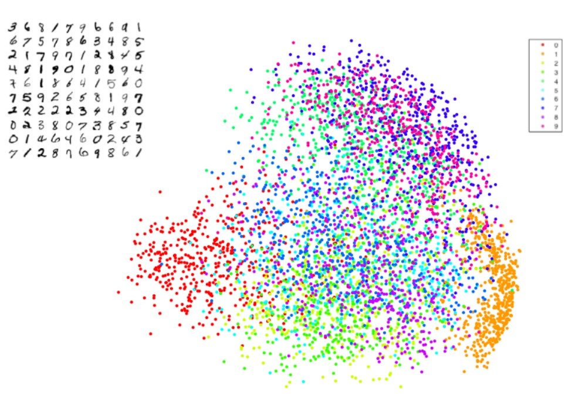

Slide 45
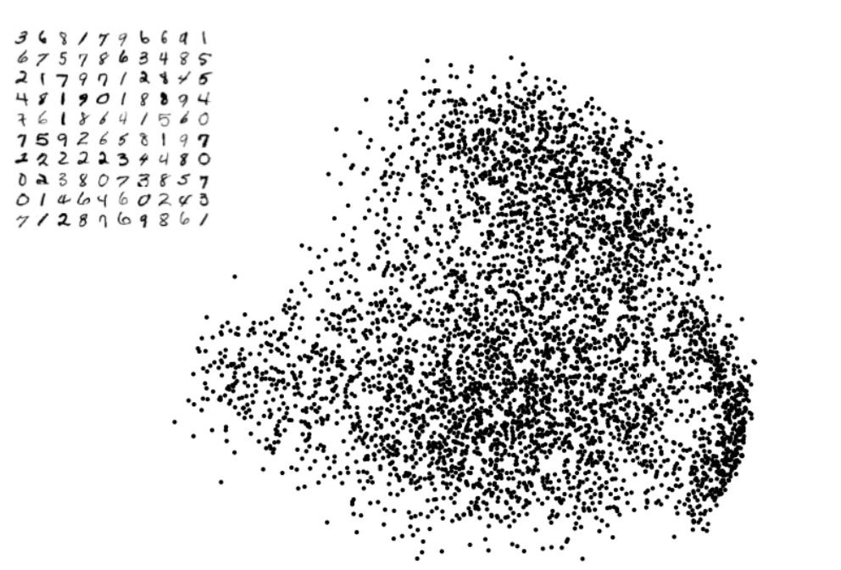

Slide 46
Why not PCA?
Recall the PCA objective: project data onto a lower dimensional subspace, such that the variance is maximized
Why the bad results?
Linear projection
Mostly preserves distances between dissimilar points
Is this really what we want for the purpose of visualization?

Slide 47
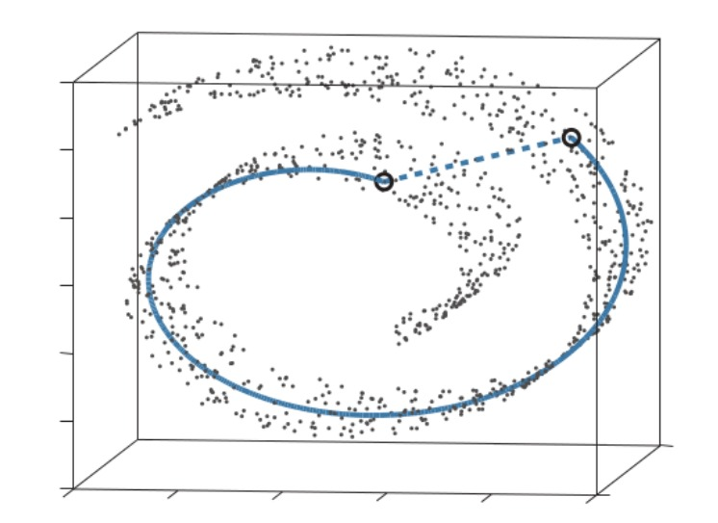
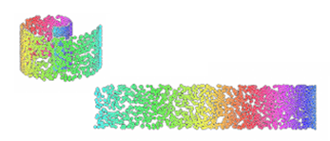
Why not PCA?
In complex datasets, large distances are usually less indicative

Slide 48
Stochastic Neighbor Embedding

Slide 49
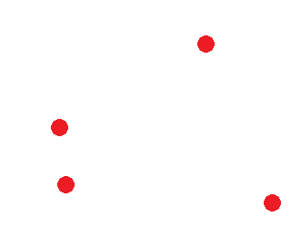
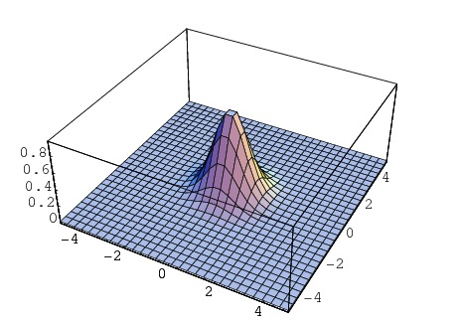
SNE (Stochastic Neighbor Embedding)
In contrast to PCA, SNE focuses on maintaining the nearest neighbors in the lower dimensional map
Introduced in [Hinton & Roweis, NIPS 2002]
SNE converts the pairwise Euclidean distances between points into a probability density $p_{j|i}$
high
low

Slide 50
SNE (Stochastic Neighbor Embedding)
Similarity of data points in high-dimension:
$$p_{j|i}=\frac{exp\left(−\frac{{\left\|x_{i}−x_{j}\right\|}^{2}}{2σ_{i}^{2}}\right)}{\sum_{k≠i}{exp\left(−\frac{{\left\|x_{i}−x_{k}\right\|}^{2}}{2σ_{i}^{2}}\right)}}$$
Similarity of data points in low-dimension:
$$q_{j|i}=\frac{exp\left(−\frac{{\left\|y_{i}−y_{j}\right\|}^{2}}{2σ_{i}^{2}}\right)}{\sum_{k≠i}{exp\left(−\frac{{\left\|y_{i}−y_{k}\right\|}^{2}}{2σ_{i}^{2}}\right)}}$$
If we were able to perfectly preserve all similarities in the data, $p_{j|i}$ and $q_{j|i}$ will be equivalent

Slide 51
SNE (Stochastic Neighbor Embedding)
SNE minimizes an objective function that measures the discrepancy between similarities in the data and similarities in the map:
$$C=\sum_{i}{D_{KL}\left(P_{i}\left\|Q_{i}\right.\right)}=\sum_{i}{\sum_{j}{p_{j|i}∙log\frac{p_{j|i}}{q_{j|i}}}}$$

Slide 52
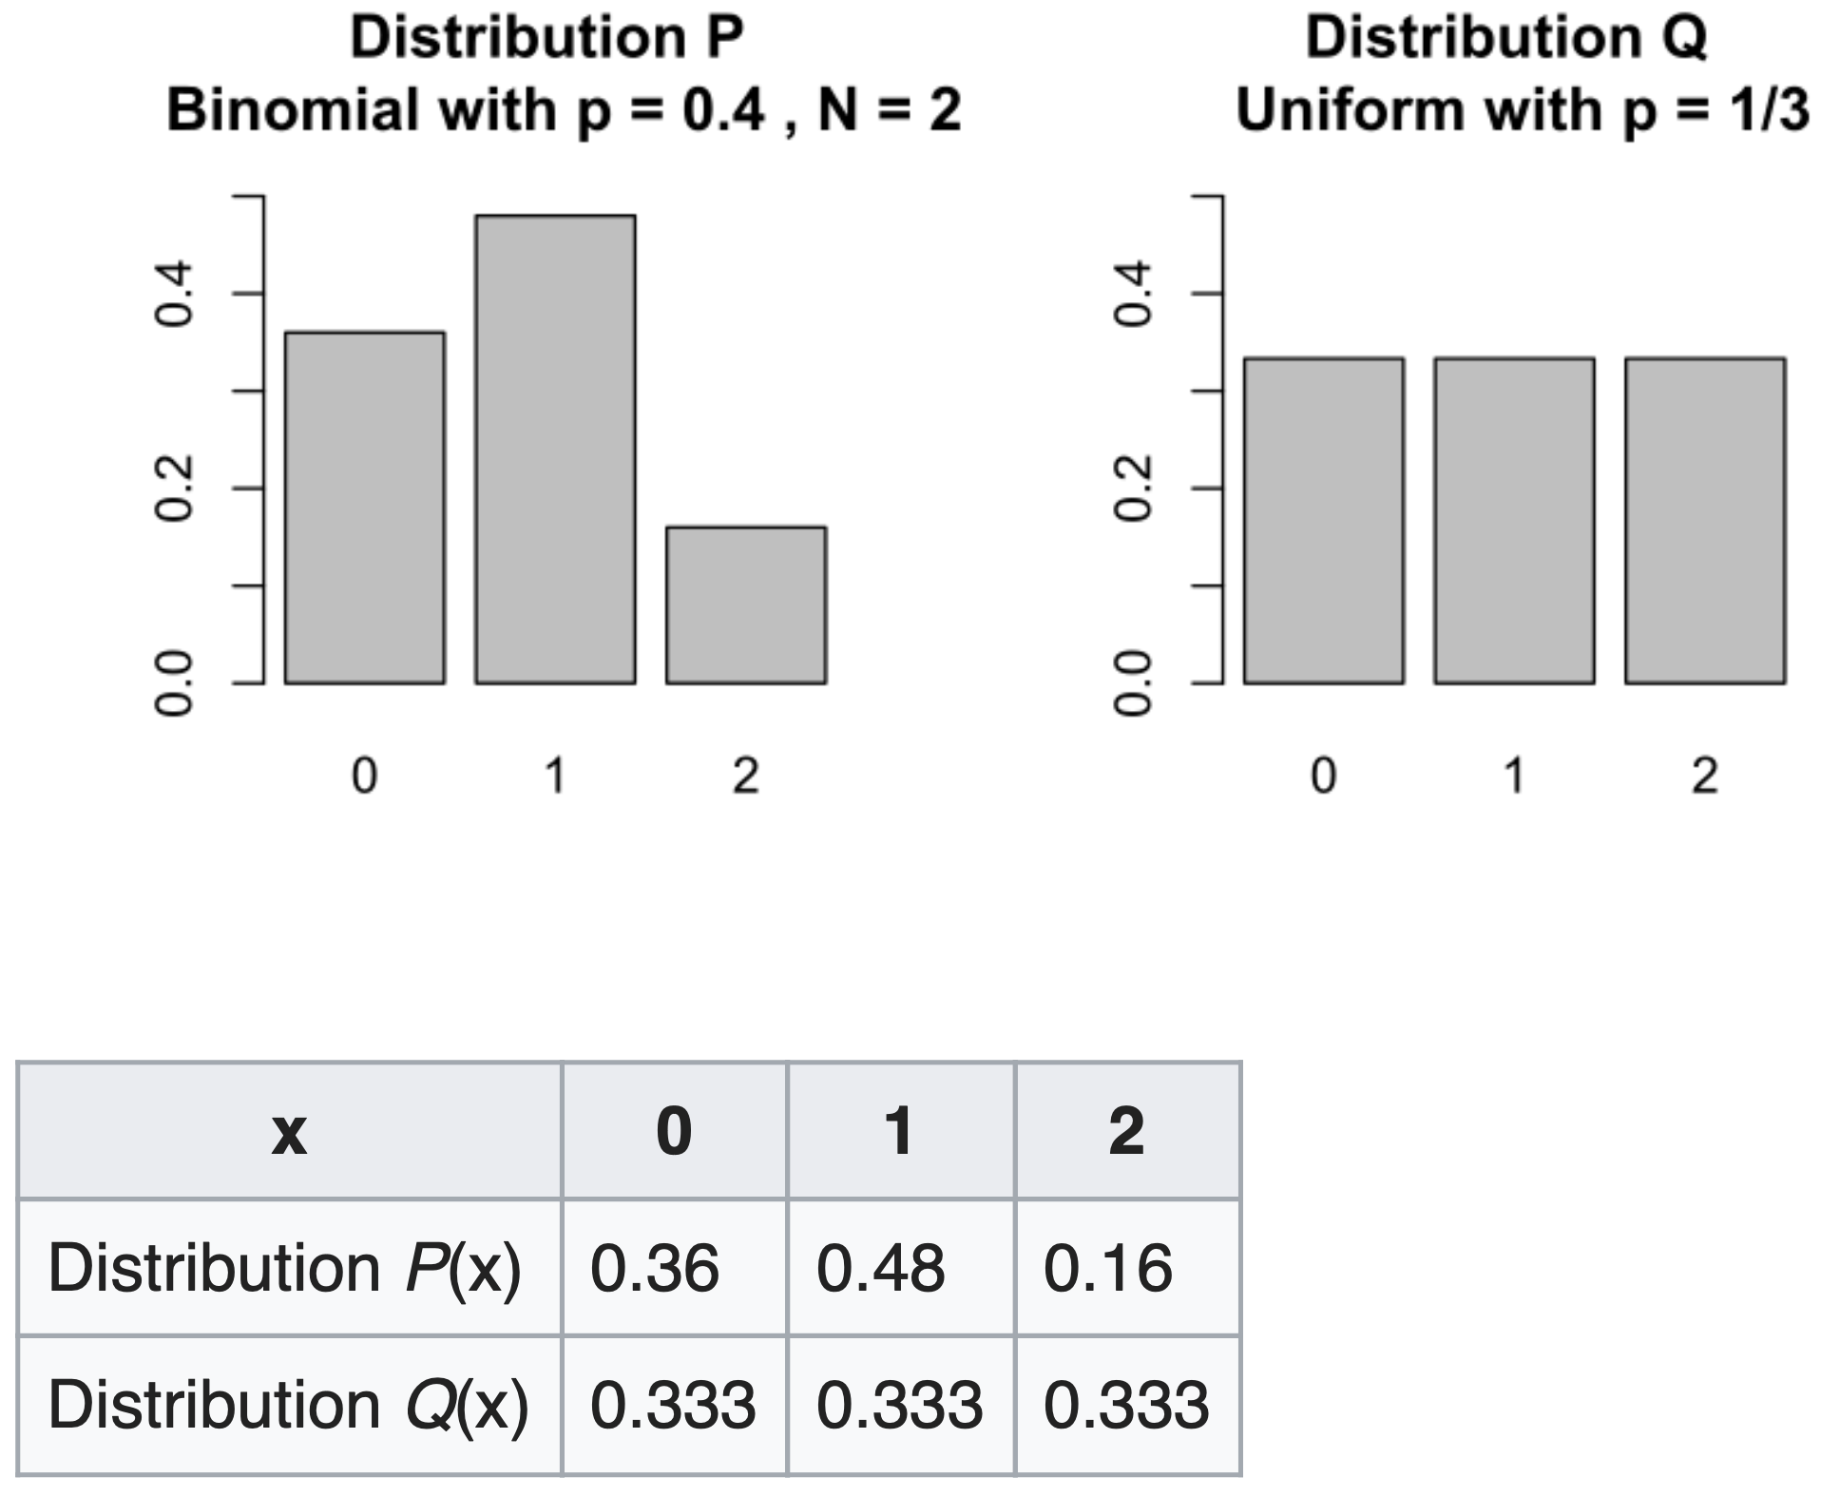
Kullback-Leibler Divergence

Slide 53
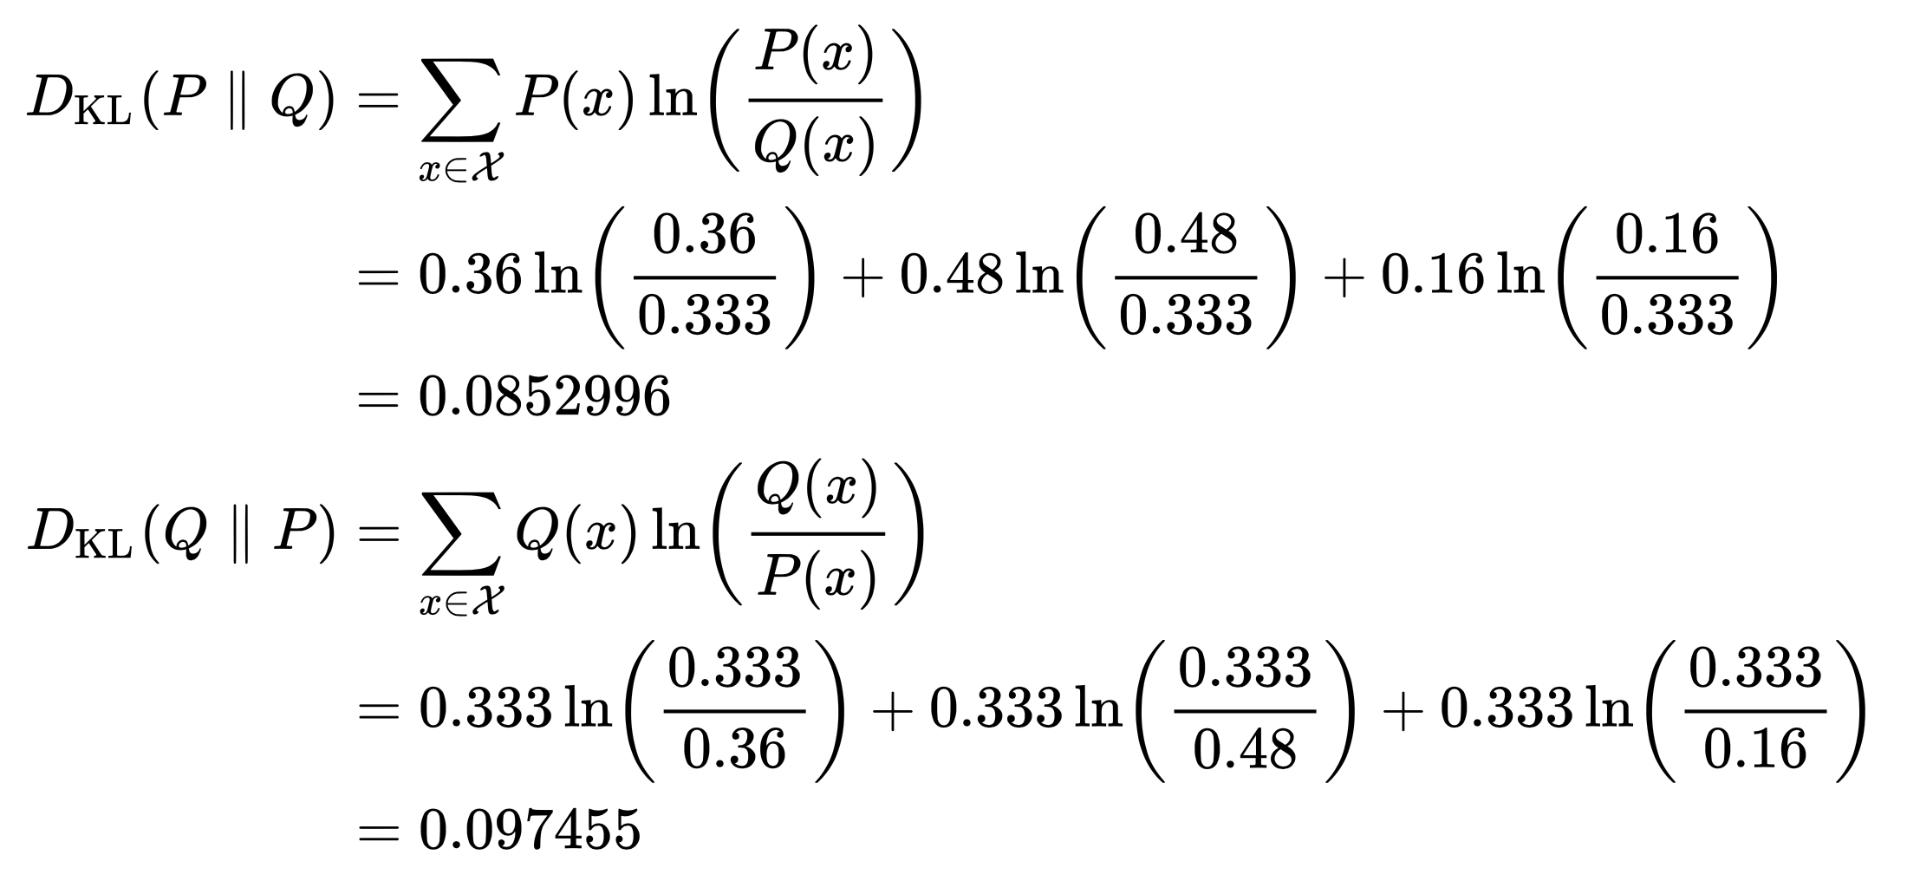
Kullback-Leibler Divergence

Slide 54
SNE (Stochastic Neighbor Embedding)
$$C=\sum_{i}{D_{KL}\left(P_{i}\left\|Q_{i}\right.\right)}=\sum_{i}{\sum_{j}{{ p}_{j|i} ∙ log\frac{p_{j|i}}{q_{j|i}}}}$$
weight
error term
Different errors have a different cost:
Close points mapped to far points ($p_{j|i}$ high, $q_{j|i}$ low) $⟹$ high penalty
Far points mapped to close points ($p_{j|i}$ low, $q_{j|i}$ high) $⟹$ low penalty
SNE focuses on preserving the local structure of the data!

Slide 55
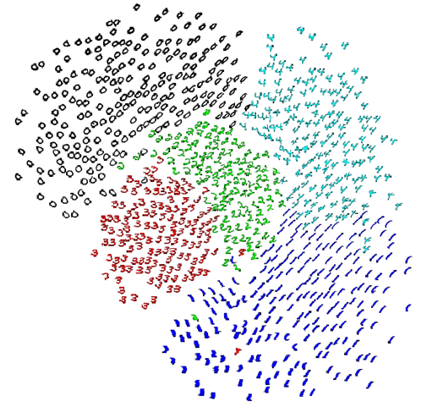
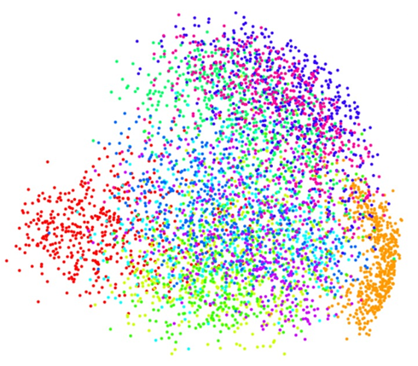
PCA versus SNE
PCA on MNIST (0-9)
SNE on MNIST (0-5)

Slide 56
Optimization
Gradient:
$$\frac{∂C}{∂y_{i}}=\sum_{j≠i}{\left(p_{j|i}−q_{j|i}+p_{j|i}−q_{j|i}\right)∙\left(y_{i}−y_{j}\right)}$$
Update rule:
$$Y^{(t)}=Y^{(t−1)}+ρ\frac{∂C}{∂y_{i}}+μ\left(Y^{(t−1)}−Y^{(t−2)}\right)$$
Optimization is performed using Gradient Descent
KL-divergence is not convex – no guaranties!
Techniques to avoid “bad” local minimum:
Large momentum (“keep going”)
Simulated Annealing (random noise)
Good visualization requires good choice of parameters

Slide 57
Are we overfitting?
Machine Learning | Visualization
Goal: Generalization Given a training set, do well on a test set. Overfitting is undesirable | Goal: Visualization We just want to “do well” on our data (“training set”) “Overfitting” is desirable
versus

Slide 58
Crowding Problem
The main problem with SNE:
Points tend to “crowd” together in the center of the map

Slide 59
t-SNE

Slide 60
t-SNE
t-Distributed Stochastic Neighbor Embedding (t-SNE) is a non-linear dimensionality reduction and visualization technique
Just as SNE, it maps the data points in a lower-dimensional space, such that points which were close in the original space remain close in the embedding space
It focuses on preserving local structure and does not preserve global structure
The results are non-deterministic
It is computationally expensive
t-SNE does not produce a transformation of the space, it generates an embedding into a completely new space
The features in the new space are difficult to interpret

Slide 61
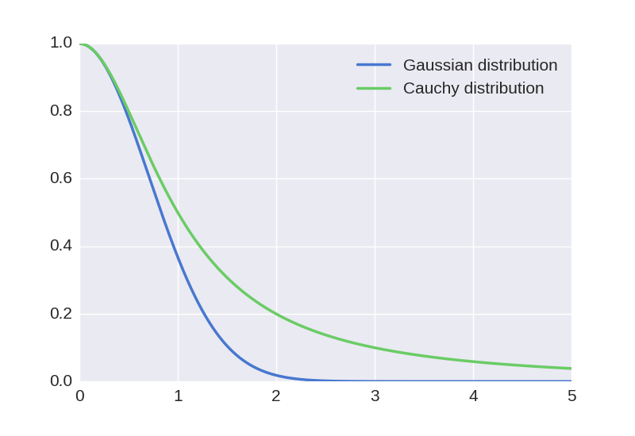
Mismatched tails can compensate for mismatched dimensionalities
$$C=\sum_{i}{D_{KL}\left(P_{i}\left\|Q_{i}\right.\right)}=\sum_{i}{\sum_{j}{p_{j|i}∙log\frac{p_{j|i}}{q_{j|i}}}}$$
Cauchy distribution = t-Student with one degree of freedom distribution
https://github.com/oreillymedia/t-SNE-tutorial

Slide 62
t-SNE
Introduced in [van der Maaten & Hinton, JMLR 2008]
Main difference:
$$q_{j|i}=\frac{{\left(1+−{\left\|y_{i}−y_{j}\right\|}^{2}\right)}^{−1}}{\sum_{k≠l}{{\left(1+−{\left\|y_{k}−y_{l}\right\|}^{2}\right)}^{−1}}}$$
instead of:
$$q_{j|i}=\frac{exp\left(−\frac{{\left\|y_{i}−y_{j}\right\|}^{2}}{2σ_{i}^{2}}\right)}{\sum_{k≠i}{exp\left(−\frac{{\left\|y_{i}−y_{k}\right\|}^{2}}{2σ_{i}^{2}}\right)}}$$

Slide 63
https://github.com/oreillymedia/t-SNE-tutorial

Slide 64
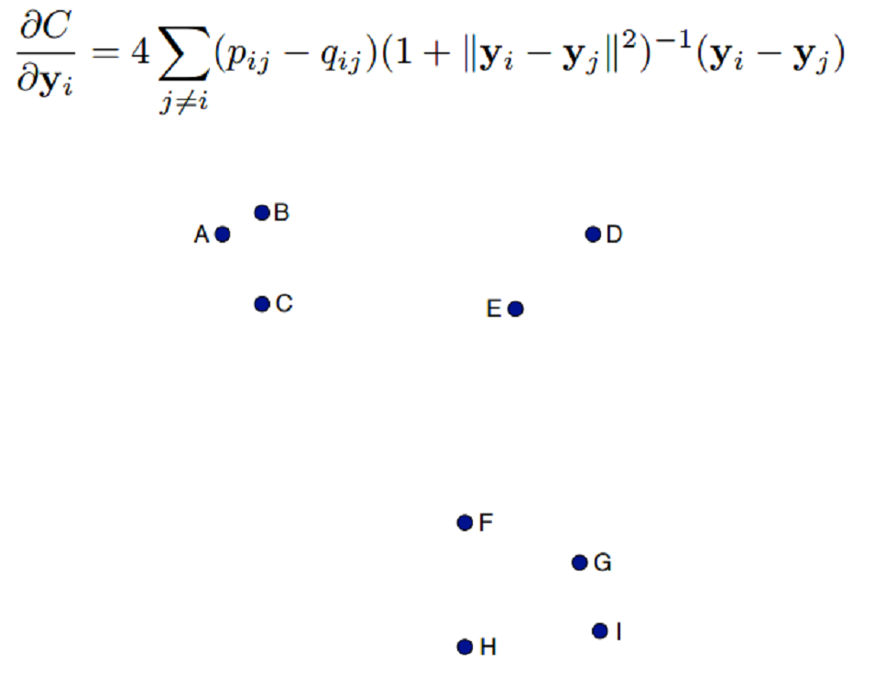
t-SNE gradient interpretation
$$\frac{∂C}{∂y_{i}}=4\sum_{j≠i}{\left(p_{j|i}−q_{j|i}\right)∙{\left(1+{\left\|y_{i}−y_{j}\right\|}^{2}\right)}^{−1}∙\left(y_{i}−y_{j}\right)}$$

Slide 65
t-SNE gradient interpretation
$$\frac{∂C}{∂y_{i}}=4\sum_{j≠i}{\left(p_{j|i}−q_{j|i}\right)∙{\left(1+{\left\|y_{i}−y_{j}\right\|}^{2}\right)}^{−1}∙\left(y_{i}−y_{j}\right)}$$
spring

Slide 66
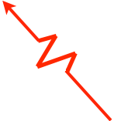
t-SNE gradient interpretation
$$\frac{∂C}{∂y_{i}}=4\sum_{j≠i}{\left(p_{j|i}−q_{j|i}\right)∙{\left(1+{\left\|y_{i}−y_{j}\right\|}^{2}\right)}^{−1}∙\left(y_{i}−y_{j}\right)}$$
exertion / compression

Slide 67
t-SNE gradient interpretation
$$\frac{∂C}{∂y_{i}}=4\sum_{j≠i}{\left(p_{j|i}−q_{j|i}\right)∙{\left(1+{\left\|y_{i}−y_{j}\right\|}^{2}\right)}^{−1}∙\left(y_{i}−y_{j}\right)}$$
What is the time complexity?
$O(n^{2})$
Limited to datasets with only few thousands of points!

Slide 68
PCA versus t-SNE
Applied on UCI Optical Recognition of Handwritten Digits Data Set
5620 samples of $8×8$-pixel images with 10 classes of handwritten digits
PCA
t-SNE

Slide 69
Barnes-Hut-SNE
Introduced in [van der Maaten, ICLR 2013]
Implementation of t-SNE with a better time complexity: $O(n∙\log{n})$
Scales to larger data sets
It reduce the number of pairwise forces that needs to be computed
Idea – forces exerted by a group of points on a point that is relatively far away are all very similar

Slide 70
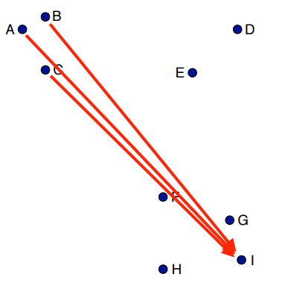
Barnes-Hut Approximation
Many of the pairwise interactions between points are very similar:

Slide 71
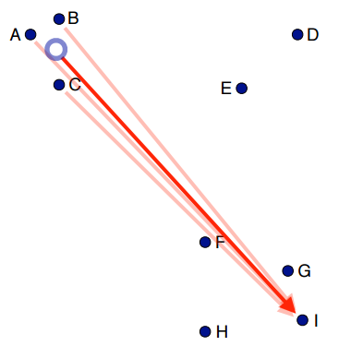
Barnes-Hut Approximation
Approximate similar interactions by a single interaction
x3

Slide 72
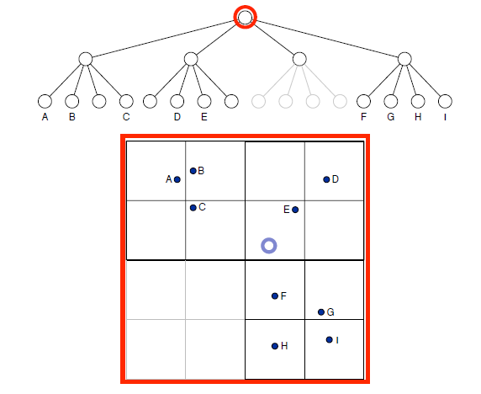
Solution based on Quadtree

Slide 73
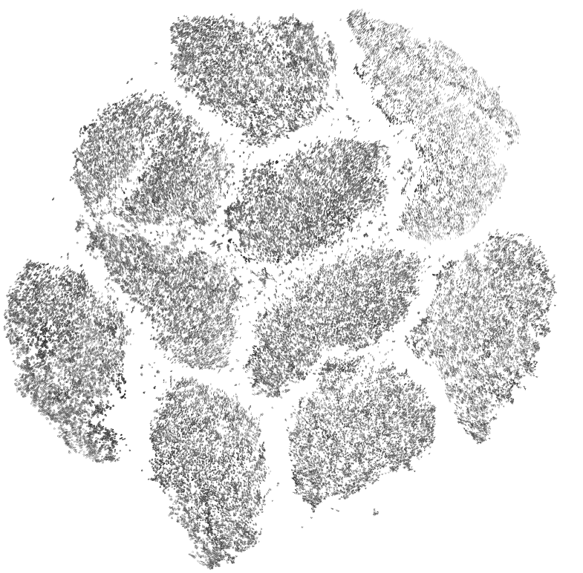
Barnes-Hut-SNE on all 70,000 MNIST images
Improvement in run time from days to ~10 minutes

Slide 74
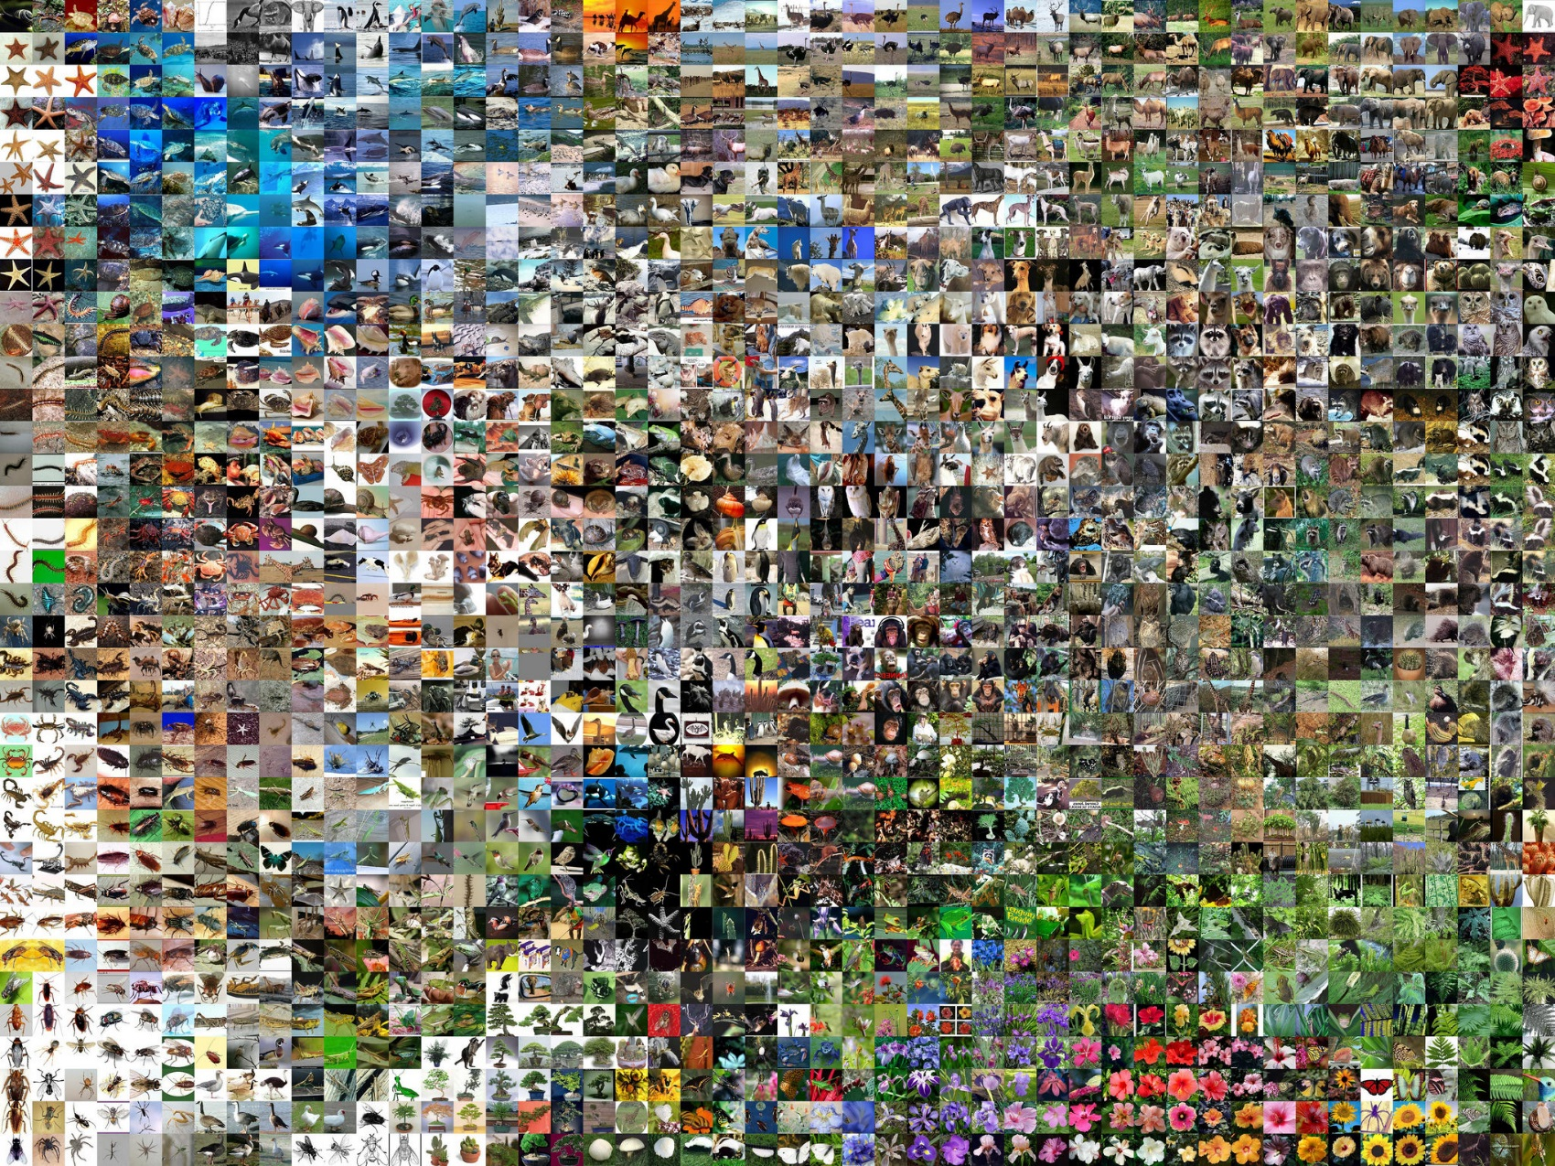
t-SNE on AlexNet embeddings
ImageNet

Slide 75
t-SNE on AlexNet embeddings
AlexNet

Slide 76
