Slide 1
Decision Trees.
Random Forests.
Radu Ionescu, Prof. PhD.
raducu.ionescu@gmail.com
Faculty of Mathematics and Computer Science
University of Bucharest

Slide 2
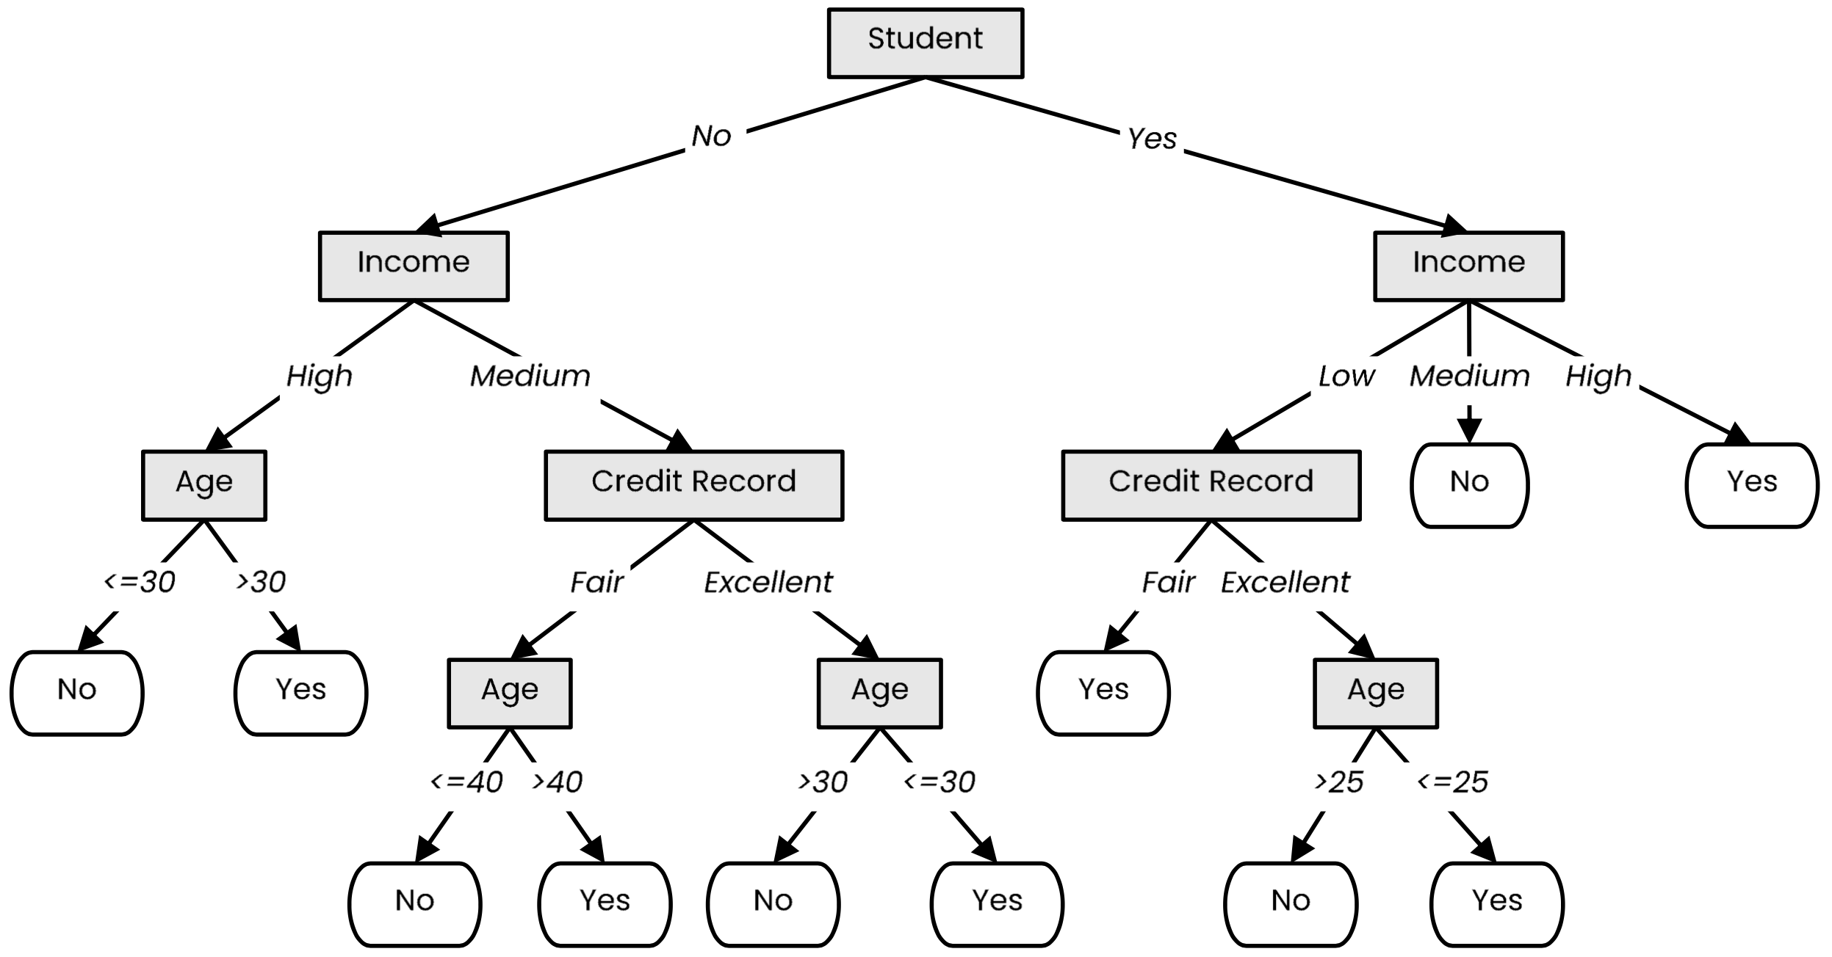
Definition
A tree-like model that illustrates series of events leading to certain decisions
Each node represents a test on an attribute and each branch is an outcome of that test
Who to loan?
Not a student
45 years old
Medium income
Fair credit record
Student
27 years old
Low income
Excellent credit record

Slide 3
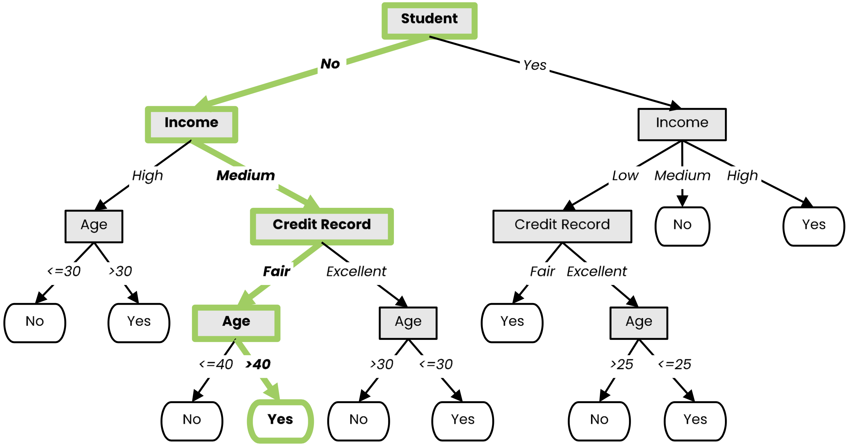
Definition
A tree-like model that illustrates series of events leading to certain decisions
Each node represents a test on an attribute and each branch is an outcome of that test
Who to loan?
Not a student
45 years old
Medium income
Fair credit record
Yes
Student
27 years old
Low income
Excellent credit record

Slide 4
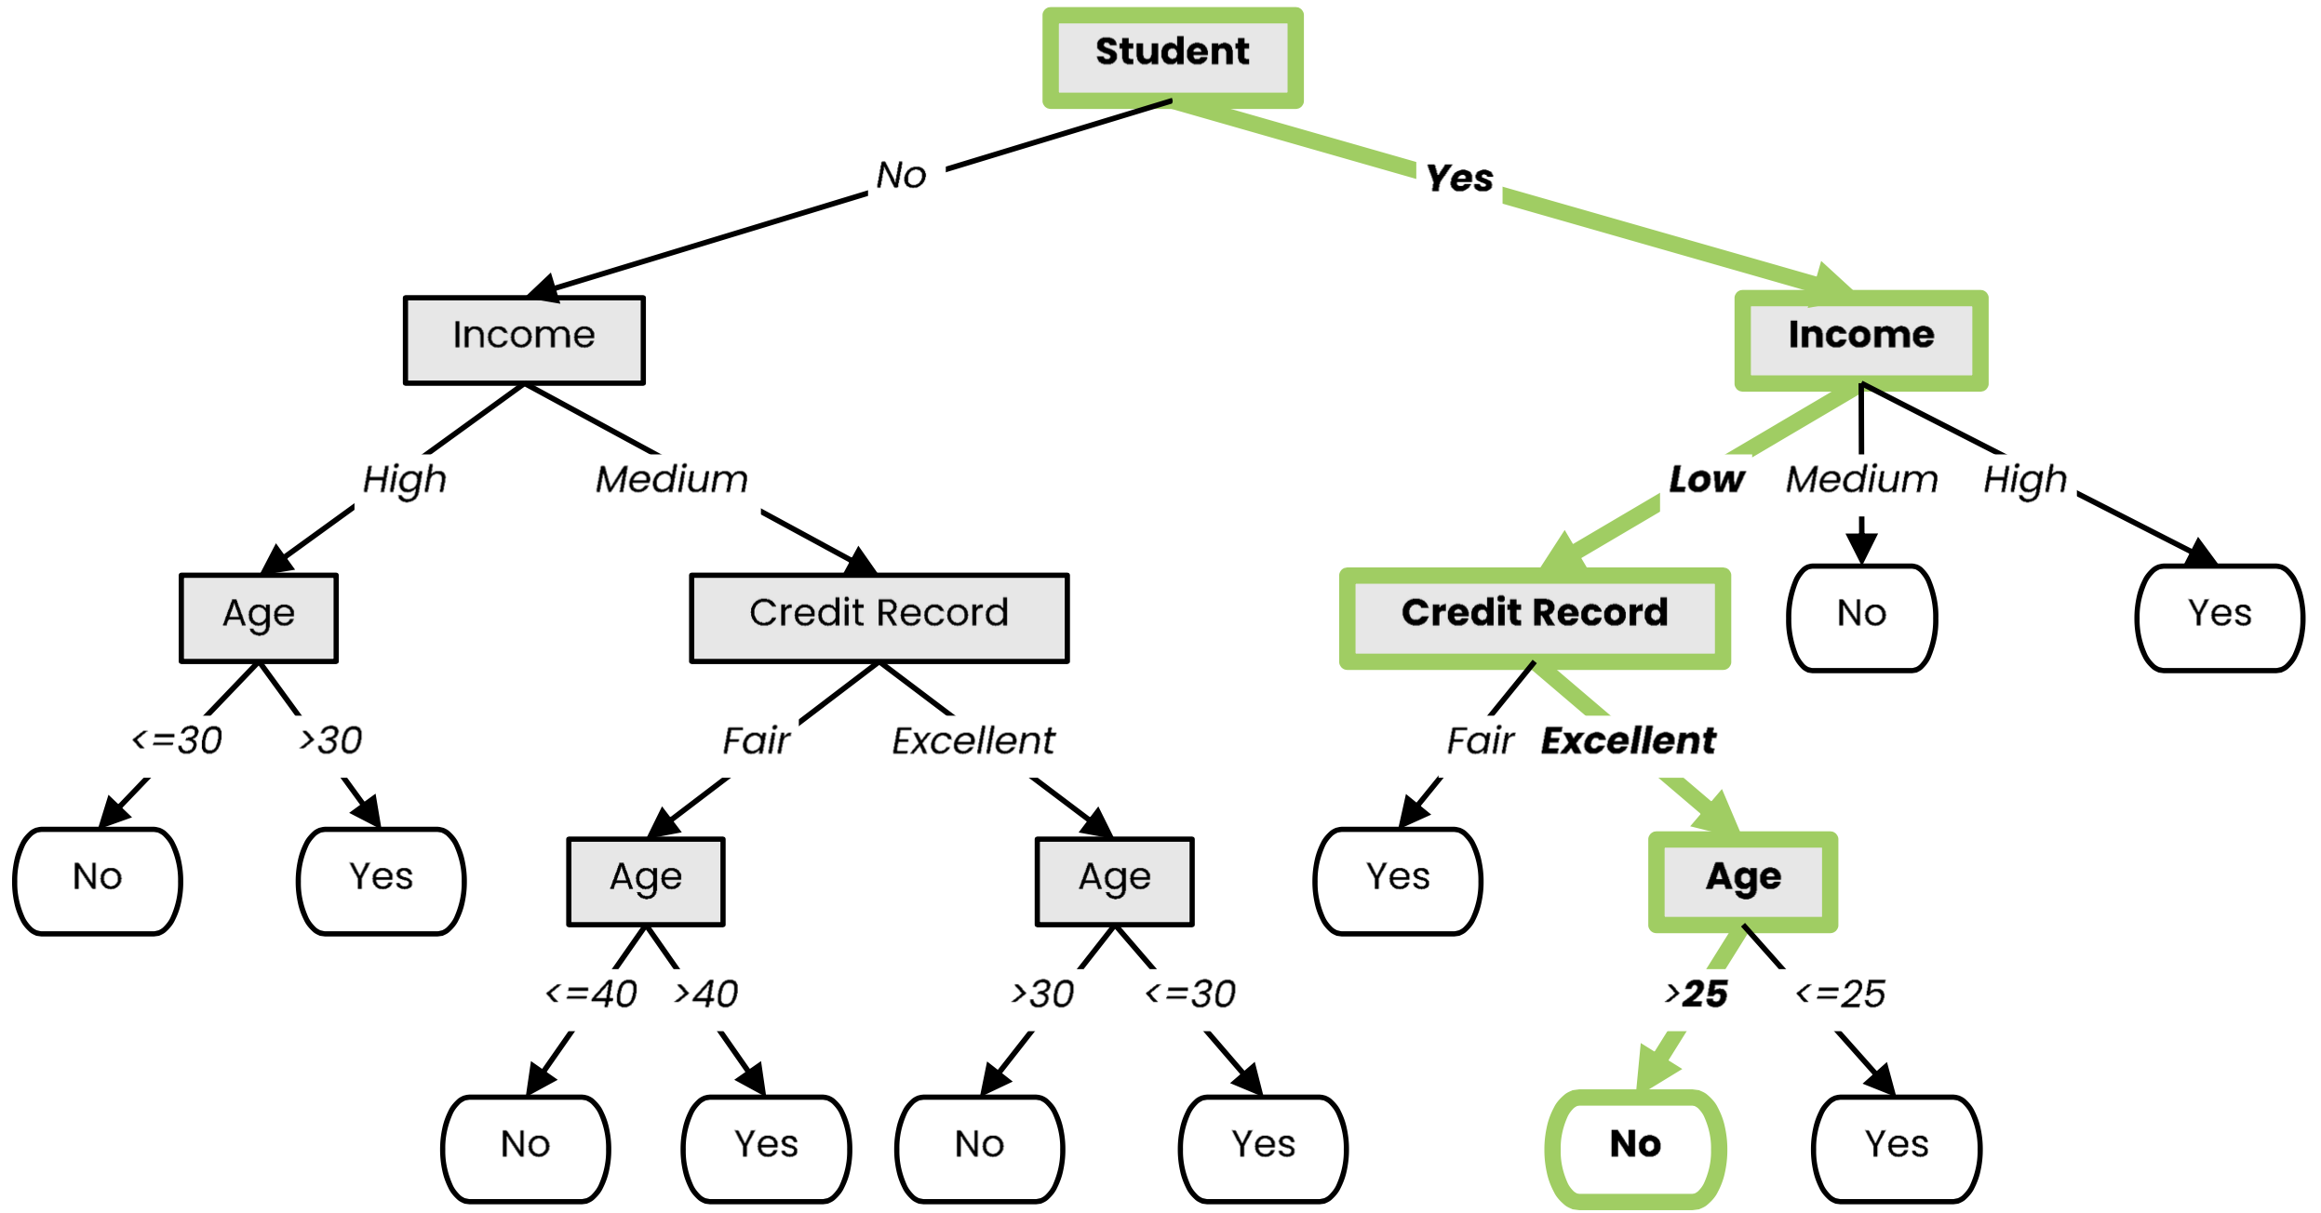
Definition
A tree-like model that illustrates series of events leading to certain decisions
Each node represents a test on an attribute and each branch is an outcome of that test
Who to loan?
Not a student
45 years old
Medium income
Fair credit record
Yes
Student
27 years old
Low income
Excellent credit record
No

Slide 5
Decision Tree Learning
We use labeled data to obtain a suitable decision tree for future predictions
We want a decision tree that works well on unseen data, while asking as few questions as possible

Slide 6
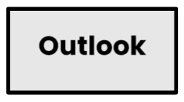
Decision Tree Learning
Basic step: choose an attribute and, based on its values, split the data into smaller sets
Recursively repeat this step until we can surely decide the label

Slide 7
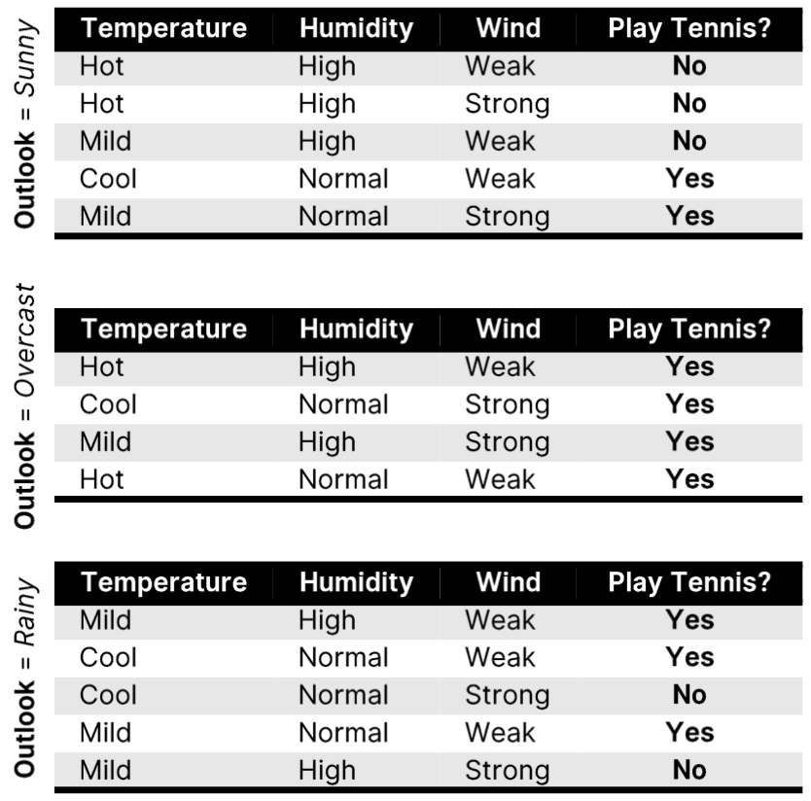
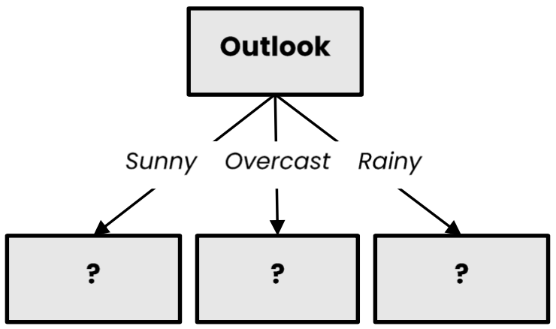
Decision Tree Learning
Basic step: choose an attribute and, based on its values, split the data into smaller sets
Recursively repeat this step until we can surely decide the label

Slide 8
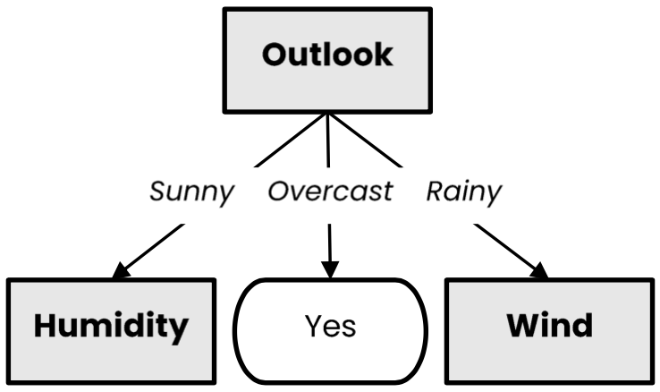
Decision Tree Learning
Basic step: choose an attribute and, based on its values, split the data into smaller sets
Recursively repeat this step until we can surely decide the label

Slide 9
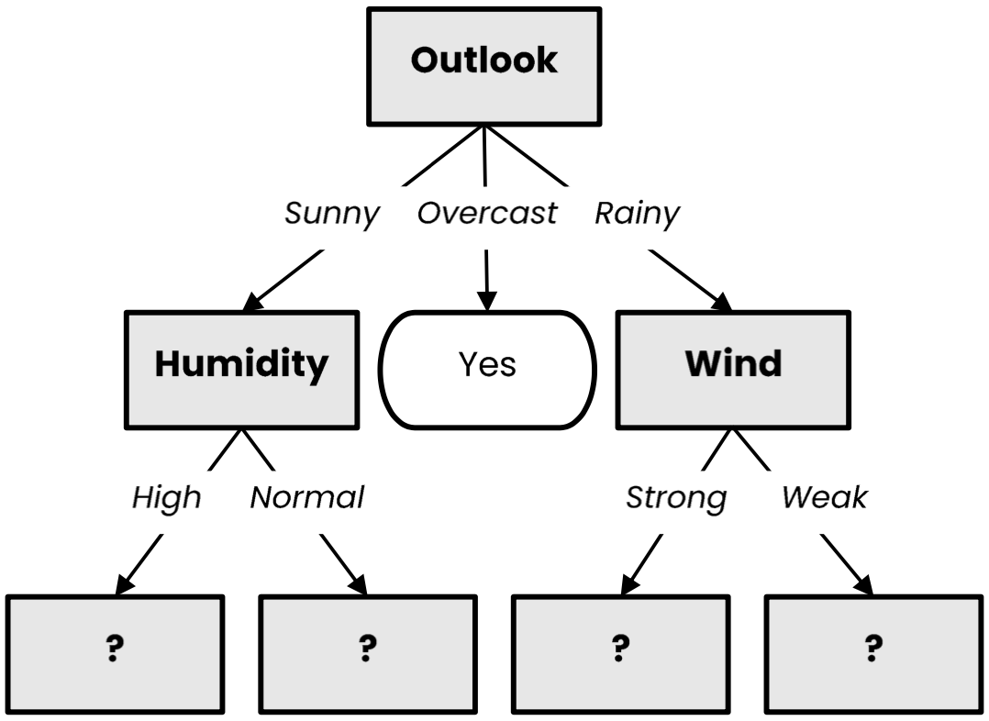
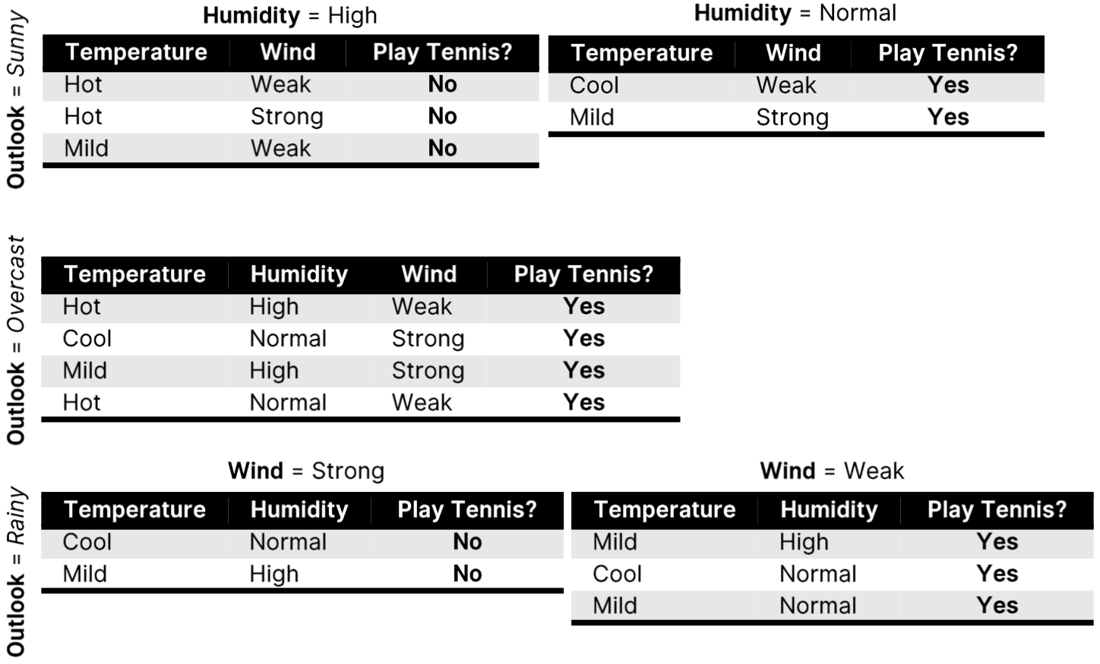
Decision Tree Learning
Basic step: choose an attribute and, based on its values, split the data into smaller sets
Recursively repeat this step until we can surely decide the label

Slide 10
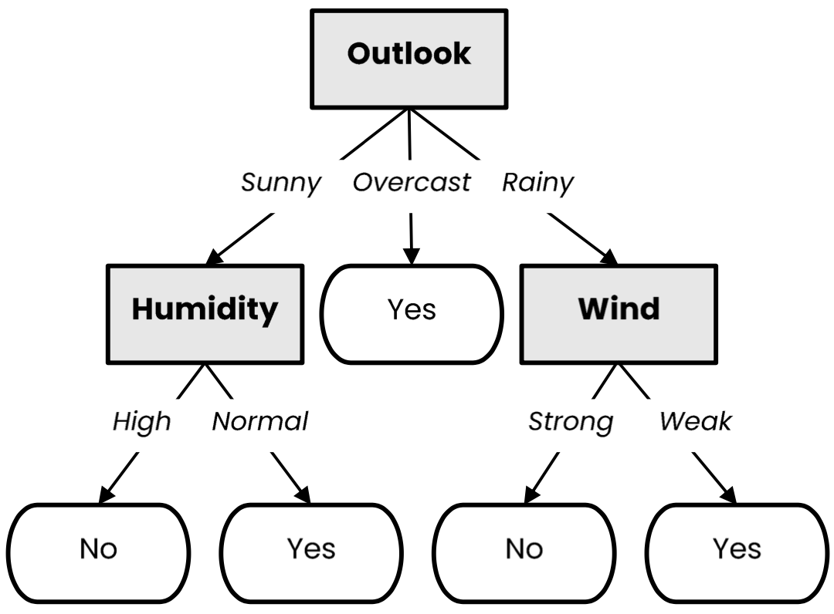
Decision Tree Learning
Basic step: choose an attribute and, based on its values, split the data into smaller sets
Recursively repeat this step until we can surely decide the label

Slide 11
Decision Tree Learning (Python)
def make_tree(X):
node = TreeNode(X)
if should_be_leaf_node(X):
node.label = majority_label(X)
else:
a = select_best_splitting_attribute(X)
for v in values(a):
𝑋_{𝑣} ={𝑥 ∈ 𝑋|𝑥[𝑎] == 𝑣}
node.children.append(make_tree(𝑋_{𝑣}))
return node

Slide 12
What is a good attribute?
Which attribute provides better splitting?
Why?
Because the resulting subsets are more pure
Knowing the value of this attribute gives us more information about the label
(the entropy of the subsets is lower)

Slide 13
Information Gain

Slide 14
Entropy
Entropy measures the degree of randomness in data
For a set of samples $X$ with $k$ classes:
$$entropy\left(X\right)=−\sum_{i=1}^{k}{p_{i}\log_{2}{(p_{i})}}$$
where $pi$ is the proportion of elements of class $i$
Lower entropy implies greater predictability!

Slide 15
Information Gain
The information gain of an attribute a is the expected reduction in entropy due to splitting on values of a:
$$gain\left(X,a\right)=entropy\left(X\right)−\sum_{v ∈ Values(a)}{\frac{\left|X_{v}\right|}{\left|X\right|}entropy(X_{v})}$$
where $Xv$ is the subset of $X$ for which $a = v$

Slide 16
Best attribute = highest information gain
$$entropy \left(X\right)= − pmammal log2 pmammal−pbird log2 pbird=−\frac{3}{7} log2\frac{3}{7}−\frac{4}{7}log2\frac{4}{7}≈ 0.985$$

Slide 17
Best attribute = highest information gain
$$entropy \left(X\right)= − pmammal log2 pmammal−pbird log2 pbird=−\frac{3}{7} log2\frac{3}{7}−\frac{4}{7}log2\frac{4}{7}≈ 0.985$$
$$entropy (X_{color=brown}) = −\frac{1}{3} log2\frac{1}{3}−\frac{2}{3} log2\frac{2}{3}≈ 0.918$$

Slide 18
Best attribute = highest information gain
$$entropy \left(X\right)= − pmammal log2 pmammal−pbird log2 pbird=−\frac{3}{7} log2\frac{3}{7}−\frac{4}{7}log2\frac{4}{7}≈ 0.985$$
$$entropy (X_{color=brown}) = −\frac{1}{3} log2\frac{1}{3}−\frac{2}{3} log2\frac{2}{3}≈ 0.918$$
$$entropy (X_{color=white}) =1$$

Slide 19
Best attribute = highest information gain
$$entropy \left(X\right)= − pmammal log2 pmammal−pbird log2 pbird=−\frac{3}{7} log2\frac{3}{7}−\frac{4}{7}log2\frac{4}{7}≈ 0.985$$
$$entropy (X_{color=brown}) = −\frac{1}{3} log2\frac{1}{3}−\frac{2}{3} log2\frac{2}{3}≈ 0.918$$
$$entropy (X_{color=white}) =1$$
$$gain \left(X, color\right)=0.985−\frac{3}{7}∙0.918−\frac{4}{7}∙1≈0.020$$

Slide 20
Best attribute = highest information gain
$$entropy \left(X\right)= − pmammal log2 pmammal−pbird log2 pbird=−\frac{3}{7} log2\frac{3}{7}−\frac{4}{7}log2\frac{4}{7}≈ 0.985$$
$$entropy (X_{color=brown}) = −\frac{1}{3} log2\frac{1}{3}−\frac{2}{3} log2\frac{2}{3}≈ 0.918$$
$$entropy (X_{color=white}) =1$$
$$gain \left(X, color\right)=0.985−\frac{3}{7}∙0.918−\frac{4}{7}∙1≈0.020$$
$$entropy (X_{fly=yes}) =0$$

Slide 21
Best attribute = highest information gain
$$entropy \left(X\right)= − pmammal log2 pmammal−pbird log2 pbird=−\frac{3}{7} log2\frac{3}{7}−\frac{4}{7}log2\frac{4}{7}≈ 0.985$$
$$entropy (X_{color=brown}) = −\frac{1}{3} log2\frac{1}{3}−\frac{2}{3} log2\frac{2}{3}≈ 0.918$$
$$entropy (X_{color=white}) =1$$
$$gain \left(X, color\right)=0.985−\frac{3}{7}∙0.918−\frac{4}{7}∙1≈0.020$$
$$entropy (X_{fly=no}) = −\frac{3}{4} log2\frac{3}{4}−\frac{1}{4} log2\frac{1}{4}≈ 0. 811$$
$$entropy (X_{fly=yes}) =0$$

Slide 22
Best attribute = highest information gain
In practice, we compute $entropy(X)$ only once!
$$entropy \left(X\right)= − pmammal log2 pmammal−pbird log2 pbird=−\frac{3}{7} log2\frac{3}{7}−\frac{4}{7}log2\frac{4}{7}≈ 0.985$$
$$entropy (X_{color=brown}) = −\frac{1}{3} log2\frac{1}{3}−\frac{2}{3} log2\frac{2}{3}≈ 0.918$$
$$entropy (X_{color=white}) =1$$
$$gain \left(X, color\right)=0.985−\frac{3}{7}∙0.918−\frac{4}{7}∙1≈0.020$$
$$entropy (X_{fly=no}) = −\frac{3}{4} log2\frac{3}{4}−\frac{1}{4} log2\frac{1}{4}≈ 0. 811$$
$$entropy (X_{fly=yes}) =0$$
$$gain \left(X, fly\right)=0.985−\frac{3}{7}∙0−\frac{4}{7}∙0.811≈0.521$$

Slide 23
ID3 Algorithm (Python)
# ID = Iterative Dichotomiser
def ID3(X):
node = TreeNode(X)
if all_points_have_same_class(X):
node.label = majority_label(X)
else:
a = select_attribute_with_highest_information_gain(X)
if gain(X, a) == 0:
node.label = majority_label(X)
else:
for v in values(a):
$Xv=\{x∈X | x[a] == v\}$
node.children.append(ID3($Xv$))
return node

Slide 24
Gini Impurity

Slide 25
Gini Impurity
Gini impurity measures how often a randomly chosen example would be incorrectly labeled if it was randomly labeled according to the label distribution
For a set of samples $X$ with $k$ classes:
$$gini\left(X\right)=1−\sum_{i=1}^{k}{p_{i}^{2}}$$
where $pi$ is the proportion of elements of class $i$
Can be used as an alternative to entropy for selecting attributes!

Slide 26
Best attribute = highest impurity decrease
In practice, we compute $gini(X)$ only once!
$$gini \left(X\right)=1 −{\left(\frac{3}{7}\right)}^{2}−{\left(\frac{4}{7}\right)}^{2}≈ 0.489$$
$$gini (X_{color=brown}) =1 −{\left(\frac{1}{3}\right)}^{2}−{\left(\frac{2}{3}\right)}^{2}≈ 0.444$$
$$gini (X_{color=white}) =0.5$$
$$△gini \left(X, color\right)=0.489−\frac{3}{7}∙0.444−\frac{4}{7}∙0.5≈0.013$$
$$gini (X_{fly=no}) =1 −{\left(\frac{3}{4}\right)}^{2}−{\left(\frac{1}{4}\right)}^{2}≈ 0. 375$$
$$gini (X_{fly=yes}) =0$$
$$△gini \left(X, fly\right)=0.489−\frac{3}{7}∙0−\frac{4}{7}∙0.375≈0.274$$

Slide 27
Entropy versus Gini Impurity
Entropy and Gini Impurity give similar results in practice
They only disagree in about 2% of cases
“Theoretical Comparison between the Gini Index and Information Gain Criteria” [Răileanu & Stoffel, AMAI 2004]
Entropy might be slower to compute, because of the log

Slide 28
Pruning

Slide 29
Pruning
Pruning is a technique that reduces the size of a decision tree by removing branches of the tree which provide little predictive power
It is a regularization method that reduces the complexity of the final model, thus reducing overfitting
Decision trees are prone to overfitting!
Pruning methods:
Pre-pruning: Stop the tree building algorithm before it fully classifies the data
Post-pruning: Build the complete tree, then replace some non-leaf nodes with leaf nodes if this improves validation error

Slide 30
Pre-pruning
Minimum threshold on entropy
𝜽_{𝒆𝒏𝒕} = 𝟎. 𝟒
Pre-pruning implies early stopping:
If some condition is met, the current node will not be split, even if it is not 100% pure
It will become a leaf node with the label of the majority class in the current set
(the class distribution could be used as prediction confidence)
Common stopping criteria include setting a threshold on:
Entropy (or Gini Impurity) of the current set
Number of samples in the current set
Gain of the best-splitting attribute
Depth of the tree
$$entropy(54|5)= 0.29 < θent$$
Stop, even if node can be split
91.52% confidence

Slide 31
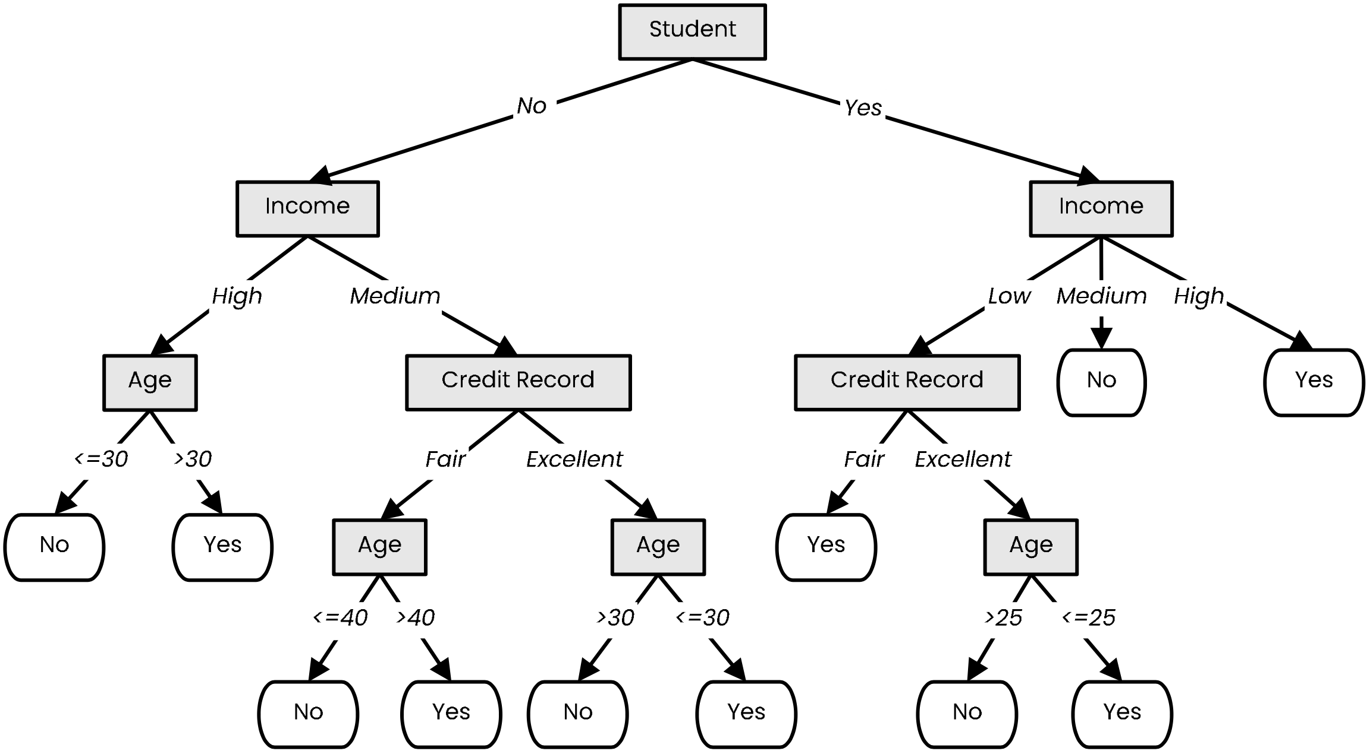
Post-pruning
Prune nodes in a bottom-up manner, if it decreases validation error

Slide 32
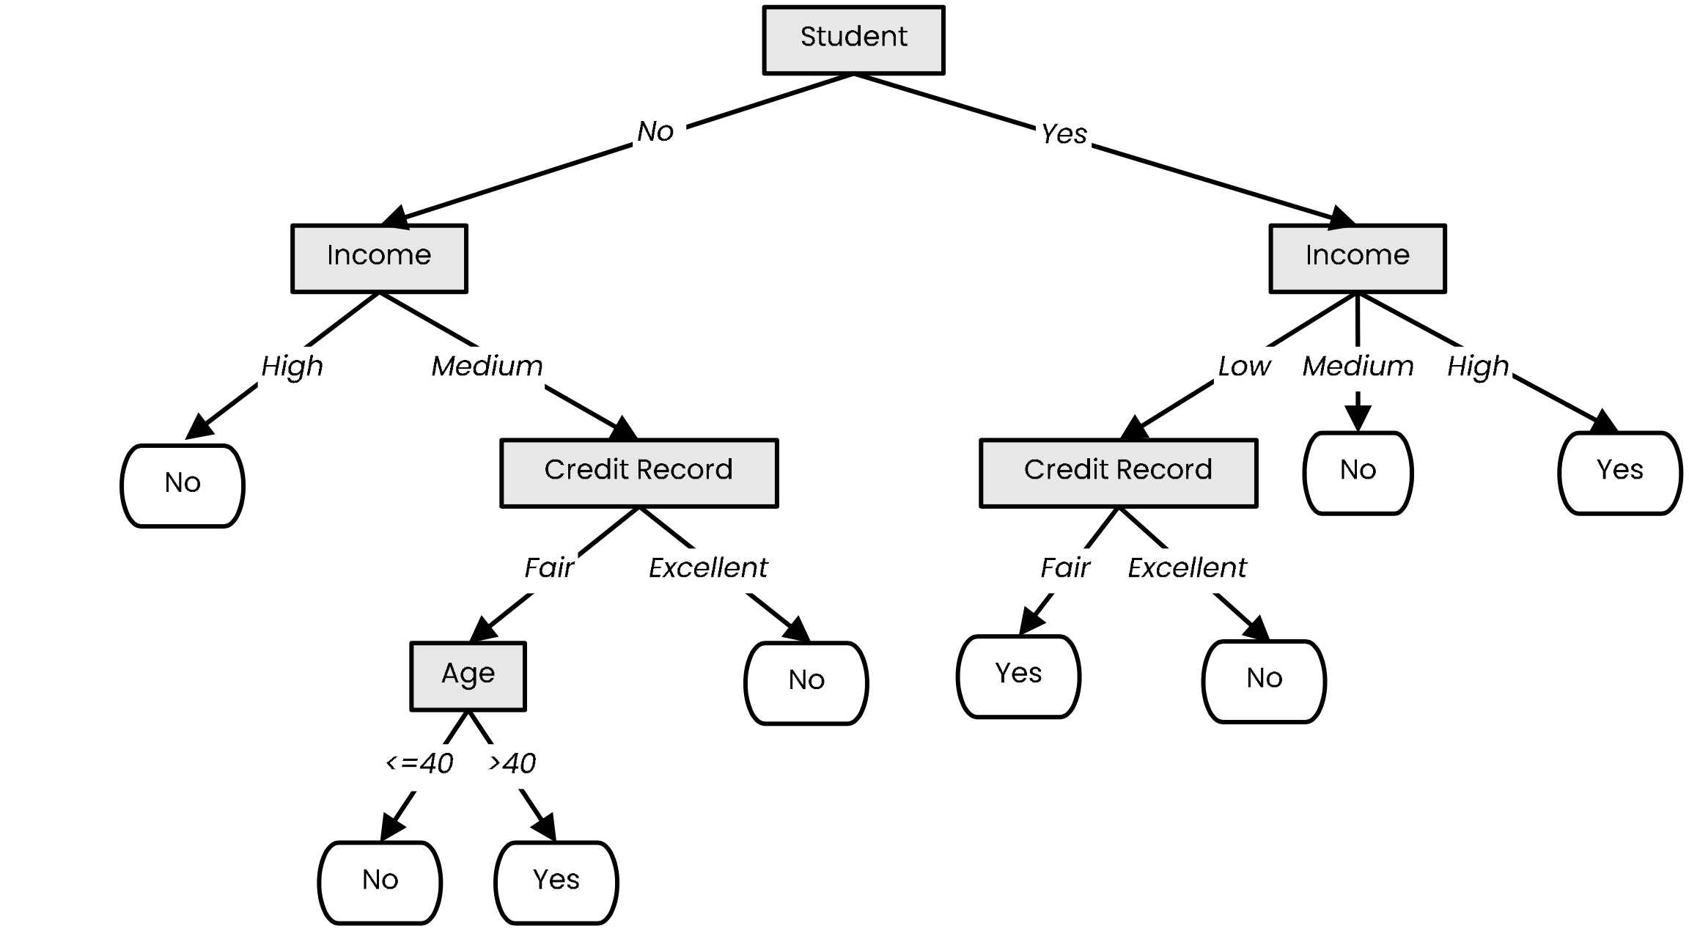
Post-pruning
Prune nodes in a bottom-up manner, if it decreases validation error

Slide 33
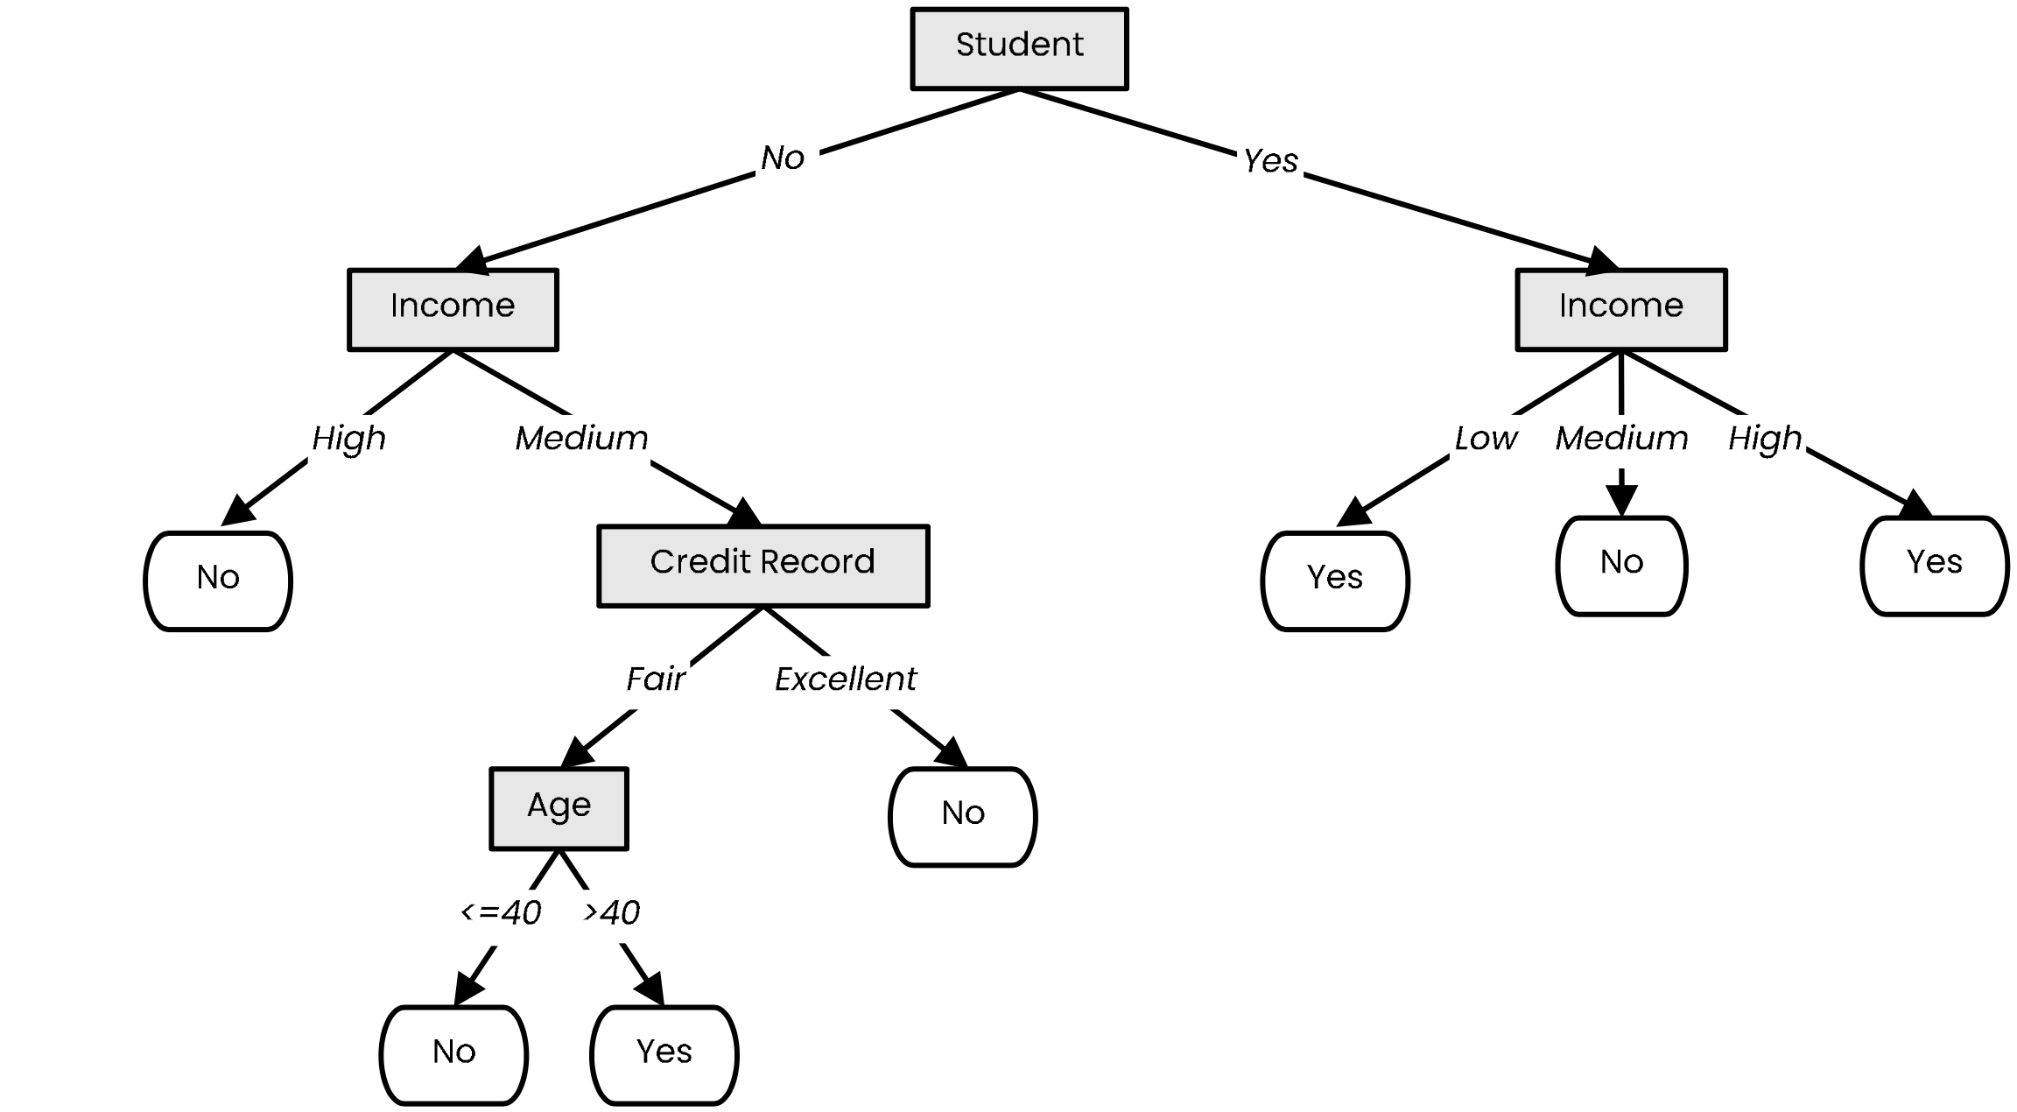
Post-pruning
Prune nodes in a bottom-up manner, if it decreases validation error

Slide 34
Handling Numerical Attributes

Slide 35
Handling numerical attributes
How does the ID3 algorithm handle numerical attributes?
Any numerical attribute would almost always bring entropy down to zero
This means it will completely overfit the training data
Consider a numerical value for humidity

Slide 36
Handling numerical attributes
Numerical attributes have to be treated differently
Find the best splitting value
Gain of numerical attribute $a$ if we split at value $t$
$$gain\left(X, a, t\right)= entropy\left(X\right)−\frac{\left|X_{a≤t}\right|}{\left|X\right|}entropy\left(X_{a≤t}\right)−\frac{\left|X_{a>t}\right|}{\left|X\right|}entropy\left(X_{a>t}\right)$$
Mean of each consecutive pair
Sort

Slide 37
Handling numerical attributes
Numerical attributes have to be treated differently
Find the best splitting value
$$gain\left(X, a, t\right)= entropy\left(X\right)−\frac{\left|X_{a≤t}\right|}{\left|X\right|}entropy\left(X_{a≤t}\right)−\frac{\left|X_{a>t}\right|}{\left|X\right|}entropy\left(X_{a>t}\right)$$
Mean of each consecutive pair
Sort
$$gain \left(X, humidity, 83.5\right)=$$

Slide 38
Handling numerical attributes
Numerical attributes have to be treated differently
Find the best splitting value
$$gain\left(X, a, t\right)= entropy\left(X\right)−\frac{\left|X_{a≤t}\right|}{\left|X\right|}entropy\left(X_{a≤t}\right)−\frac{\left|X_{a>t}\right|}{\left|X\right|}entropy\left(X_{a>t}\right)$$
Mean of each consecutive pair
Sort
$$gain \left(X, humidity, 83.5\right)=0.94$$

Slide 39
Handling numerical attributes
Numerical attributes have to be treated differently
Find the best splitting value
$$gain\left(X, a, t\right)= entropy\left(X\right)−\frac{\left|X_{a≤t}\right|}{\left|X\right|}entropy\left(X_{a≤t}\right)−\frac{\left|X_{a>t}\right|}{\left|X\right|}entropy\left(X_{a>t}\right)$$
Mean of each consecutive pair
Sort
$$gain \left(X, humidity, 83.5\right)=0.94−\frac{7}{14}∙0.59$$

Slide 40
Handling numerical attributes
Numerical attributes have to be treated differently
Find the best splitting value
$$gain\left(X, a, t\right)= entropy\left(X\right)−\frac{\left|X_{a≤t}\right|}{\left|X\right|}entropy\left(X_{a≤t}\right)−\frac{\left|X_{a>t}\right|}{\left|X\right|}entropy\left(X_{a>t}\right)$$
Mean of each consecutive pair
Sort
$$gain \left(X, humidity, 83.5\right)=0.94−\frac{7}{14}∙0.59−\frac{7}{14}∙0.98$$

Slide 41
Handling numerical attributes
Numerical attributes have to be treated differently
Find the best splitting value
$$gain\left(X, a, t\right)= entropy\left(X\right)−\frac{\left|X_{a≤t}\right|}{\left|X\right|}entropy\left(X_{a≤t}\right)−\frac{\left|X_{a>t}\right|}{\left|X\right|}entropy\left(X_{a>t}\right)$$
Mean of each consecutive pair
Sort
$$gain \left(X, humidity, 83.5\right)=0.94−\frac{7}{14}∙0.59−\frac{7}{14}∙0.98$$
$$≈0.152$$

Slide 42
Handling numerical attributes
Numerical attributes have to be treated differently
Find the best splitting value
Mean of each consecutive pair
Gain for every candidate
Sort
83.5 is the best splitting value with an information gain of 0.152

Slide 43
Handling numerical attributes
Numerical attributes have to be treated differently
Find the best splitting value
83.5 is the best splitting value for Humidity with an information gain of 0.152
Humidity is now treated as a categorical attribute with two possible values
A new optimal split is computed at every level of the tree
A numerical attribute can be used several times in the tree, with different split values
 |  | >
 |  | >
 |  | >
 |  | >
 |  | ≤
 |  | ≤
 |  | ≤
 |  | >
 |  | ≤
 |  | ≤
 |  | ≤
 |  | >
 |  | ≤
 |  | >

Slide 44
Handling Missing Values

Slide 45
Handling missing values at training time
Data sets might have samples with missing values for some attributes
Simply ignoring them would mean throwing away a lot of information
There are better ways of handling missing values:

Slide 46
Handling missing values at training time
Data sets might have samples with missing values for some attributes
Simply ignoring them would mean throwing away a lot of information
There are better ways of handling missing values:
Set them to the most common value

Slide 47
Handling missing values at training time
Data sets might have samples with missing values for some attributes
Simply ignoring them would mean throwing away a lot of information
There are better ways of handling missing values:
Set them to the most common value
Set them to the most probable value given the label
$$P\left(Yes | Bird\right)=\frac{2}{3}= 0.66$$
$$P\left(No | Bird\right)=\frac{1}{3}= 0.33$$
$$P\left(White | Mammal\right)=1$$
$$P\left(Brown | Mammal\right)=0$$

Slide 48
Handling missing values at training time
Data sets might have samples with missing values for some attributes
Simply ignoring them would mean throwing away a lot of information
There are better ways of handling missing values:
Set them to the most common value
Set them to the most probable value given the label
Add a new instance for each possible value

Slide 49
Handling missing values at training time
Data sets might have samples with missing values for some attributes
Simply ignoring them would mean throwing away a lot of information
There are better ways of handling missing values:
Set them to the most common value
Set them to the most probable value given the label
Add a new instance for each possible value
Leave them unknown, but discard the sample when evaluating the gain of that attribute
(if the attribute is chosen for splitting, send the instances
with unknown values to all children)
$$entropy(X_{color=brown})=0$$
$$entropy(X_{color=white})=1$$
gain$\left(X | color\right)=0.985−\frac{2}{6}∙0−\frac{4}{6}∙1$
$= 0.318$

Slide 50
Handling missing values at training time
Data sets might have samples with missing values for some attributes
Simply ignoring them would mean throwing away a lot of information
There are better ways of handling missing values:
Set them to the most common value
Set them to the most probable value given the label
Add a new instance for each possible value
Leave them unknown, but discard the sample when evaluating the gain of that attribute
(if the attribute is chosen for splitting, send the instances
with unknown values to all children)
Build a decision tree on all other attributes (including label) to predict missing values
(use instances where the attribute is defined as training data)

Slide 51
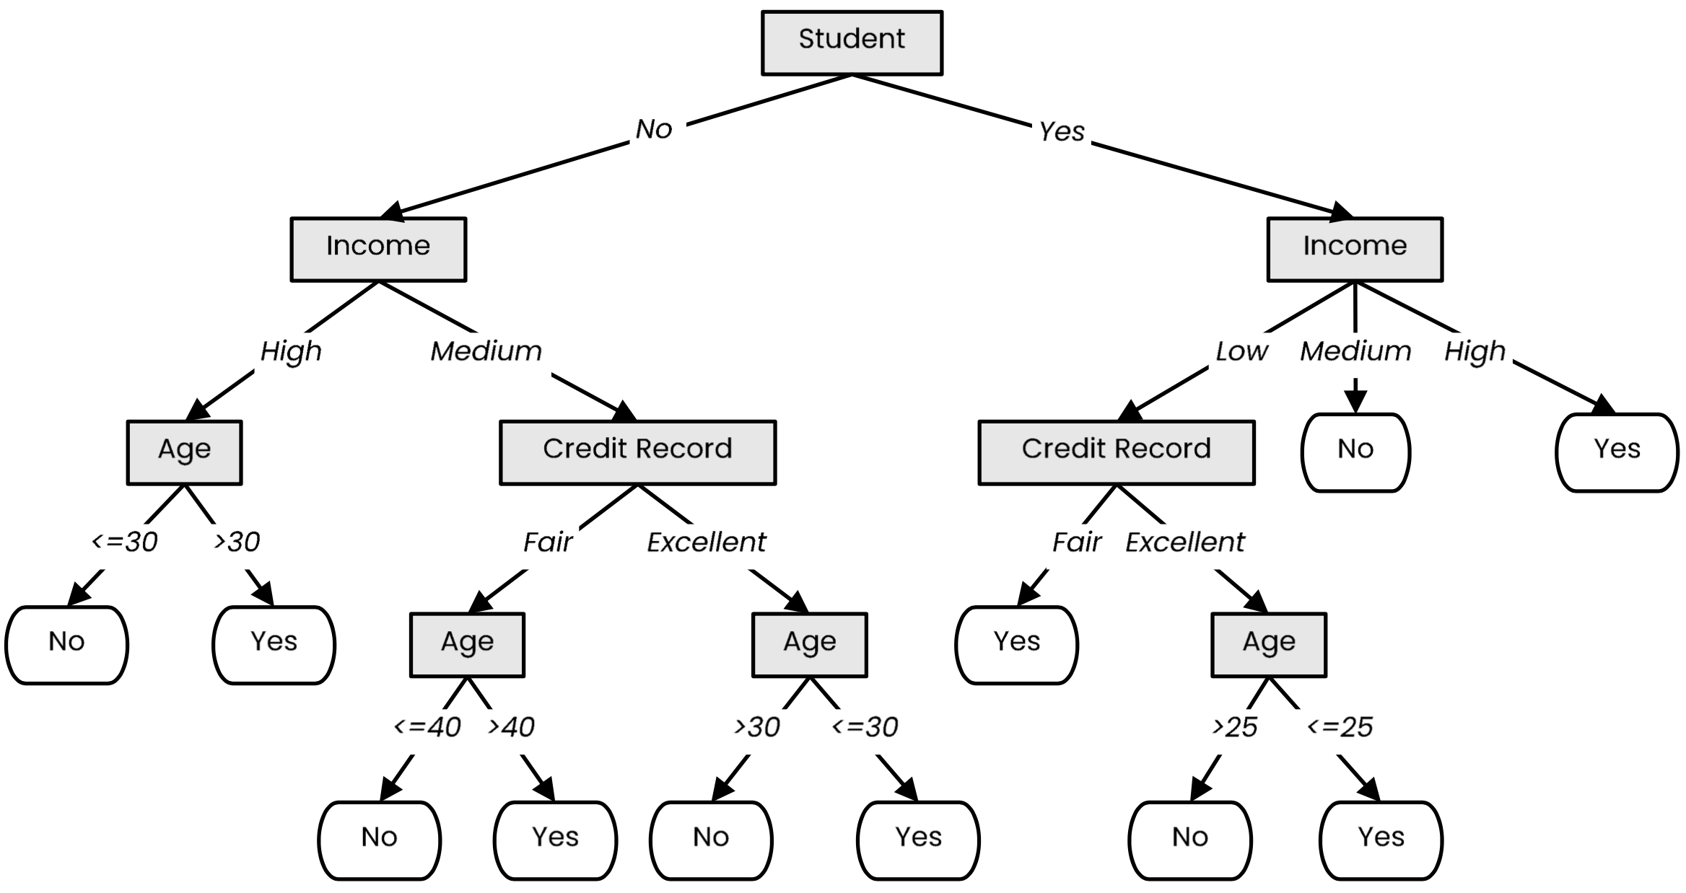
Handling missing values at inference time
When we encounter a node that checks an attribute with a missing value, we explore all possibilities
Loan?
Not a student
49 years old
Unknown income
Fair credit record

Slide 52
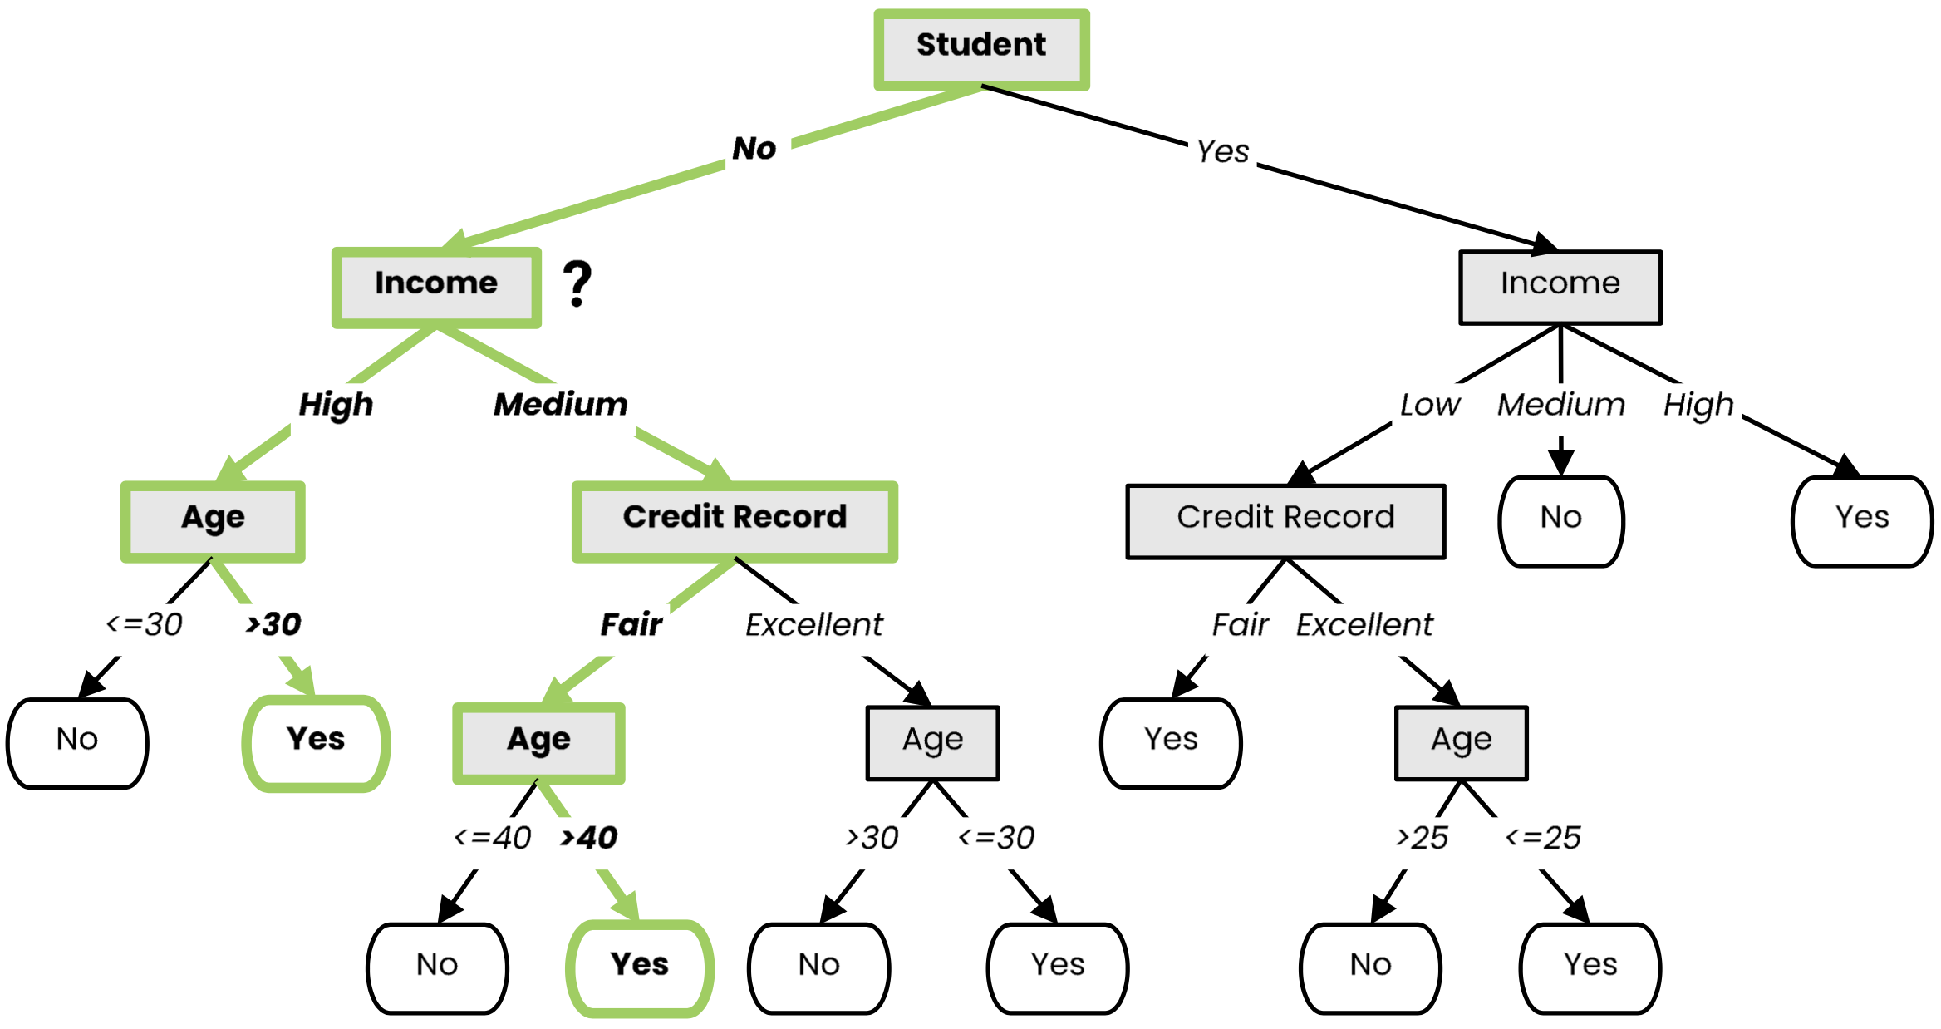
Handling missing values at inference time
When we encounter a node that checks an attribute with a missing value, we explore all possibilities
We explore all branches and take the final prediction based on a (weighted) vote of the corresponding leaf nodes
Loan?
Not a student
49 years old
Unknown income
Fair credit record
Yes

Slide 53
C4.5 Algorithm
C4.5 algorithm is an extension of ID3 algorithm that brings several improvements:
Ability to handle both categorical (discrete) and numerical (continuous) attributes
(continuous attributes are split by finding a best-splitting threshold)
Ability to handle missing values both at training and inference time
(missing values at training are not used when information gain is computed; missing values at inference time are handled by exploring all corresponding branches)
Ability to handle attributes with different costs
Post-pruning in a bottom-up manner for removing branches that decrease validation error (i.e., that increase generalization capacity)

Slide 54
Decision Boundaries
Decision trees produce non-linear decision boundaries
Support Vector Machines
Decision Tree

Slide 55
Decision Trees: Training and Inference
Training
Inference

Slide 56
History of Decision Trees
The first regression tree algorithm
“Automatic Interaction Detection (AID)” [Morgan & Sonquist, 1963]
The first classification tree algorithm
“Theta Automatic Interaction Detection (THAID)” [Messenger & Mandel, 1972]
Decision trees become popular
“Classification and regression trees (CART)” [Breiman et al., 1984]
Introduction of the ID3 algorithm
“Induction of Decision Trees” [Quinlan, 1986]
Introduction of the C4.5 algorithm
“C4.5: Programs for Machine Learning” [Quinlan, 1993]

Slide 57
Summary
Decision trees represent a tool based on a tree-like graph of decisions and their possible outcomes
Decision tree learning is a machine learning method that employs a decision tree as a predictive model
ID3 builds a decision tree by iteratively splitting the data based on the values of an attribute with the largest information gain (decrease in entropy)
Using the decrease of Gini Impurity is also a commonly-used option in practice
C4.5 is an extension of ID3 that handles attributes with continuous values, missing values and adds regularization by pruning branches likely to overfit

Slide 58
Random Forests
(Ensemble learning with decision trees)

Slide 59
Random Forests
Random Forests:
Instead of building a single decision tree and use it to make predictions, build many slightly different trees and combine their predictions
We have a single data set, so how do we obtain slightly different trees?
1. Bagging (Bootstrap Aggregating):
Take random subsets of data points from the training set to create N smaller data sets
Fit a decision tree on each subset
2. Random Subspace Method (also known as Feature Bagging):
Fit N different decision trees by constraining each one to operate on a random subset of features

Slide 60
Bagging at training time
N subsets (with replacement)
Training set

Slide 61
Bagging at inference time
A test sample
75% confidence

Slide 62
Random Subspace Method at training time
Training data

Slide 63
Random Subspace Method at inference time
A test sample
66% confidence

Slide 64
Random Forests
Tree 1
Tree 2
Random Forest
Tree N

Slide 65
History of Random Forests
Introduction of the Random Subspace Method
“Random Decision Forests” [Ho, 1995] and “The Random Subspace Method for Constructing Decision Forests” [Ho, 1998]
Combined the Random Subspace Method with Bagging. Introduce the term Random Forest (a trademark of Leo Breiman and Adele Cutler)
“Random Forests” [Breiman, 2001]

Slide 66
Ensemble Learning
Ensemble Learning:
Method that combines multiple learning algorithms to obtain performance improvements over its components
Random Forests are one of the most common examples of ensemble learning
Other commonly-used ensemble methods:
Bagging: multiple models on random subsets of data samples
Random Subspace Method: multiple models on random subsets of features
Boosting: train models iteratively, while making the current model focus on the mistakes of the previous ones by increasing the weight of misclassified samples

Slide 67
Boosting
All samples have the same weight

Slide 68
Boosting
All samples have the same weight
Reweight based on model’s mistakes

Slide 69
Boosting
Next model sees weighted samples

Slide 70
Boosting
Reweight based on current model’s mistakes

Slide 71
Boosting

Slide 72
Boosting

Slide 73
Summary
Ensemble Learning methods combine multiple learning algorithms to obtain performance improvements over its components
Commonly-used ensemble methods:
Bagging (multiple models on random subsets of data samples)
Random Subspace Method (multiple models on random subsets of features)
Boosting (train models iteratively, while making the current model focus on the mistakes of the previous ones by increasing the weight of misclassified samples)
Random Forests are an ensemble learning method that employ decision tree learning to build multiple trees through bagging and random subspace method.
They rectify the overfitting problem of decision trees!

Slide 74
Decision Trees and Random Forest (Python)
from sklearn.tree import DecisionTreeClassifier
from sklearn.ensemble import RandomForestClassifier
clf = DecisionTreeClassifier(criterion = "entropy", min_samples_leaf = 3)
# Lots of parameters: criterion = "gini" / "entropy";
# max_depth;
# min_impurity_split;
clf.fit(X, y) # It can only handle numerical attributes!
# Categorical attributes need to be encoded, see LabelEncoder and OneHotEncoder
clf.predict([x]) # Predict class for x
clf.feature_importances_ # Importance of each feature
clf.tree_ # The underlying tree object
clf = RandomForestClassifier(n_estimators = 20) # Random Forest with 20 trees

