Slide 1
Kernel Methods.
Ridge Regression.
Radu Ionescu, Prof. PhD.
raducu.ionescu@gmail.com
Faculty of Mathematics and Computer Science
University of Bucharest

Slide 2
The evolution of learning methods
1950s: the introduction of the perceptron (Rosenblatt, 1957)
1980s: the back-propagation algorithm for training multi-layer perceptron becomes widely popular (Hinton, 1986)
1990s: the introduction of kernel methods (Cortes, 1995)

Slide 3
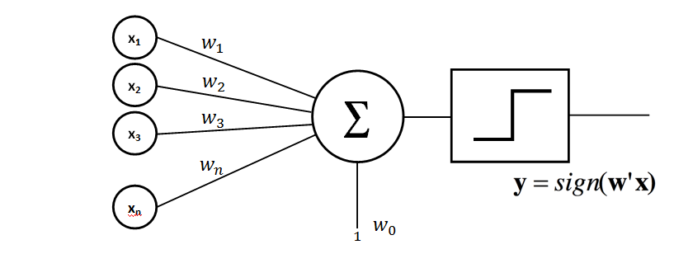
The Perceptron
$$x_{1}$$
$$w_{1}$$
$$x_{2}$$
$$w_{2}$$
$$w_{3}$$
$$x_{3}$$
$$w_{n}$$
$$y=sign(w^{′}∙x+b)$$
$$w_{0}=b$$
$$x_{n}$$
$$1$$

Slide 4
Linear separating hyperplane
$$x_{2}$$
$$w$$
$$w∙x+b>0$$
$$y=1$$
1
$$−\frac{b}{w_{1}}$$
$$w∙x+b=0$$
$$y=1$$
$$x_{1}$$
-1
1
$$w∙x+b<0$$
$$y=−1$$
$$−\frac{b}{w_{2}}$$
-1
Where $w_{1}=−1$,$w_{2}=1$, $b=1$

Slide 5
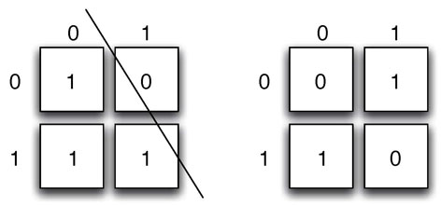
XOR (Minsky & Papert, 1969)
A linear classification method cannot solve the XOR problem

Slide 6
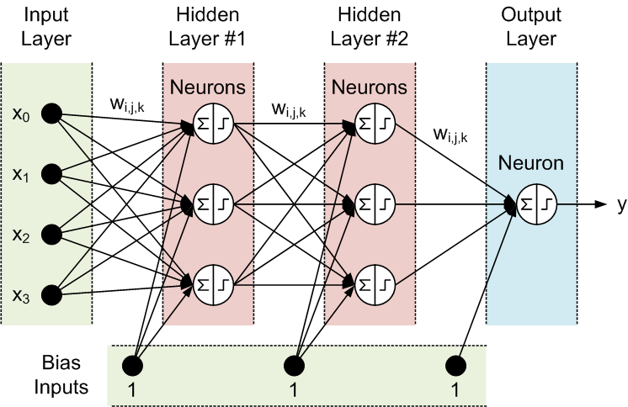
Solution 1: Neural Networks

Slide 7
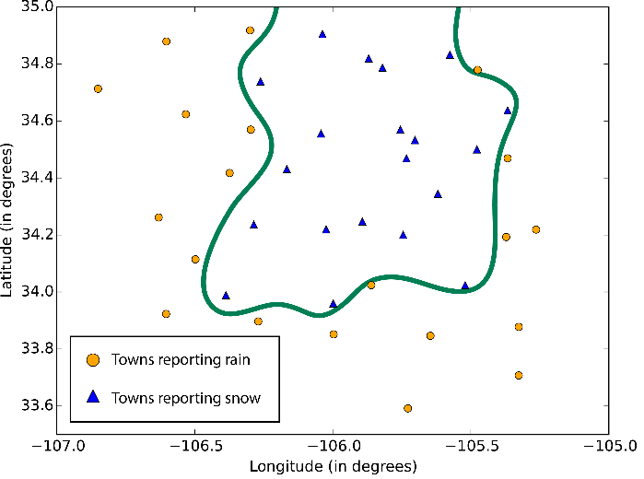
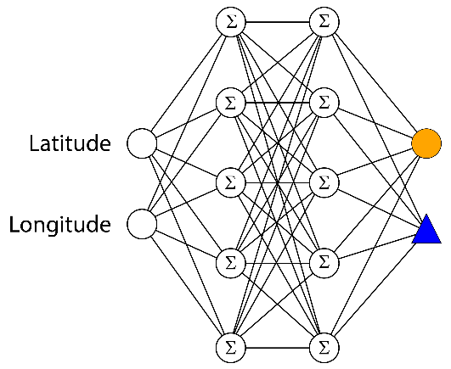
Solution 1: Neural Networks
The decision border is non-linear

Slide 8
Solution 2: Kernel Methods
Kernel methods are based on two steps:
1. Embed data in a higher-dimensional Hilbert space
2. Search for linear relations in the embedding space
The embedding can be performed implicitly, by specifying the scalar product among data samples
Steps 1 and 2 can be comprised in one step!

Slide 9
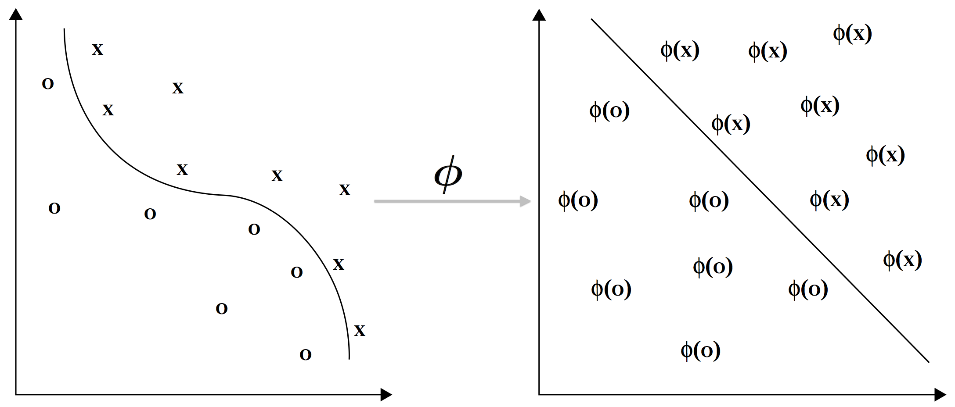
Embedding the data with an embedding map
Non-linear relations from the original space become linear in the embedding space

Slide 10
Kernel methods
The learning algorithms are usually implemented such that the coordinates of the embedded points are not needed
Specifying the scalar product between pairs of points is enough!
“Kernel trick”: The scalar product is replaced with any pairwise similarity function, also termed kernel function

Slide 11
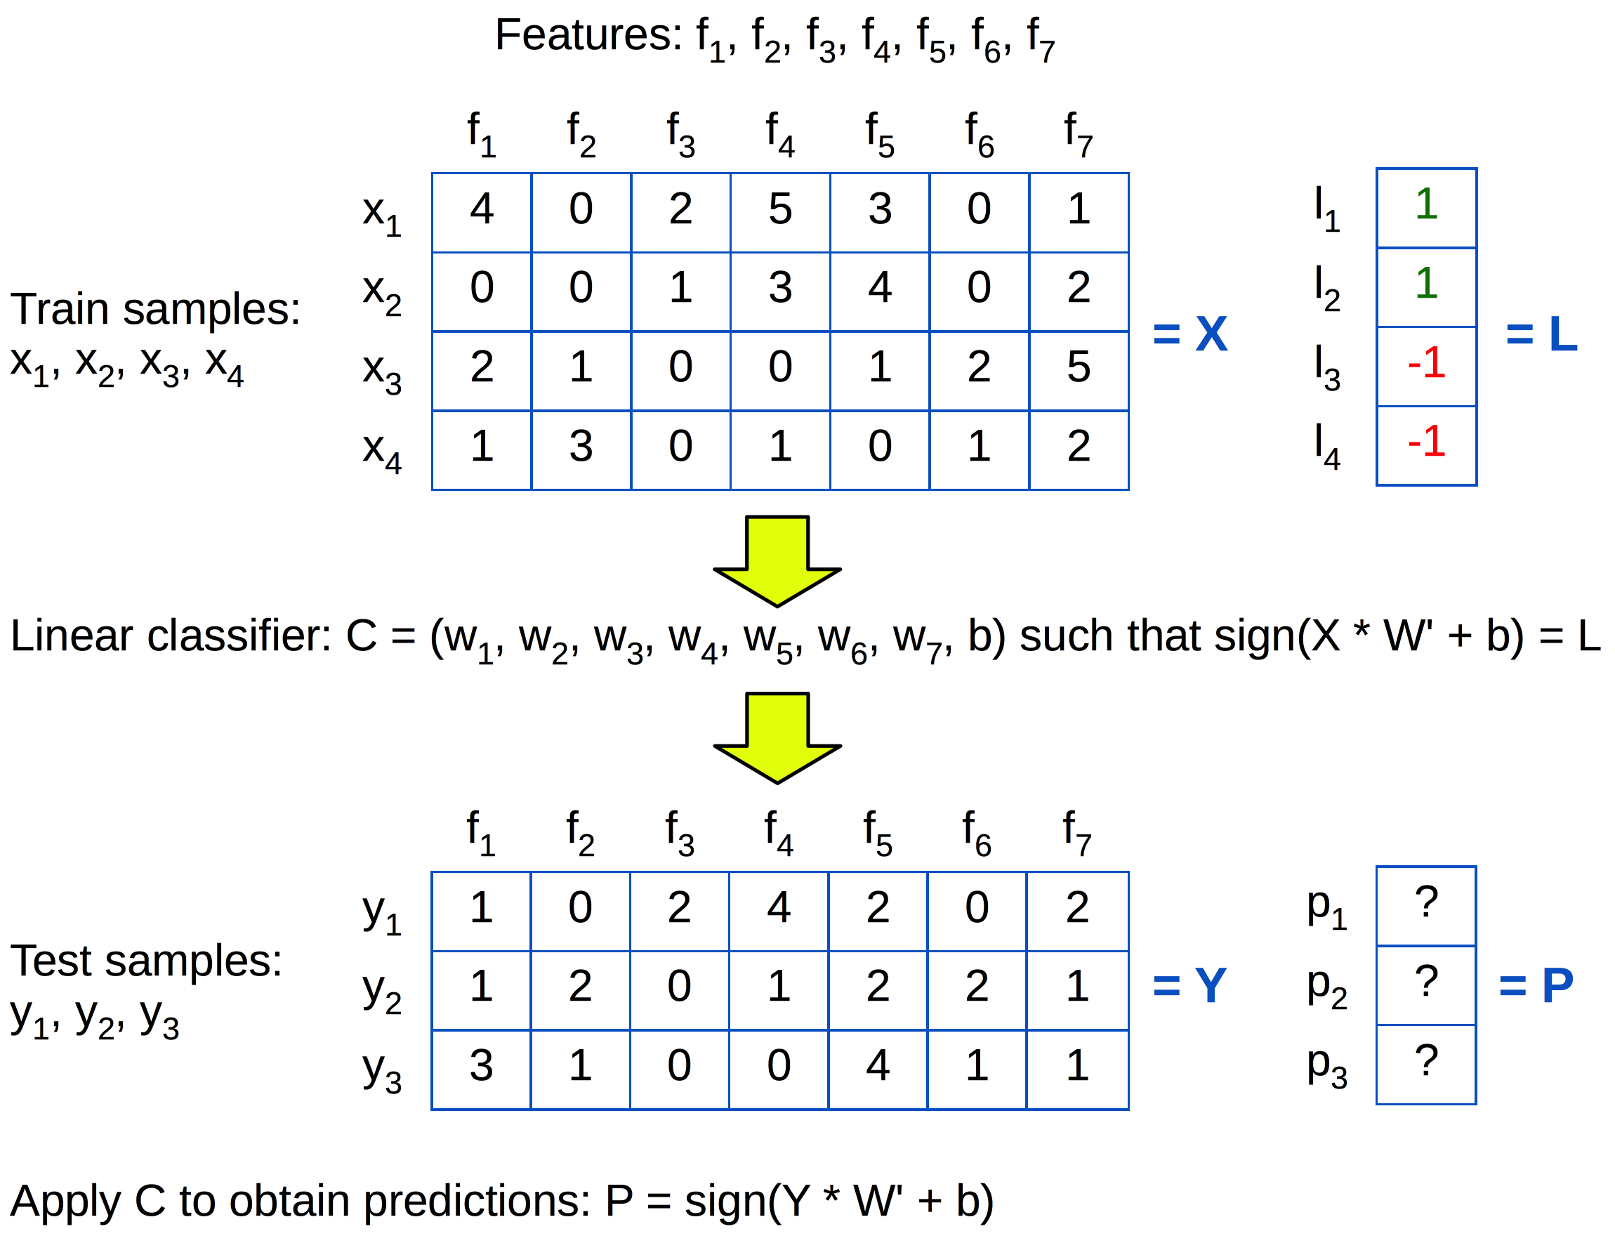
Primal Form

Slide 12
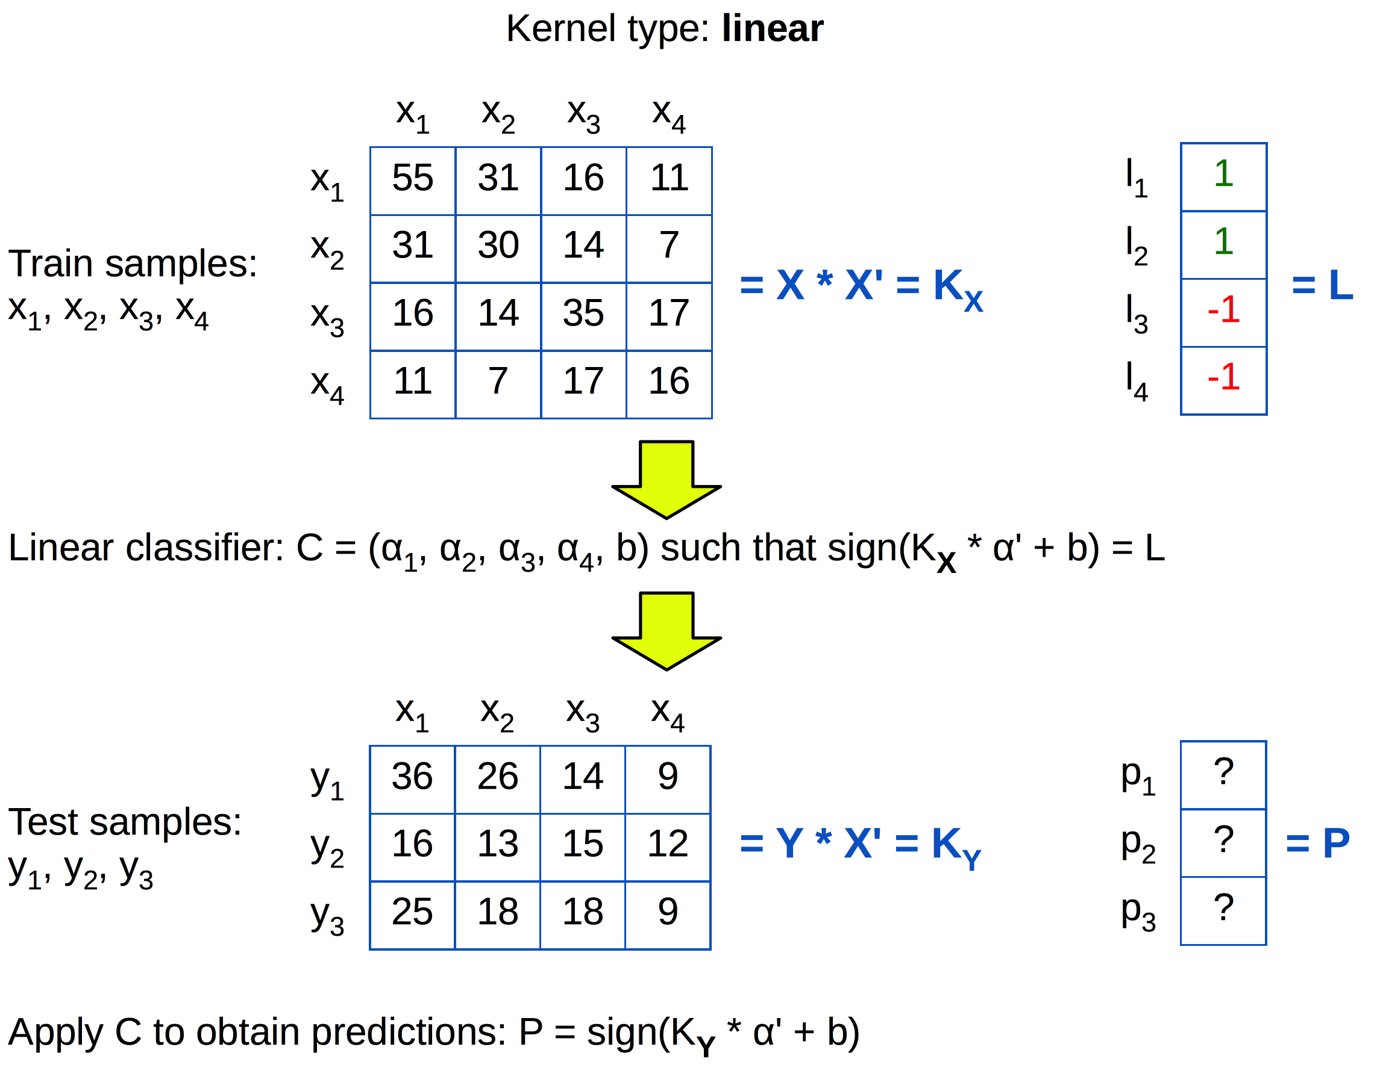
Dual form

Slide 13
Linear regression
The problem of finding g of the form:
That best interpolates a training set:

Slide 14
Linear regression
$$y=g(x)=\left\langle w,x\right\rangle$$
$$y_{i}$$
$w$
$$ξ$$
$$x_{i}$$

Slide 15
Linear regression
The error of the linear function on a particular training sample is:
The loss on all training data points is:

Slide 16
Linear regression
Loss written vectorially:
What is the optimal value for w?

Slide 17
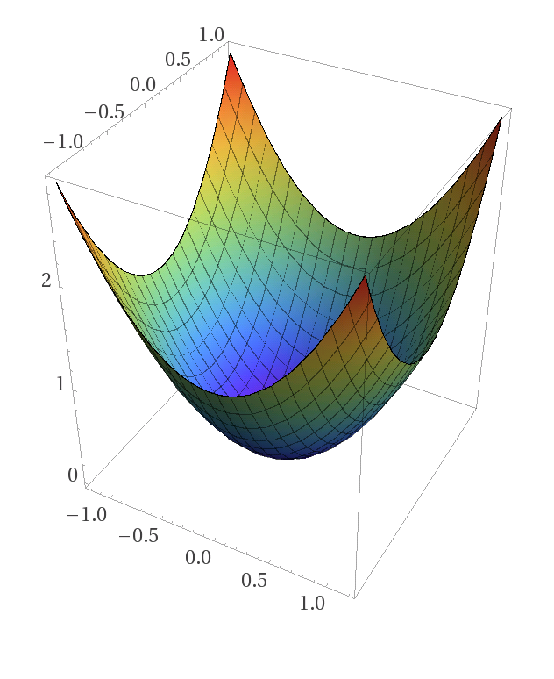
Loss is convex
$$ℒ(w)$$
w₂
w₁

Slide 18
Linear regression
The optimal w:
We get the normal equation:
We can compute w, if the inverse exists:

Slide 19
Ridge Regression
If the inverse does not exist, the problem is “ill-conditioned” and it needs regularization
The optimization criterion becomes:
And the optimal solution will be given by:

Slide 20
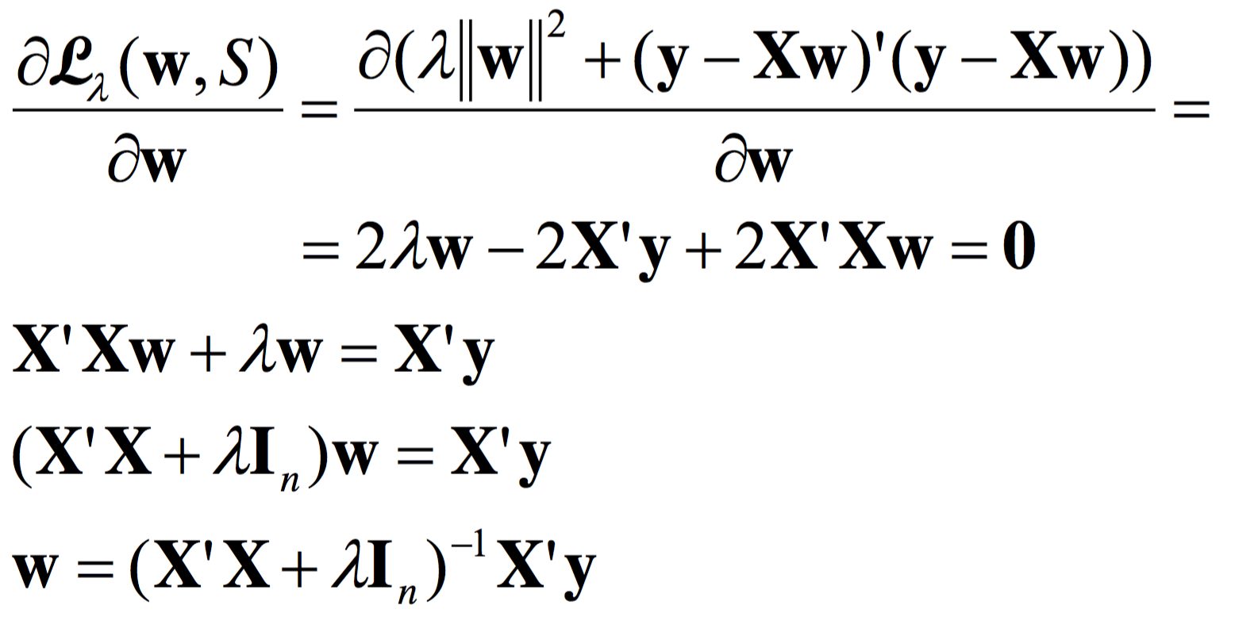
Ridge Regression
The optimal solution:

Slide 21
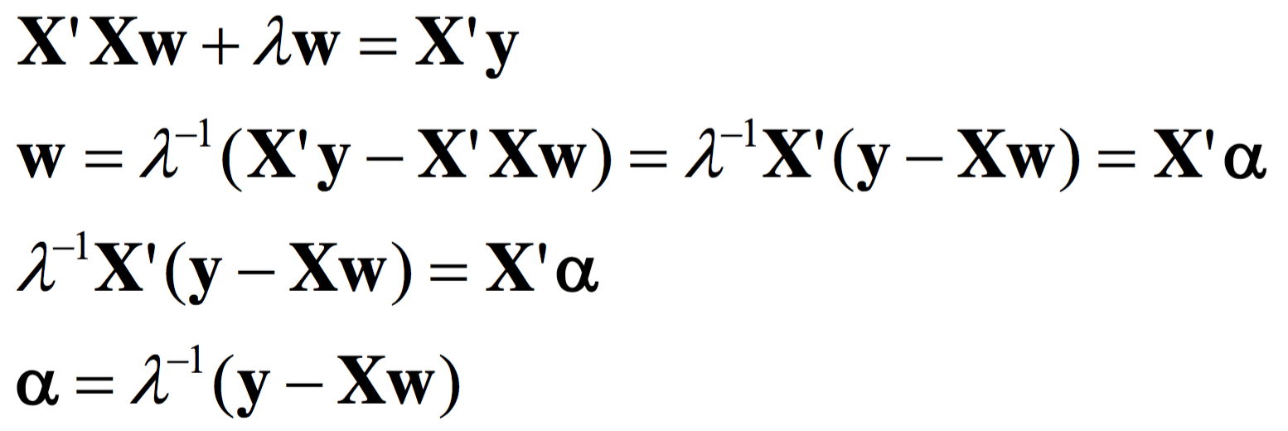
Dual Ridge Regression
But:
So:

Slide 22
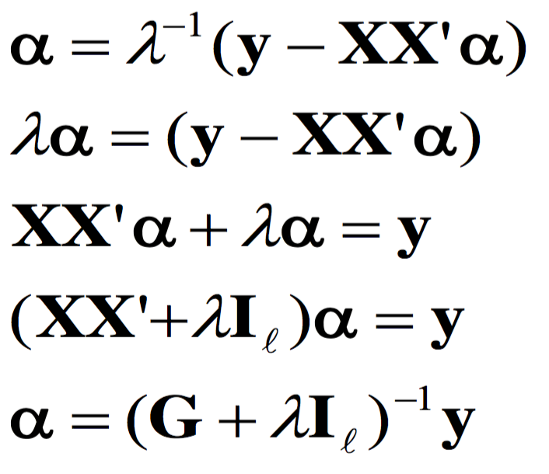
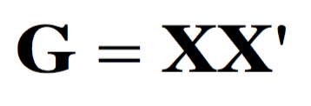
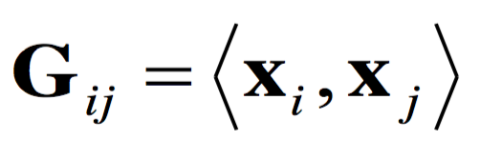
Dual Ridge Regression
Where:
is called the Gram matrix:

Slide 23
Dual Ridge Regression
In the dual form, the information from the training samples is given only by the inner product between pairs of training points:
The predictive function is given by:

Slide 24
Primal Form

Slide 25
Dual form

Slide 26
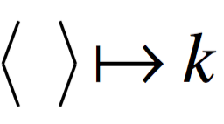
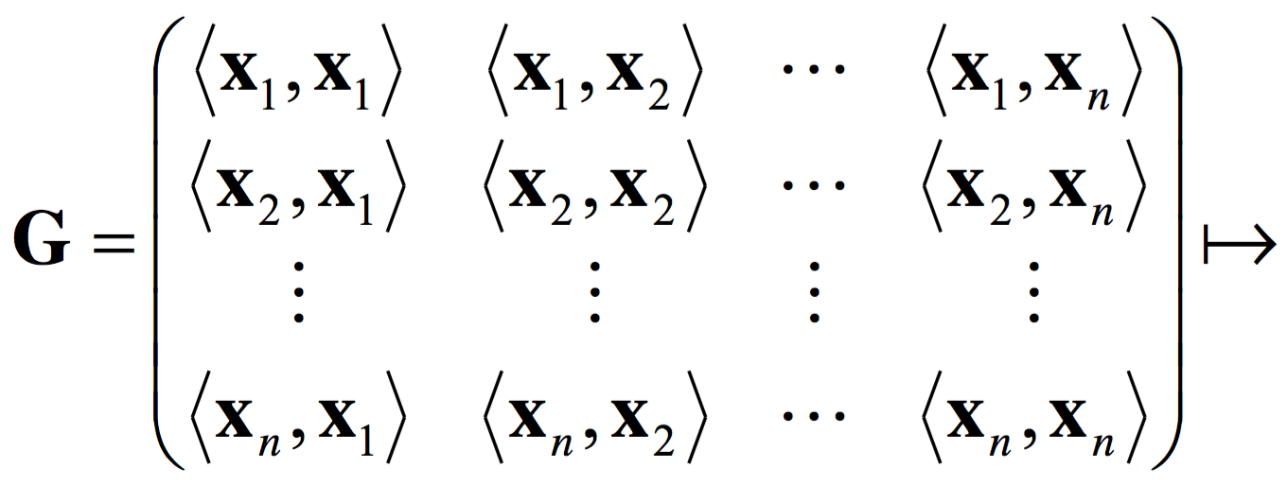
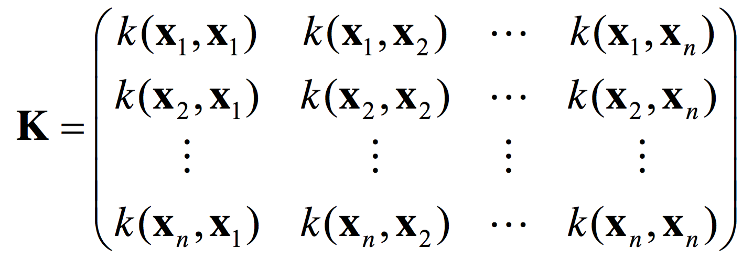
Kernel Ridge Regression
We can now apply the “kernel trick”, replacing the scalar product with another kernel function k:

Slide 27
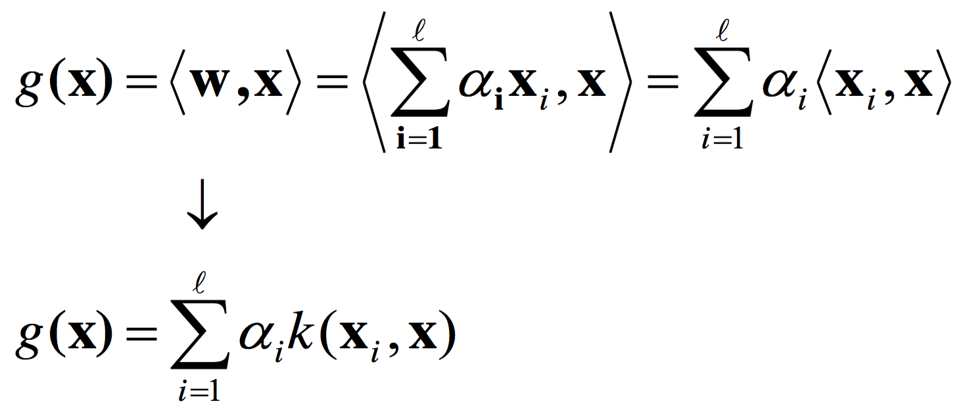
Kernel Ridge Regression
The dual weights are computed as follows:
The predictive function becomes:

Slide 28
Kernel Ridge Regression (Python)
# Regularization parameter lambda:
lmb = 10 ** -6
# X_train – training data (one sample per line)
# T_train – training labels
n = X_train.shape[0]
K = np.matmul(X_train, X_train.T)
# Training the method:
alpha = np.matmul(np.linalg.inv(K + lmb * np.eye(n)),
T_train)
# Predicting the training labels:
Y_train = np.matmul(K, alpha)
Y_train = np.sign(Y_train)
acc_train = (T_train == Y_train).mean())
print('Train accuracy: %.4f' % acc_train)

Slide 29
Kernel Ridge Regression (Python)
# X_test – test data (one sample per line)
# T_test – test labels
K_test = np.matmul(X_test, X_train.T)
# Predicting the test labels:
Y_test = np.matmul(K_test, alpha)
Y_test = np.sign(Y_test)
acc_test = (T_test == Y_test).mean()
print('Test accuracy: %.4f' % acc_test)

Slide 30
The Kernel Function
Definition: A kernel is a function
for which there is a mapping from X to a Hilbert space F
such that for any we have:
Theorem: The function k is a kernel if and only if k is symmetric and finitely positive semi-definite

Slide 31
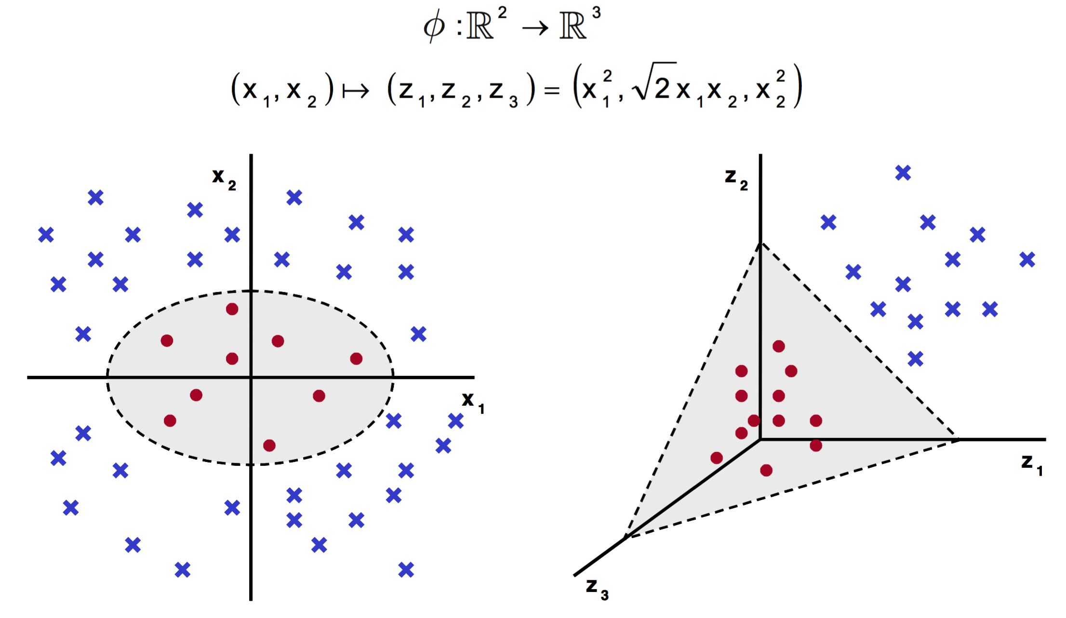
Examples of kernels
By explicitly providing the embedding map:

Slide 32
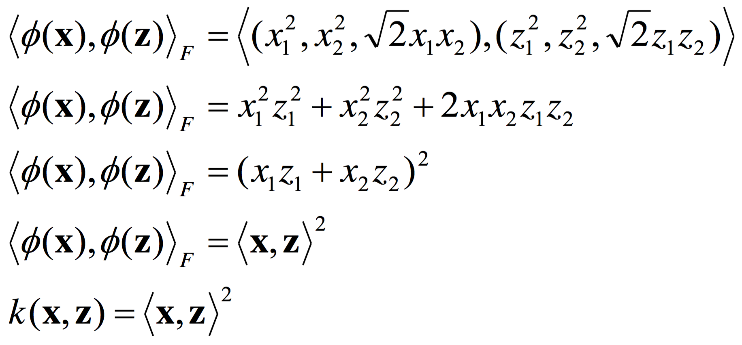
Examples of kernels
The kernel from the previous example:
The same kernel also corresponds to this map:

Slide 33
The Polynomial Kernel
For a real positive constant c and a natural number d:
The constant c controls the amount of influence of polynomials of various degrees

Slide 34
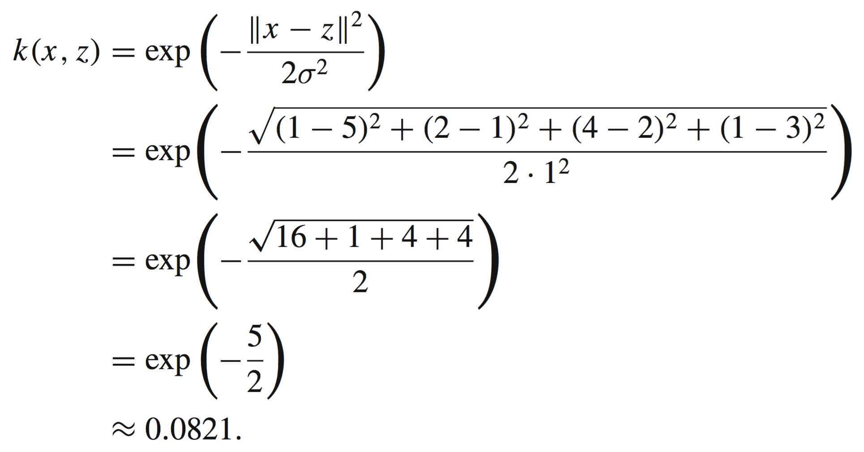
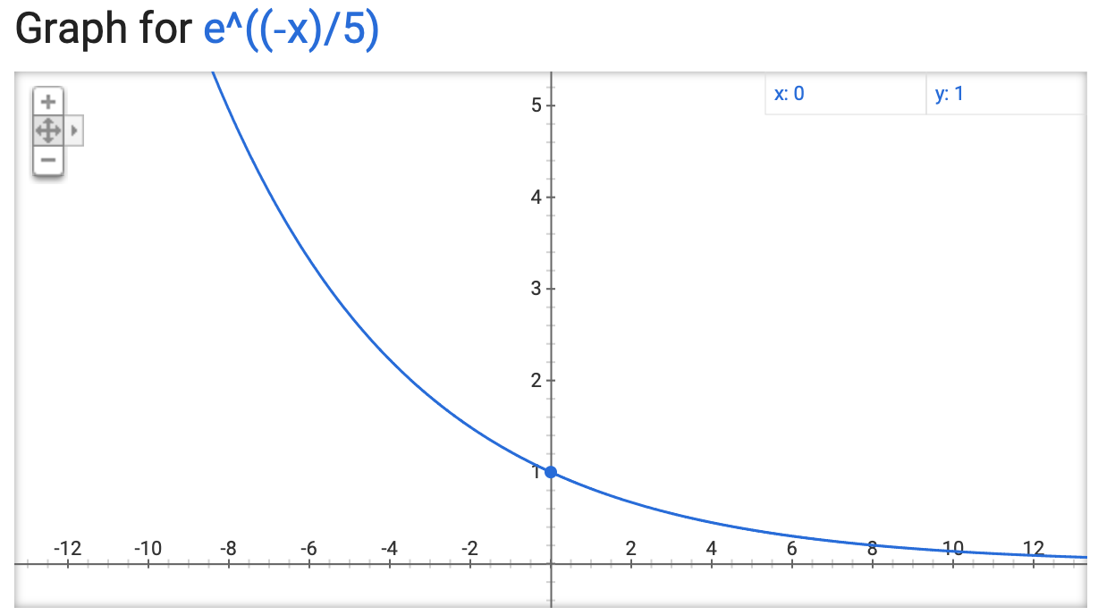
The Gaussian (RBF) Kernel
For and from :

Slide 35
The Intersection Kernel
For and from :

Slide 36
Other kernel functions
The Hellinger kernel:
The PQ kernel [Ionescu & Popescu, PRL15]:

Slide 37
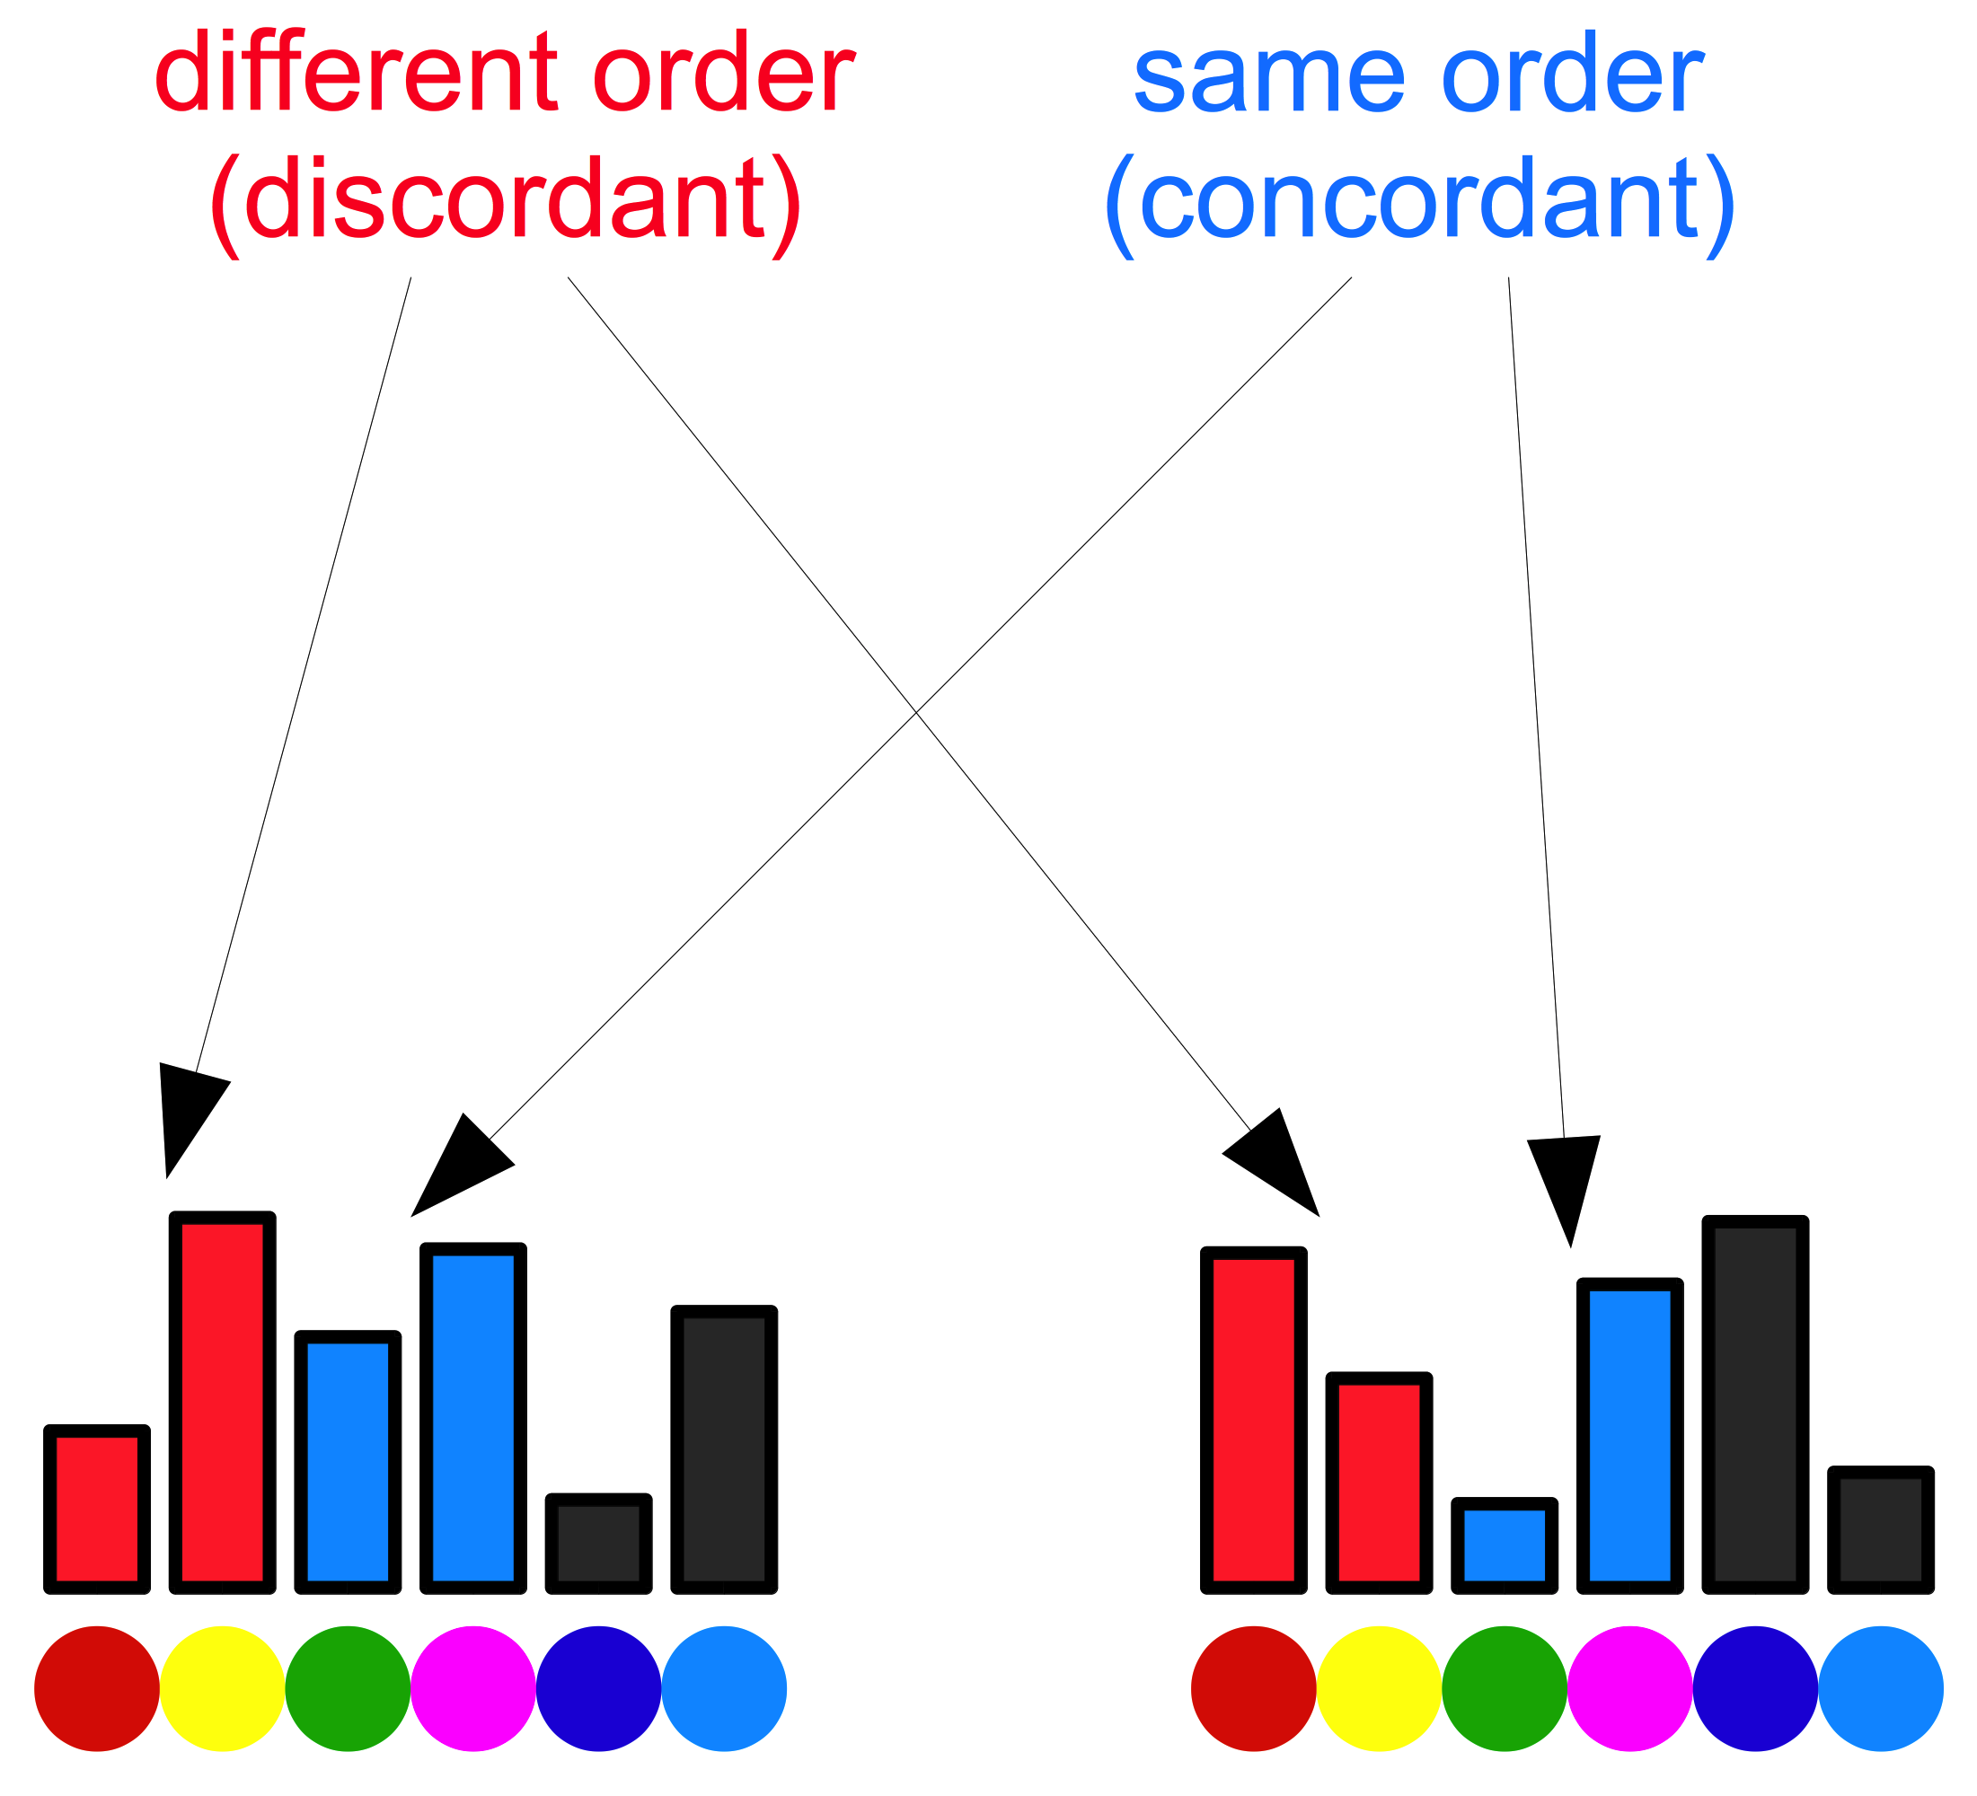
Other kernel functions
The Hellinger kernel:
The PQ kernel:

Slide 38
String kernels
String kernels measure the similarity of strings, by counting the number of contiguous subsequences (n-grams) of characters that two strings have in common
Text documents can be interpreted as strings
Advantages:
We do not have to tokenize the text
Language independence (can be applied to any language, only re-training is necessary)

Slide 39
String kernels
Example:
Given s = “pineapple pi” and t = “apple pie” over an alphabet Σ, and the n-gram length p = 2,
the hash maps S and T contain <key>:<value> pairs of the type <2-gram>:<number of occurrences> in s and t:
S = {pi:2, in:1, ne:1, ea:1, ap:1, pp:1, pl:1, le:1, e_:1, _p:1},
T = {ap:1, pp:1, pl:1, le:1, e_:1, _p:1, pi:1, ie:1}

Slide 40
Presence bits string kernel
The presence bits string kernel is defined as follows:
$$k_{2}^{0/1}\left(s,t\right)=\sum_{v∈Σ^{p}}{S^{0/1}\left(v\right)∙T^{0/1}(v) }$$
Example (continued):
S = {pi:2, in:1, ne:1, ea:1, ap:1, pp:1, pl:1, le:1, e_:1, _p:1},
T = {ap:1, pp:1, pl:1, le:1, e_:1, _p:1, pi:1, ie:1}
$k_{2}^{0/1}\left(s,t\right)=$ $1∙1+1∙1+1∙1+1∙1+1∙1+1∙1+1∙1$
$=1+1+1+1+1+1+1$
$=7$

Slide 41
Why kernel methods?
They obtain state-of-the-art results in various NLP tasks:
Native Language Identification [Ionescu & Popescu, BEA17]
Arabic Dialect Identification [Butnaru & Ionescu, VarDial18]
Romanian Dialect Identification [Butnaru & Ionescu, ACL19]
Useful for building a compact representation when:
number of samples << number of features
E.g., in TOEFL11 dataset, the number of unique n-grams (n={5,6,7,8,9}) is:
4,662,520
… versus the number of training samples:
11,000

Slide 42
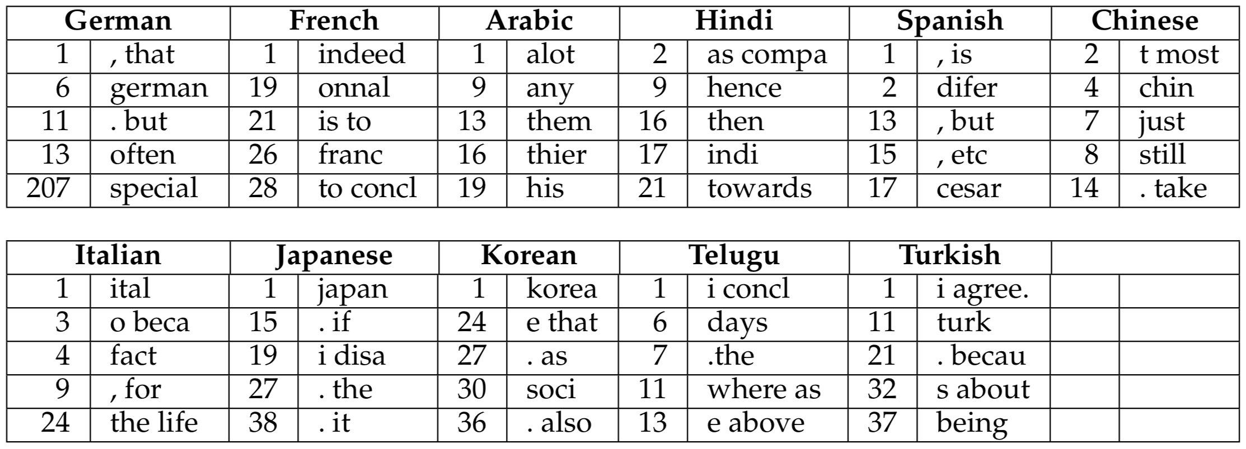
Why kernel methods?
They generalize better than words
Examples of native language transfer patterns on TOEFL11

Slide 43
French→English transfer patterns
{onnal}
“…many academics subjects. Additionnally, people always have a subject…”
“I would not be in control of my personnal schedule during the trip.”
{evelopp}
“…and who will have the curiosity to developp research on the disease.”
“…be able to do so. Underdevelopped countries are a case in point.”
{n France}
“…studied law in both England and in France, I have had the chance…”
“Numbers have actually shown that in France the number of new cars…”
{to conc}
“…without a tour guide. To conclude, there are several advantages…”
“…job they will enjoy. To conclude, I think that the best solution is…”
{exemple}
“…after using them. Onother exemple is my underwear that I bougth…”
“Science is a great exemple of how successful people want to improve…”

Slide 44
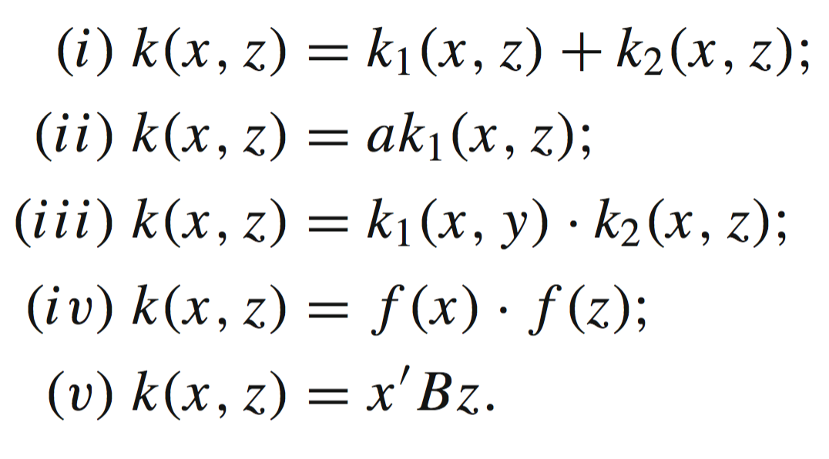
New kernels based on combinations
Given two kernels k₁ and k₂, a real positive constant a, a function f with real values and a symmetric and positive semi-definite matrix B, the following functions are also kernels:

Slide 45
Primal Form

Slide 46
Dual Form

Slide 47
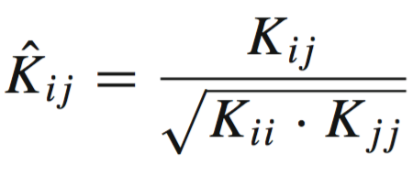
Data normalization
In primal form:
In dual form:
Directly on the kernel matrix:

Slide 48
Data normalization (Python)
% X - data (one sample per row)
% L2 norm in primal form:
norms = np.linalg.norm(X, axis = 1, keepdims = True)
X = X / norms
% L2 norm in dual form:
K = np.matmul(X, X.T)
KNorm = np.sqrt(np.diag(K))
KNorm = KNorm[np.newaxis]
K = K / np.matmul(KNorm.T, KNorm)

Slide 49
Bibliography

Slide 51
