Slide 1
Support Vector Machines.
Logistic Regression.
Radu Ionescu, Prof. PhD.
raducu.ionescu@gmail.com
Faculty of Mathematics and Computer Science
University of Bucharest

Slide 2
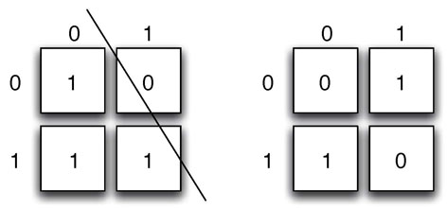
XOR (Minsky & Papert, 1969)
A linear classification method cannot solve the XOR problem

Slide 3
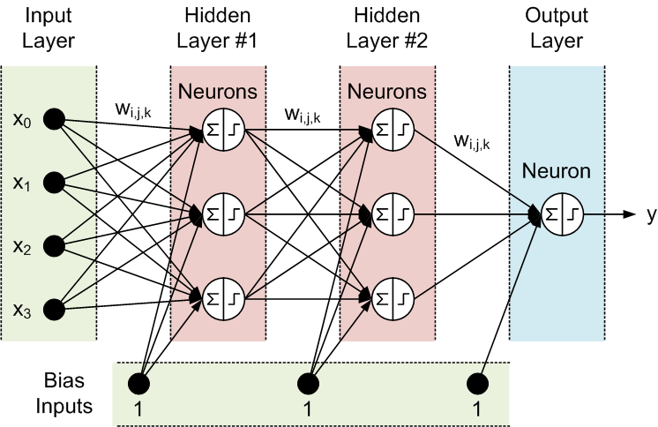
Solution 1: Neural Networks

Slide 4
Solution 2: Kernel Methods
Kernel methods are based on two steps:
1. Embed data in a higher-dimensional Hilbert space
2. Search for linear relations in the embedding space
The embedding can be performed implicitly, by specifying the scalar product among data samples
Steps 1 and 2 can be comprised in one step!

Slide 5
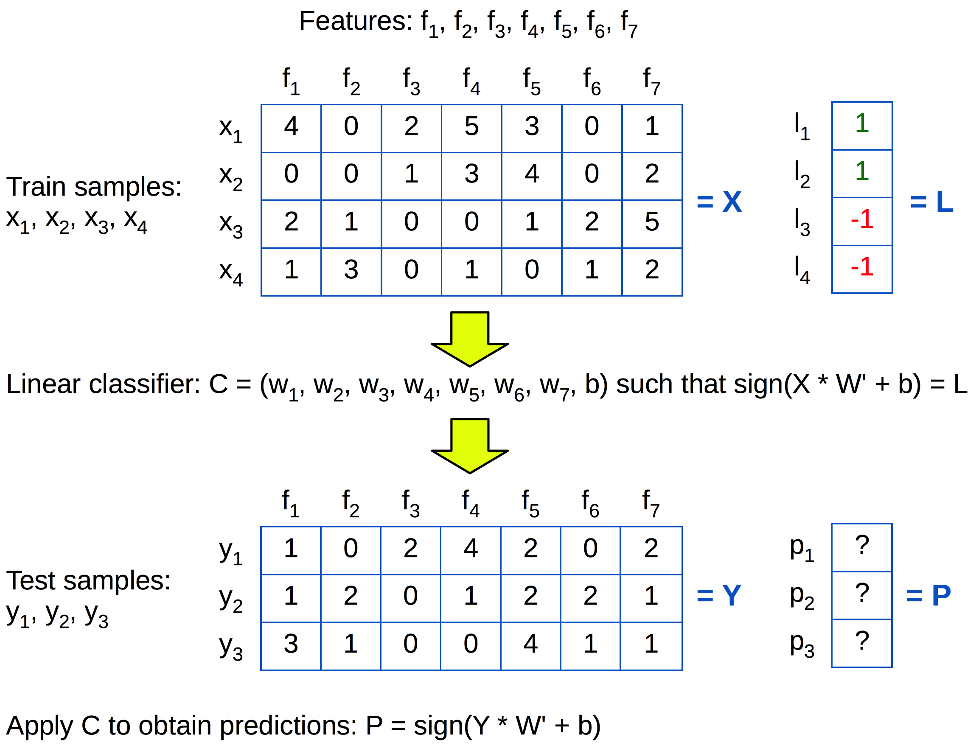
Primal Form

Slide 6
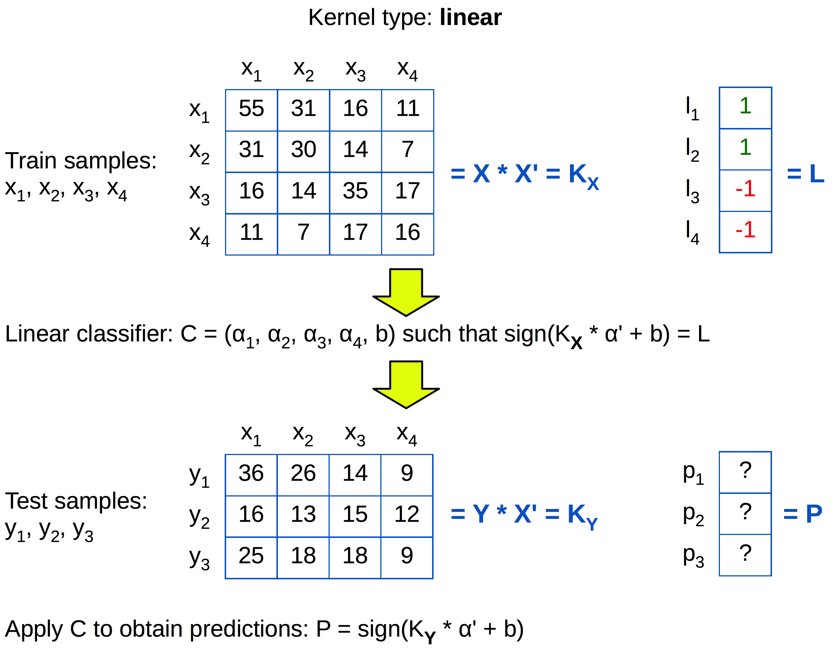
Dual form

Slide 7
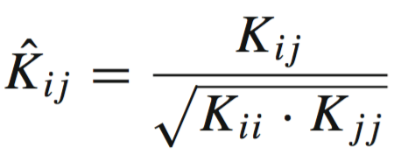
Data normalization
In primal form:
In dual form:
Directly on the kernel matrix:

Slide 8
Data normalization (Python)
% X - data (one sample per row)
% L2 norm in primal form:
norms = np.linalg.norm(X, axis = 1, keepdims = True)
X = X / norms
% L2 norm in dual form:
K = np.matmul(X, X.T)
KNorm = np.sqrt(np.diag(K))
KNorm = KNorm[np.newaxis]
K = K / np.matmul(KNorm.T, KNorm)

Slide 9
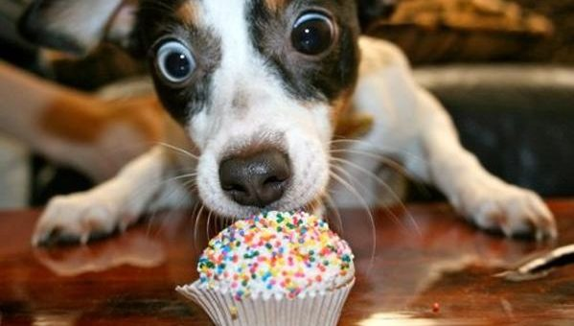
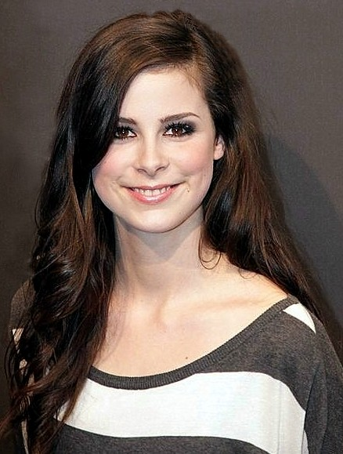
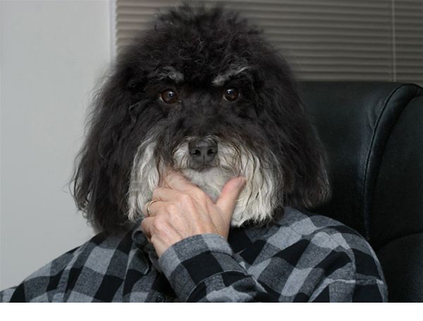
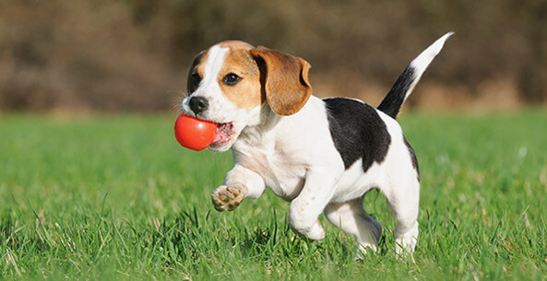
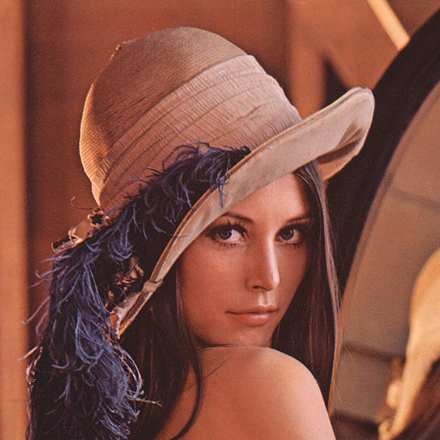
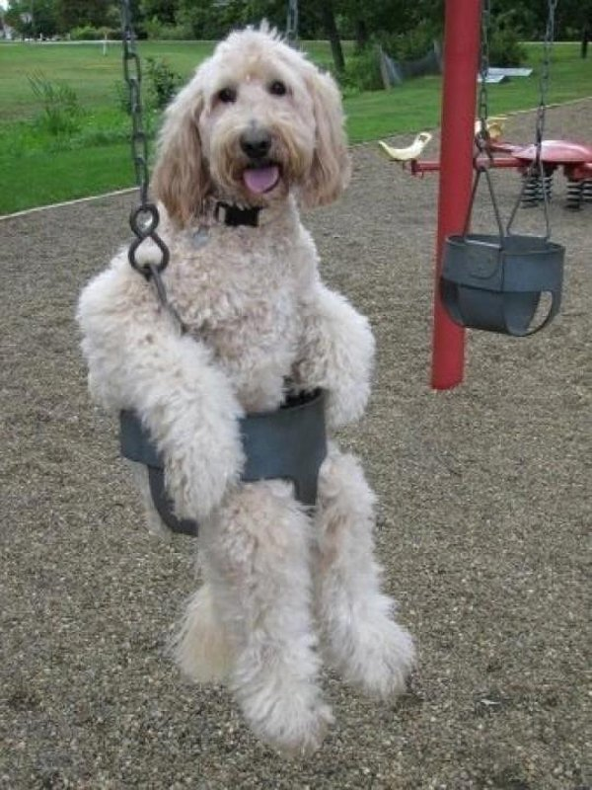
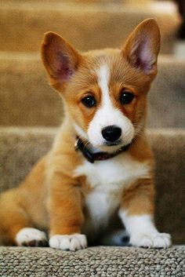
How do we separate these points optimally?

Slide 10
How do we separate these points optimally?

Slide 11
How do we separate these points optimally?

Slide 12
Pick the maximum margin hyperplane

Slide 13
Pick the maximum margin hyperplane
Support Vector Machines (SVM)

Slide 14
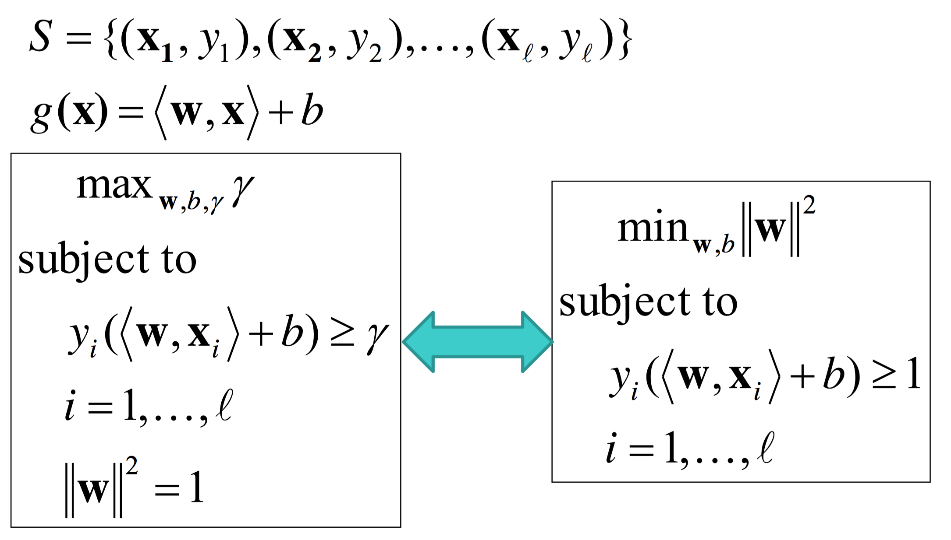
SVM (Hard Margin)

Slide 15
Pick the maximum margin hyperplane
Support Vector Machines (SVM)

Slide 16
SVM Dual (Hard Margin)
Lagrange multipliers: a way of finding the extremum of a function subject to constraints
We want to minimize ${\left\|w\right\|}^{2}$ subject to $y_{i}\left(\left\langle w,x_{i}\right\rangle +b\right)−1≥0$
We define a new function and find its minimum instead
$$L\left(w,b,α\right)={\left\|w\right\|}^{2}−\sum_{i}{α_{i}\left[y_{i}\left(\left\langle w,x_{i}\right\rangle +b\right)−1\right],α_{i}≥0}$$
$$\frac{∂L}{∂w}=w−\sum_{i}{α_{i}y_{i}x_{i}=0⟹}w= \sum_{i}{α_{i}y_{i}x_{i}}$$
$$\frac{∂L}{∂b}=−\sum_{i}{α_{i}y_{i}=0⟹}\sum_{i}{α_{i}y_{i}=0}$$
$α_{i}$ are called Lagrange multipliers

Slide 17
SVM Dual (Hard Margin)
$L={\left\|w\right\|}^{2}−\sum_{i}{α_{i}\left[y_{i}\left(\left\langle w,x_{i}\right\rangle +b\right)−1\right] }$
$w= \sum_{i}{α_{i}y_{i}x_{i}}$
$\sum_{i}{α_{i}y_{i}=0}$
Note: The optimization depends only on the scalar product of training sample pairs
$α_{i}$ will be non-zero only for support vectors
Our decision rule (in primal form) was: $x$ is positive if $\left\langle w,x\right\rangle +b≥0$
In dual form, it becomes: $\sum_{i}{α_{i}y_{i}\left\langle x_{i},x\right\rangle }$ $+b≥0$
Note: The decision also depends on the scalar product
Note: $b$ can be computed from $\sum_{i}{α_{i}y_{i}\left\langle x_{i},x_{+}\right\rangle }$ $+b=1$, for some positive support vector $x_{+}$
$$L=\sum_{i}{α_{i}}−\sum_{i}{\sum_{j}{α_{i}α_{j}y_{i}y_{j}\left\langle x_{i},x_{j}\right\rangle } }$$

Slide 18
SVM Dual (Hard Margin)
The decision rule (in dual form) is:
$x$ is positive if $\sum_{i}{α_{i}y_{i}\left\langle x_{i},x\right\rangle }$ $+b≥0$
In order to obtain $α_{i}$ and $b$, we have to:
$$min\sum_{i}{α_{i}}−\sum_{i}{\sum_{j}{α_{i}α_{j}y_{i}y_{j}\left\langle x_{i},x_{j}\right\rangle } }$$
$$subject to α_{i}≥0, ∀i$$

Slide 19
SVM (Hard Margin)
Primal form
Decision rule:
$$\left\langle w,x\right\rangle +b≥0$$
Optimization problem:
$$min{\left\|w\right\|}^{2}$$
$$subject to y_{i}\left(\left\langle w,x_{i}\right\rangle +b\right)−1≥0$$
Dual form
Decision rule:
$\sum_{i}{α_{i}y_{i}\left\langle x_{i},x\right\rangle }$ $+b≥0$
Optimization problem:
$$min\sum_{i}{α_{i}}−\sum_{i}{\sum_{j}{α_{i}α_{j}y_{i}y_{j}\left\langle x_{i},x_{j}\right\rangle } }$$
$$subject to α_{i}≥0$$
Primal has as many params as features ($n$)
Dual has as many params as samples ($l$)
It is more efficient to optimize primal if $l≫n$

Slide 20
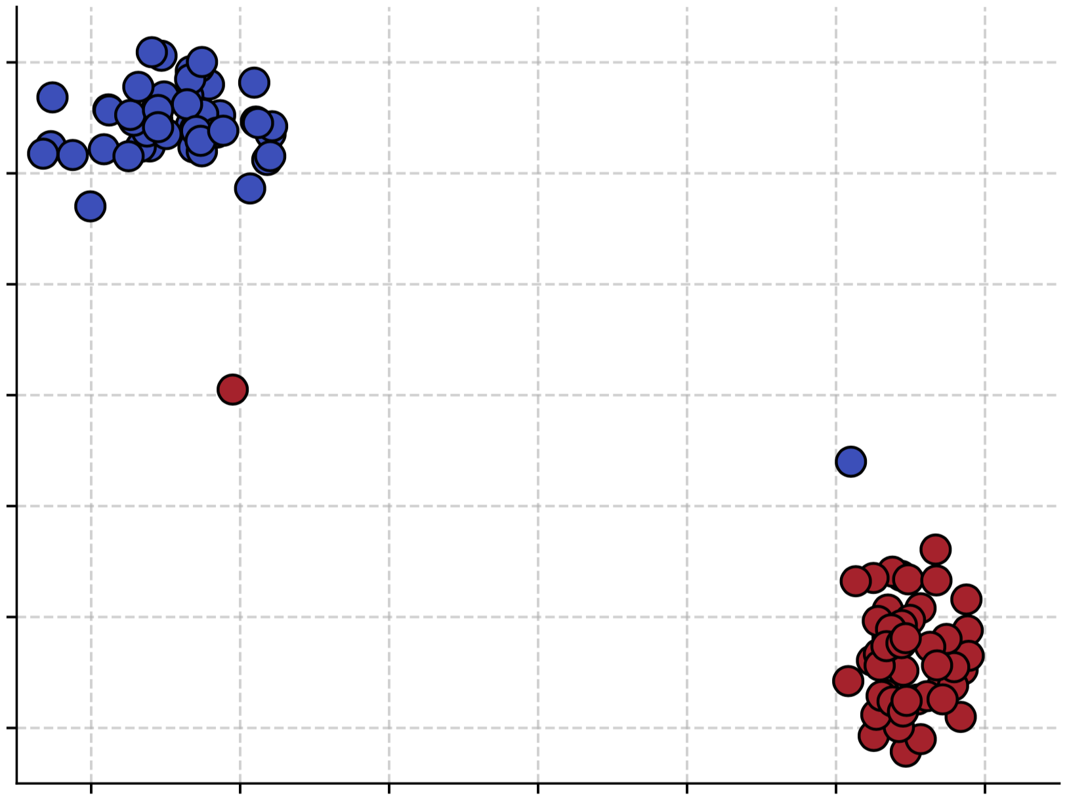
SVM (Soft Margin)
What happens when we train a hard-margin SVM on this data set?

Slide 21
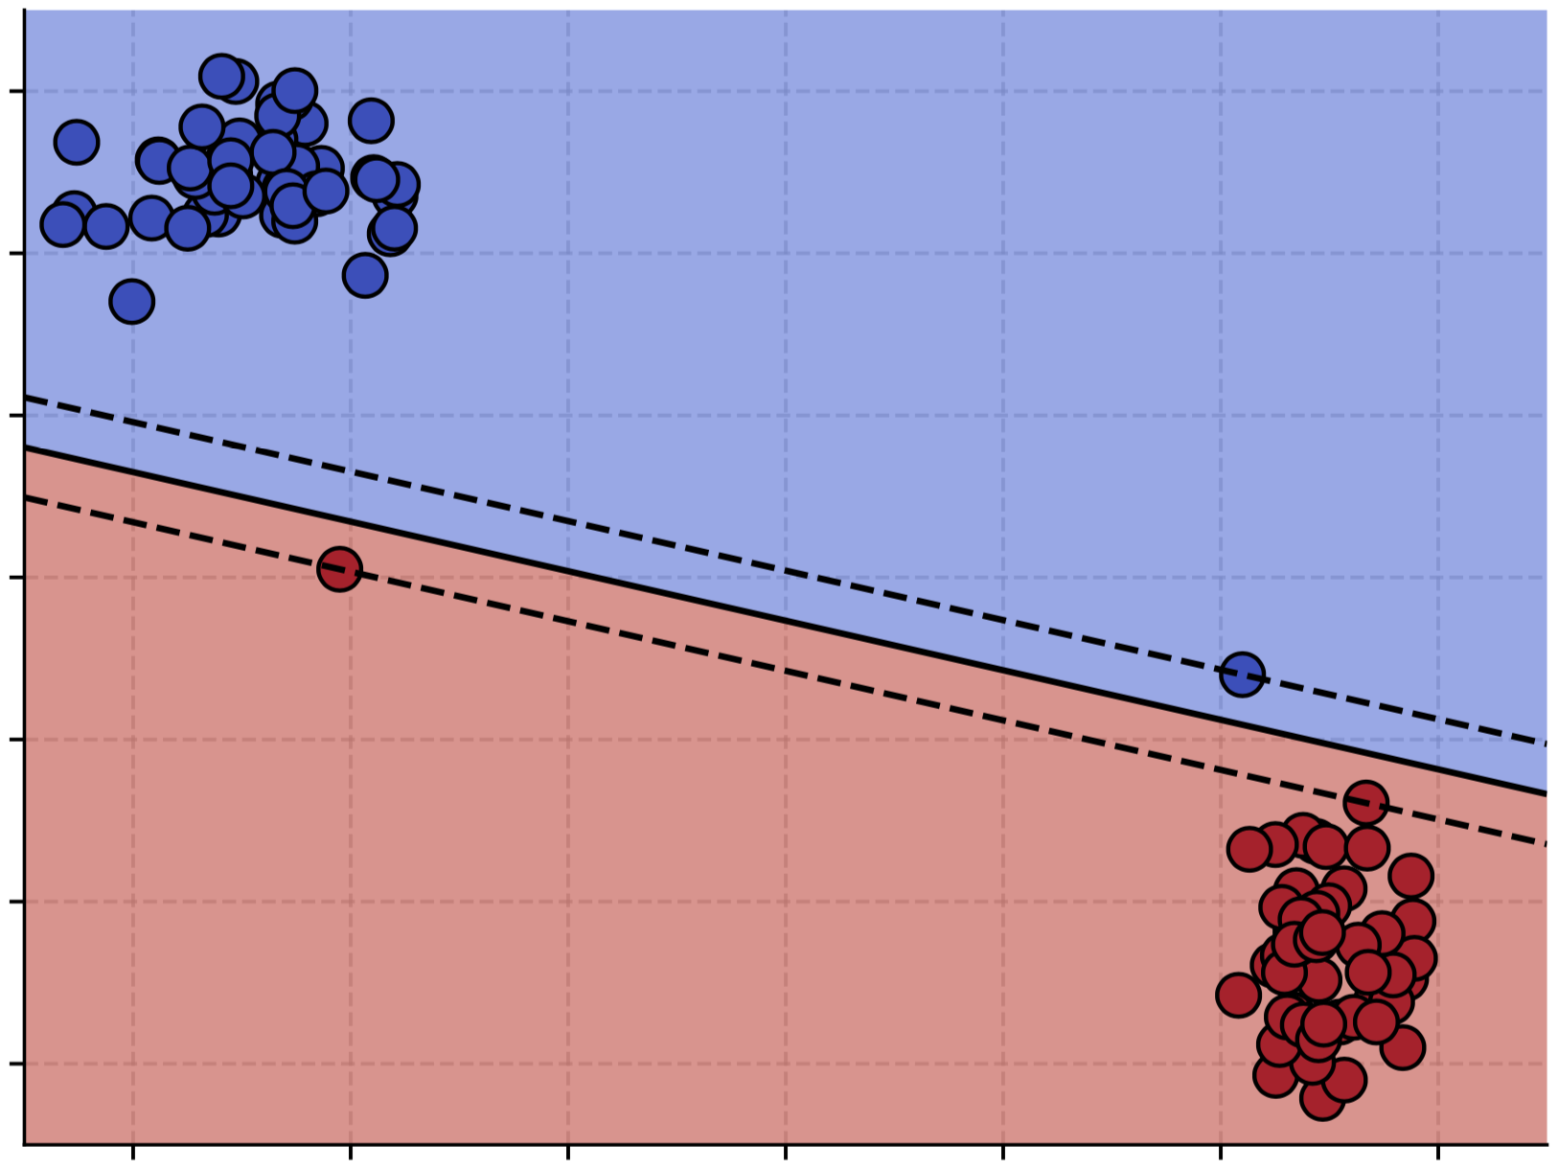
SVM (Soft Margin)
What happens when we train a hard-margin SVM on this data set?
It succeeds at separating the training samples, but with a very tight margin

Slide 22
SVM (Soft Margin)
What happens when we train a hard-margin SVM on this data set?

Slide 23
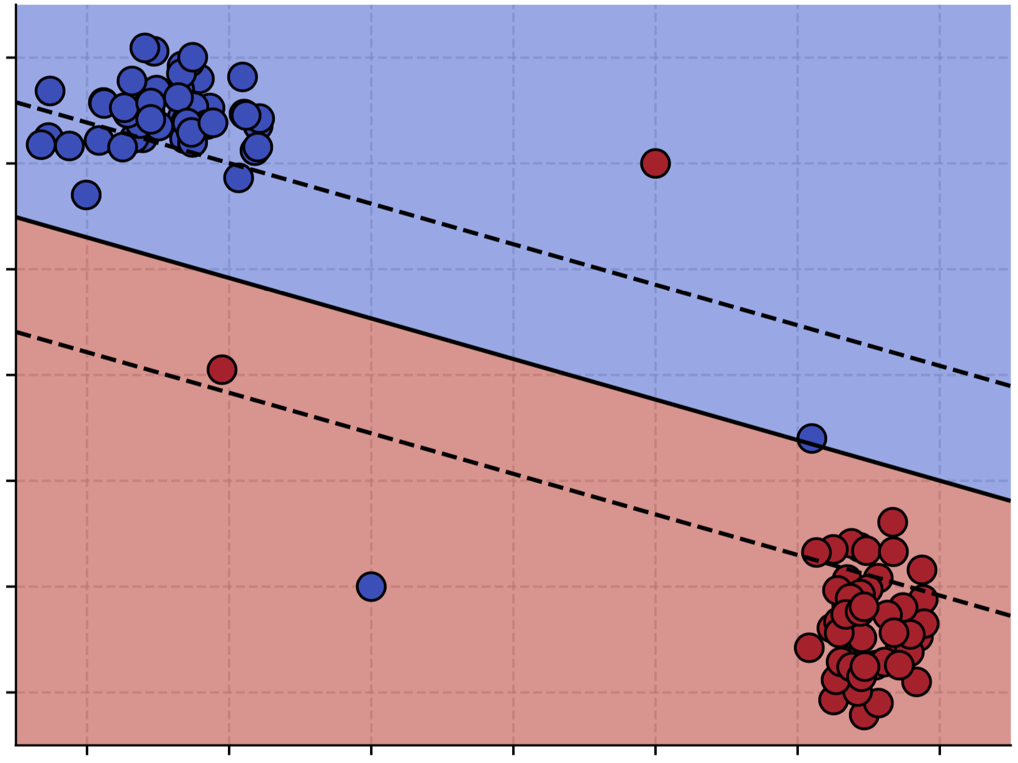
SVM (Soft Margin)
What happens when we train a hard-margin SVM on this data set?
It fails, because the samples are not linearly separable

Slide 24
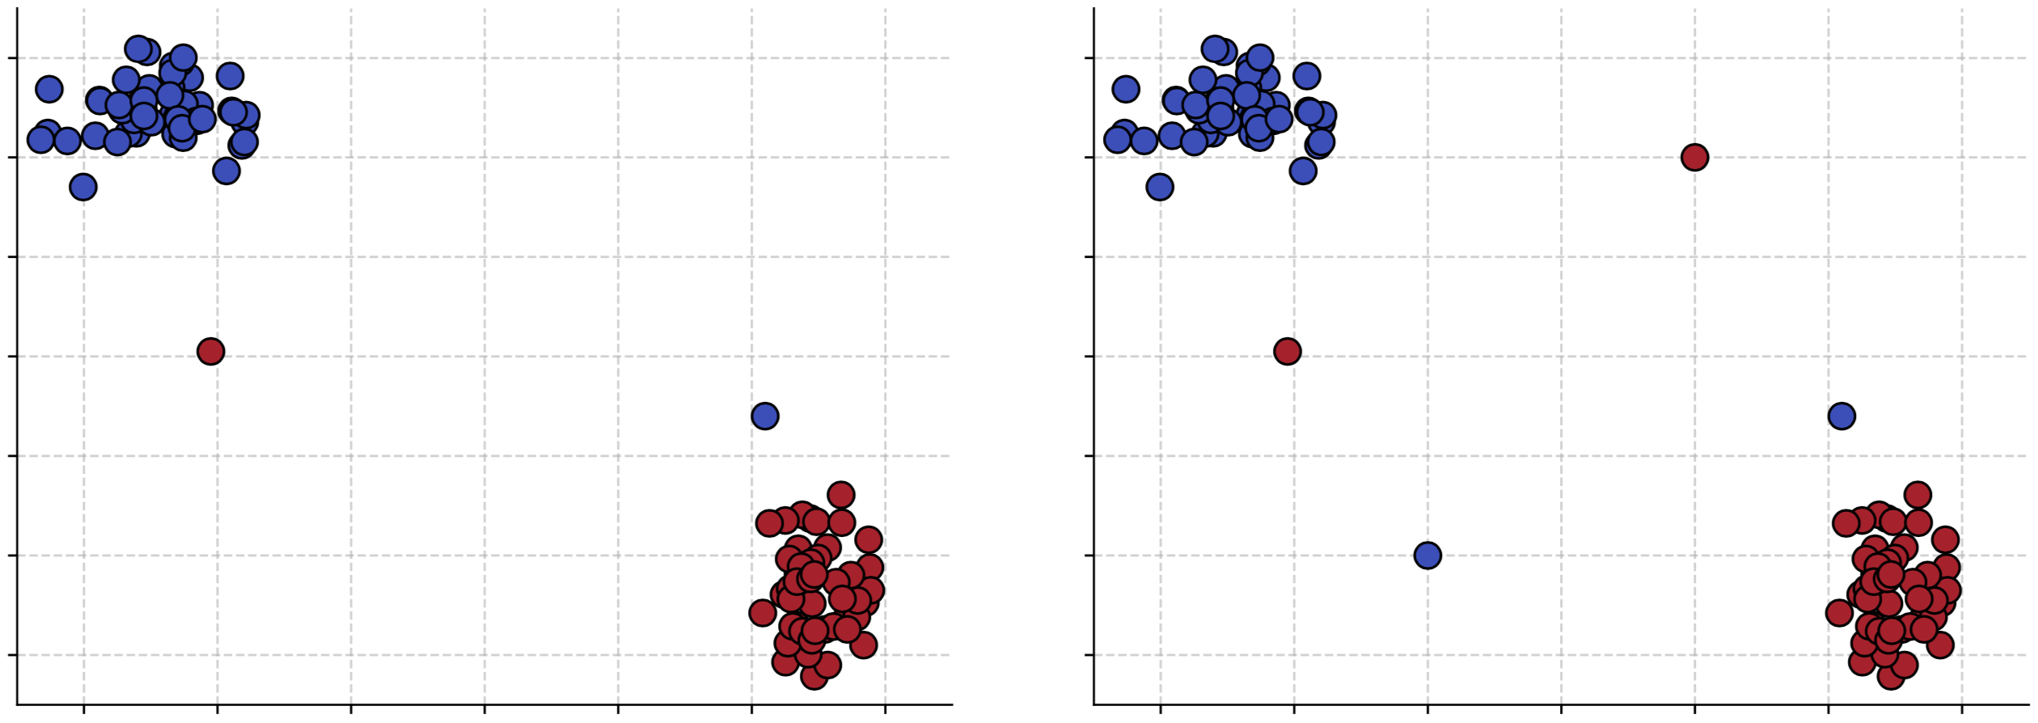
SVM (Soft Margin)
What would the more “reasonable” solutions be?

Slide 25
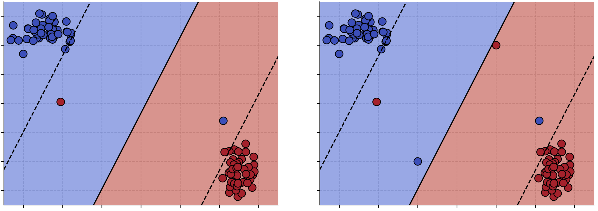
SVM (Soft Margin)
What would the more “reasonable” solutions be?

Slide 26
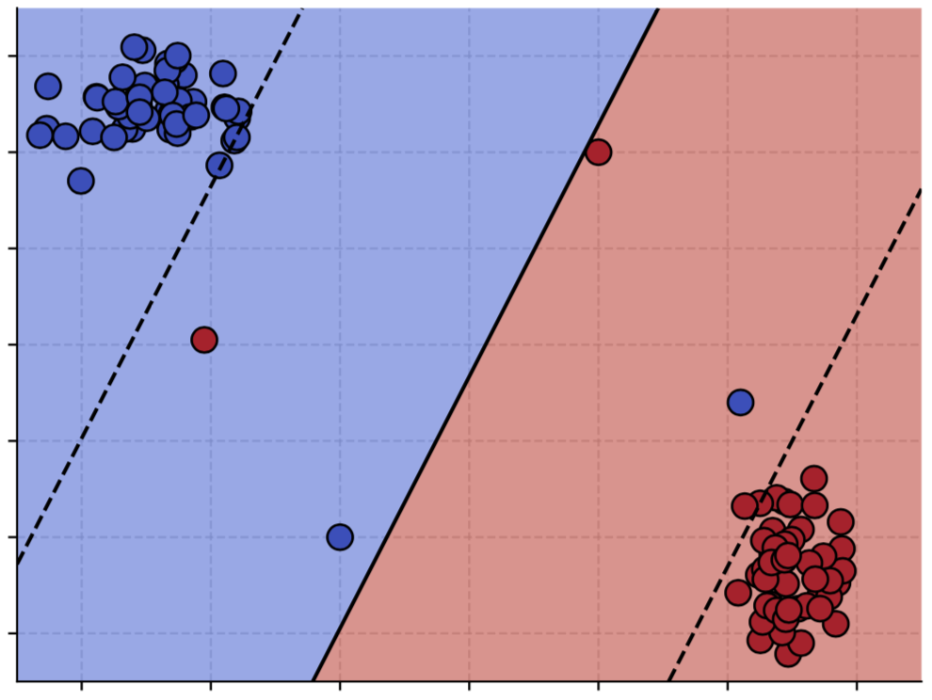
SVM (Soft Margin)
Allow some training samples to be misclassified, at a cost.

Slide 27
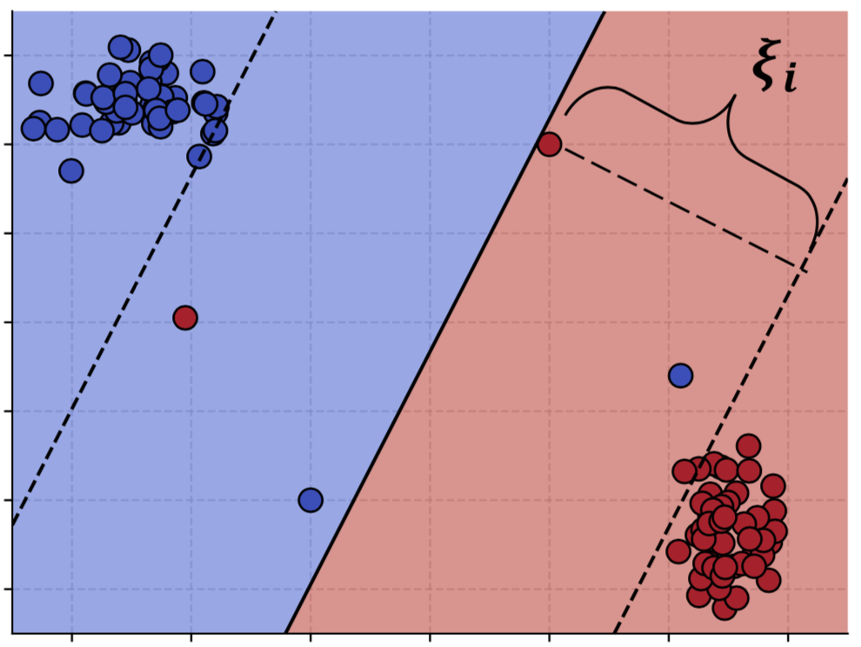
SVM (Soft Margin)
Allow some training samples to be misclassified, at a cost.
We introduce slack variables $ξ_{i}≥0$ (how much example $x_{i}$ is allowed to cross the border):
$y_{i}\left(\left\langle w,x_{i}\right\rangle +b\right)−1≥0$ becomes
$$y_{i}\left(\left\langle w,x_{i}\right\rangle +b\right)−1≥−ξ_{i}$$
The optimization problem becomes:
$$min{\left\|w\right\|}^{2}+C\sum_{i}{ξ_{i} }$$
$$subject to y_{i}\left(\left\langle w,x_{i}\right\rangle +b\right)−1≥−ξ_{i}$$
Trade-off between making the margin wide and allowing training mistakes
$C$ controls the weight of the mistakes

Slide 28
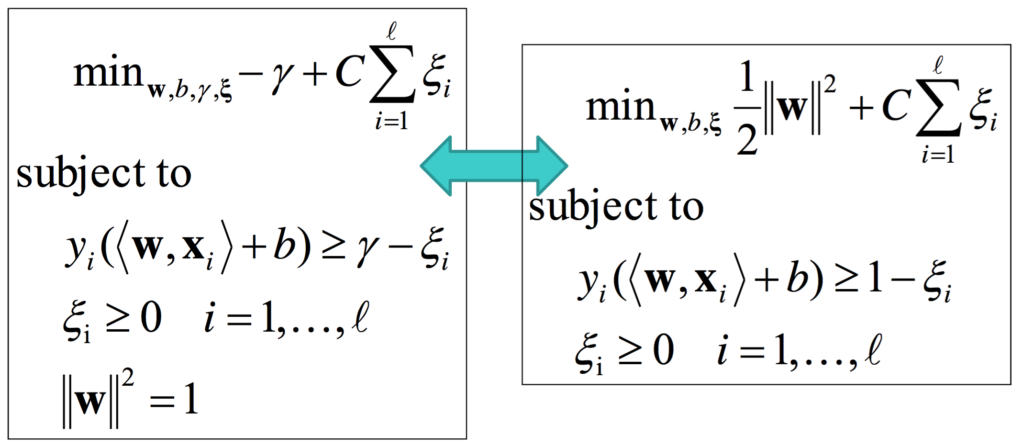
SVM (Soft Margin)
When the examples are non-linearly separable:

Slide 29
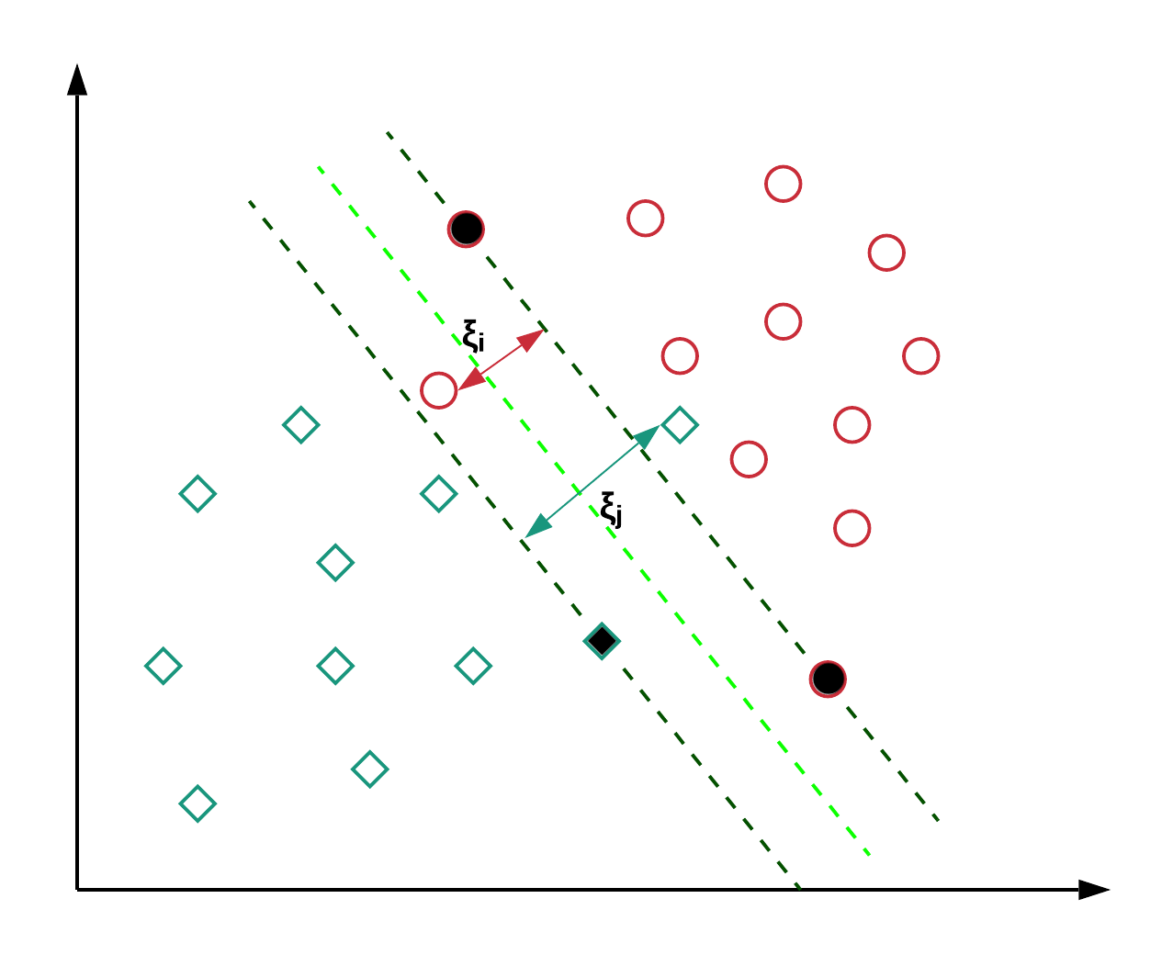
SVM (Soft Margin)

Slide 30
Hinge Loss
$$min{\left\|w\right\|}^{2}+C\sum_{i}{ξ_{i} }$$
$$subject to y_{i}\left(\left\langle w,x_{i}\right\rangle +b\right)−1≥−ξ_{i}$$
$ξ_{i}≥0$
By replacing $ξ_{i}$ in the minimization problem, we get:
$$min{\left\|w\right\|}^{2}+C\sum_{i}{\max\left(0, 1−y_{i}\left(\left\langle w,x_{i}\right\rangle +b\right)\right) }$$
$$ξ_{i}=\max\left(0, 1−y_{i}\left(\left\langle w,x_{i}\right\rangle +b\right)\right)$$

Slide 31
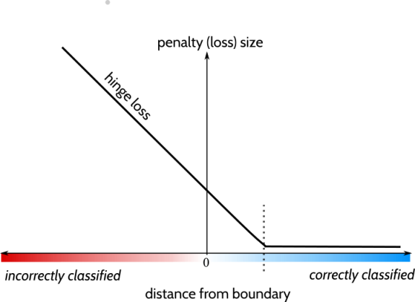
Hinge Loss
$$min{\left\|w\right\|}^{2}+C\sum_{i}{\max\left(0, 1−y_{i}\left(\left\langle w,x_{i}\right\rangle +b\right)\right) }$$
The hinge loss is defined as follows:
$$L\left(x_{i}\right)=\max\left(0, 1−y_{i}\left(\left\langle w,x_{i}\right\rangle +b\right)\right)$$
We can rewrite the minimization
problem as follows:
$$min\left(C\sum_{i}{L\left(x_{i}\right)+{\left\|w\right\|}^{2}}\right)$$
Note: The soft-margin SVM is actually minimizing the hinge loss with regularization

Slide 32
SVM (Soft Margin)
The decision rule (in primal form) is:
$x$ is positive if $\left\langle w,x\right\rangle +b ≥0$
In order to obtain $w$ and $b$, we have to:
$$min{\left\|w\right\|}^{2}+C\sum_{i}{ξ_{i} }$$
$$subject to y_{i}\left(\left\langle w,x_{i}\right\rangle +b\right)−1≥−ξ_{i}$$
Or
$$min{\left\|w\right\|}^{2}+C\sum_{i}{\max\left(0, 1−y_{i}\left(\left\langle w,x_{i}\right\rangle +b\right)\right) }$$

Slide 33
SVM Dual (Soft Margin)
The decision rule (in dual form) is:
$x$ is positive if $\sum_{i}{α_{i}y_{i}\left\langle x_{i},x\right\rangle }$ $+b≥0$
In order to obtain $α_{i}$ and $b$, we have to:
$$min\sum_{i}{α_{i}}−\sum_{i}{\sum_{j}{α_{i}α_{j}y_{i}y_{j}\left\langle x_{i},x_{j}\right\rangle } }$$
$$subject to {0 ≤α}_{i}≤C, ∀i$$
Note: we add an upper bound on the Lagrange multipliers

Slide 34
SVM (Python)
Scikit-learn:
https://scikit-learn.org/stable/modules/svm.html#svm-classification
from sklearn import svm
clf = svm.SVC(C = 1.0)
clf.fit(X_train, T_train)
Y_test = clf.predict(X_test)
Plus many other classifiers (based on same use pattern)

Slide 35
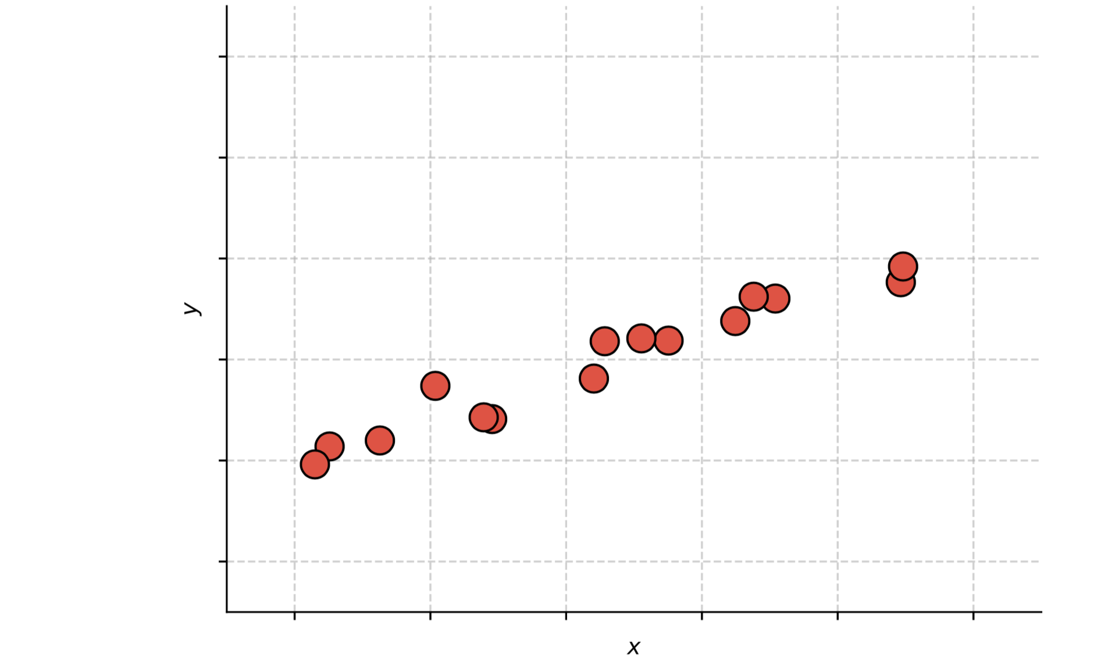
Support Vector Regression
Training: find the flattest function that can fit the training data inside a tube of radius $ε$
Inference: prediction is based on: $\hat{y}=\left\langle w,x\right\rangle +b$

Slide 36
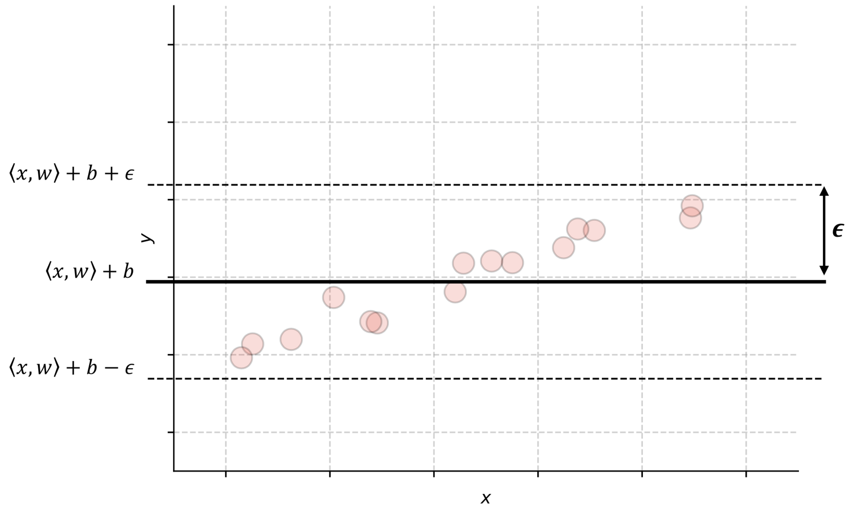
Support Vector Regression
Training: find the flattest function that can fit the training data inside a tube of radius $ε$
Inference: prediction is based on: $\hat{y}=\left\langle w,x\right\rangle +b$
Flat function = does not change much with parameters, i.e. small $\left\|w\right\|$
We need to find the smallest $\left\|w\right\|$ for which the prediction error is at most $ε:$
$$min{\left\|w\right\|}^{2}$$
$$subject to \left|y_{i}−\left(\left\langle w,x_{i}\right\rangle +b\right)\right|≤ε$$
Extreme case: we can fit all data points with a function that does not change at all, i.e. $\left\|w\right\|=0$.

Slide 37
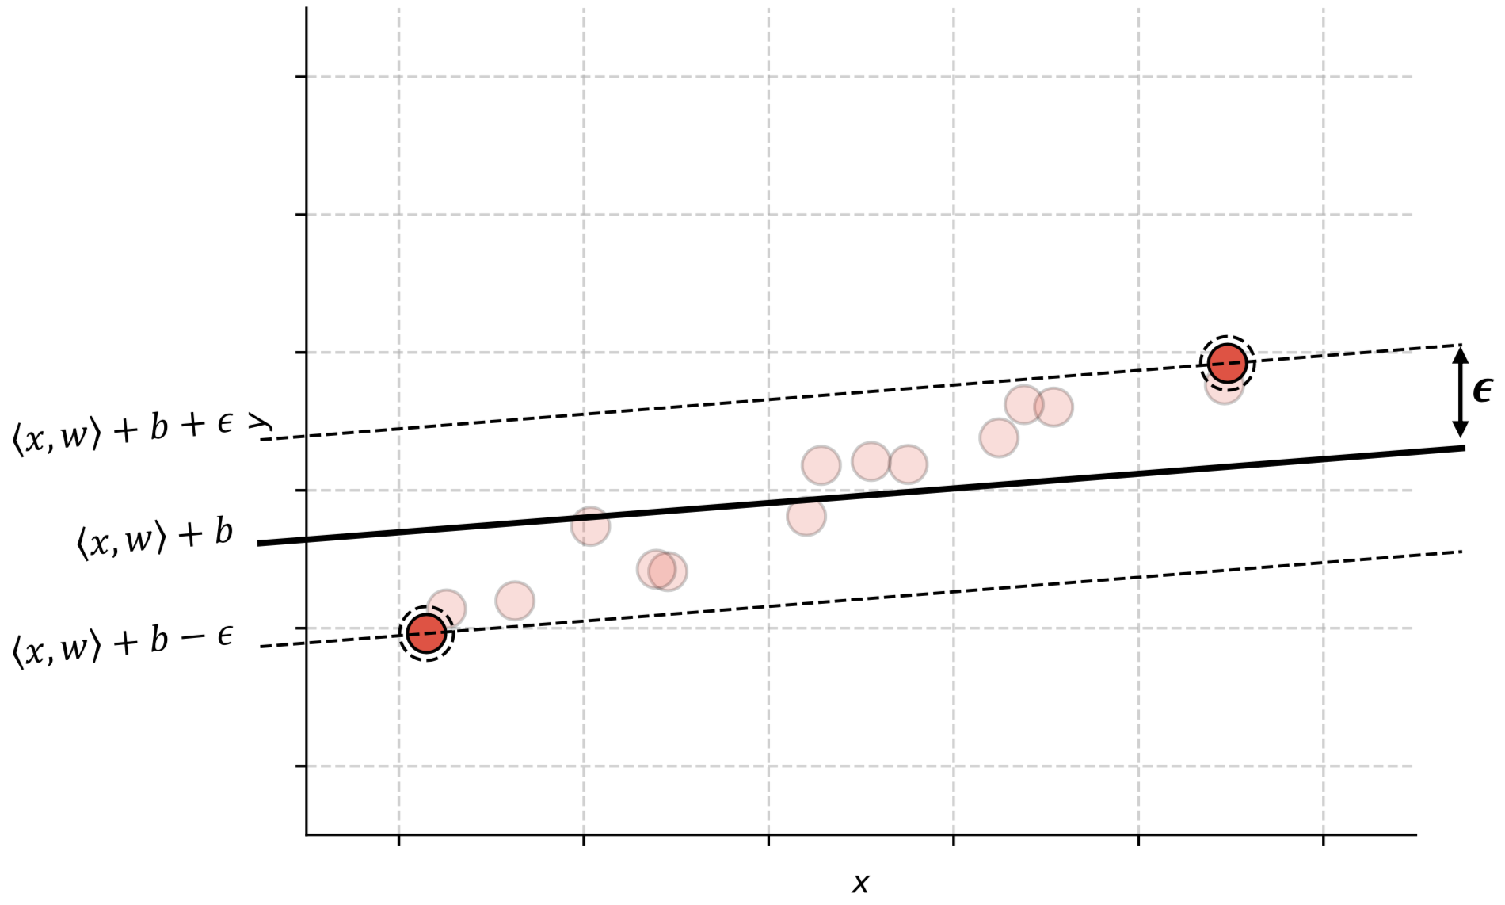
Support Vector Regression
Training: find the flattest function that can fit the training data inside a tube of radius $ε$
Inference: prediction is based on: $\hat{y}=\left\langle w,x\right\rangle +b$
Flat function = does not change much with parameters, i.e. small $\left\|w\right\|$
We need to find the smallest $\left\|w\right\|$ for which the prediction error is at most $ε:$
$$min{\left\|w\right\|}^{2}$$
$$subject to \left|y_{i}−\left(\left\langle w,x_{i}\right\rangle +b\right)\right|≤ε$$
When $ε$is small, $w$ and $b$ need to be adjusted in order to fit all data points.

Slide 38
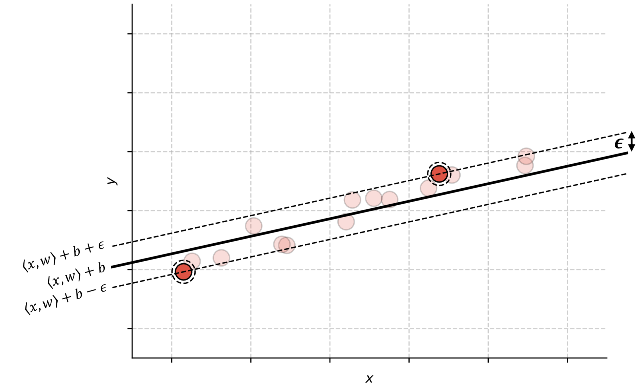
Support Vector Regression
Training: find the flattest function that can fit the training data inside a tube of radius $ε$
Inference: prediction is based on: $\hat{y}=\left\langle w,x\right\rangle +b$
Flat function = does not change much with parameters, i.e. small $\left\|w\right\|$
We need to find the smallest $\left\|w\right\|$ for which the prediction error is at most $ε:$
$$min{\left\|w\right\|}^{2}$$
$$subject to \left|y_{i}−\left(\left\langle w,x_{i}\right\rangle +b\right)\right|≤ε$$
When $ε$is small, $w$ and $b$ need to be adjusted in order to fit all data points.

Slide 39
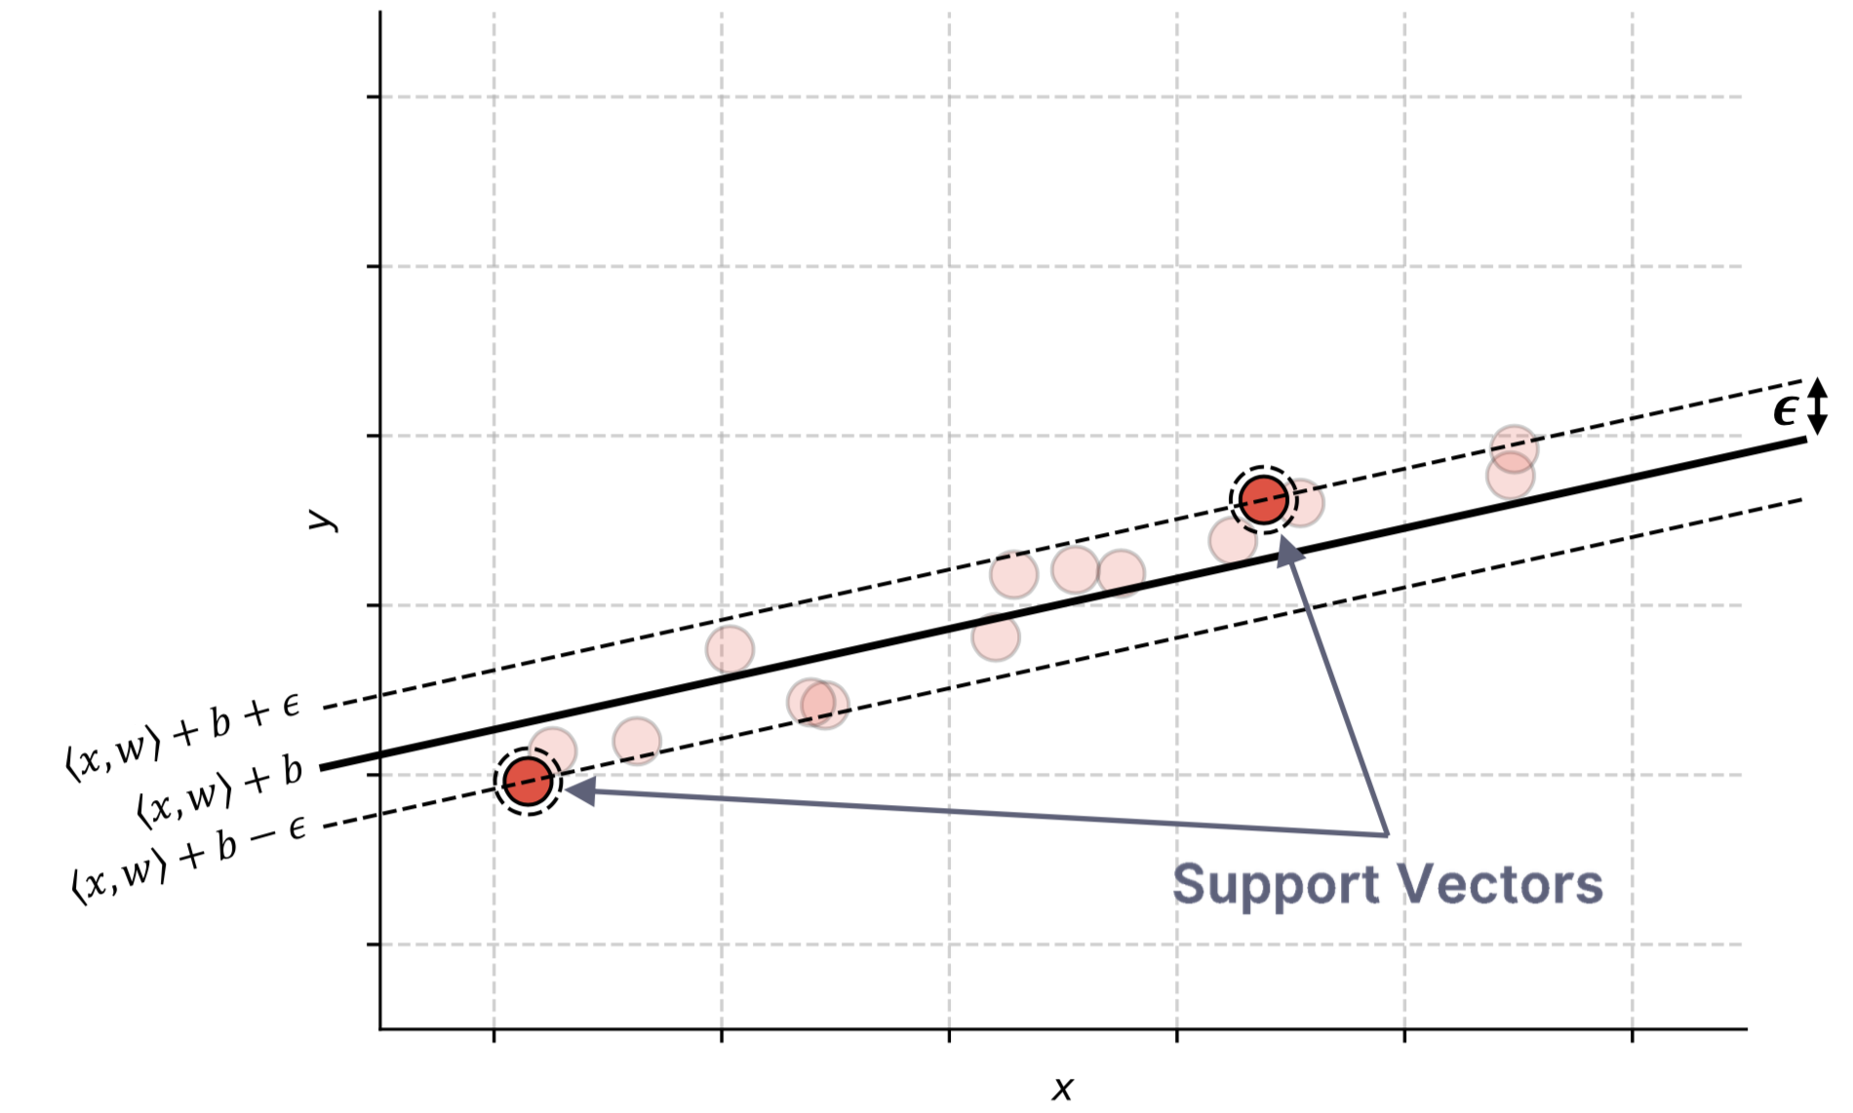
Support Vector Regression
Training: find the flattest function that can fit the training data inside a tube of radius $ε$
Inference: prediction is based on: $\hat{y}=\left\langle w,x\right\rangle +b$
Flat function = does not change much with parameters, i.e. small $\left\|w\right\|$
We need to find the smallest $\left\|w\right\|$ for which the prediction error is at most $ε:$
$$min{\left\|w\right\|}^{2}$$
$$subject to \left|y_{i}−\left(\left\langle w,x_{i}\right\rangle +b\right)\right|≤ε$$
The model can be expressed only in terms of the scalar product of some training samples (support vectors), i.e. we can apply kernel functions

Slide 40
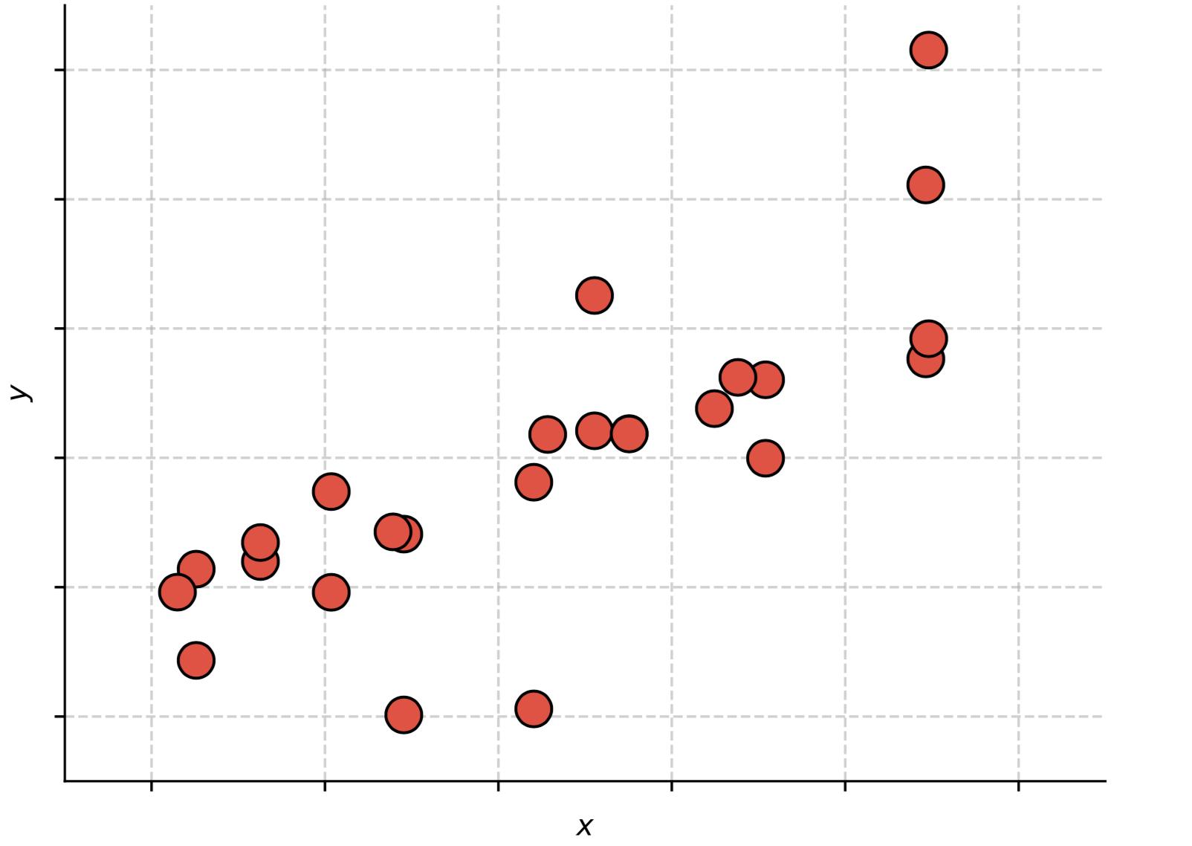
SVR (Soft Margin)
Training: find the flattest function that can fit the training data inside a tube of radius $ε$
Inference: prediction is based on: $\hat{y}=\left\langle w,x\right\rangle +b$
Sometimes it is not reasonable to find a function that fits all training samples inside a tube of radius $ε$

Slide 41
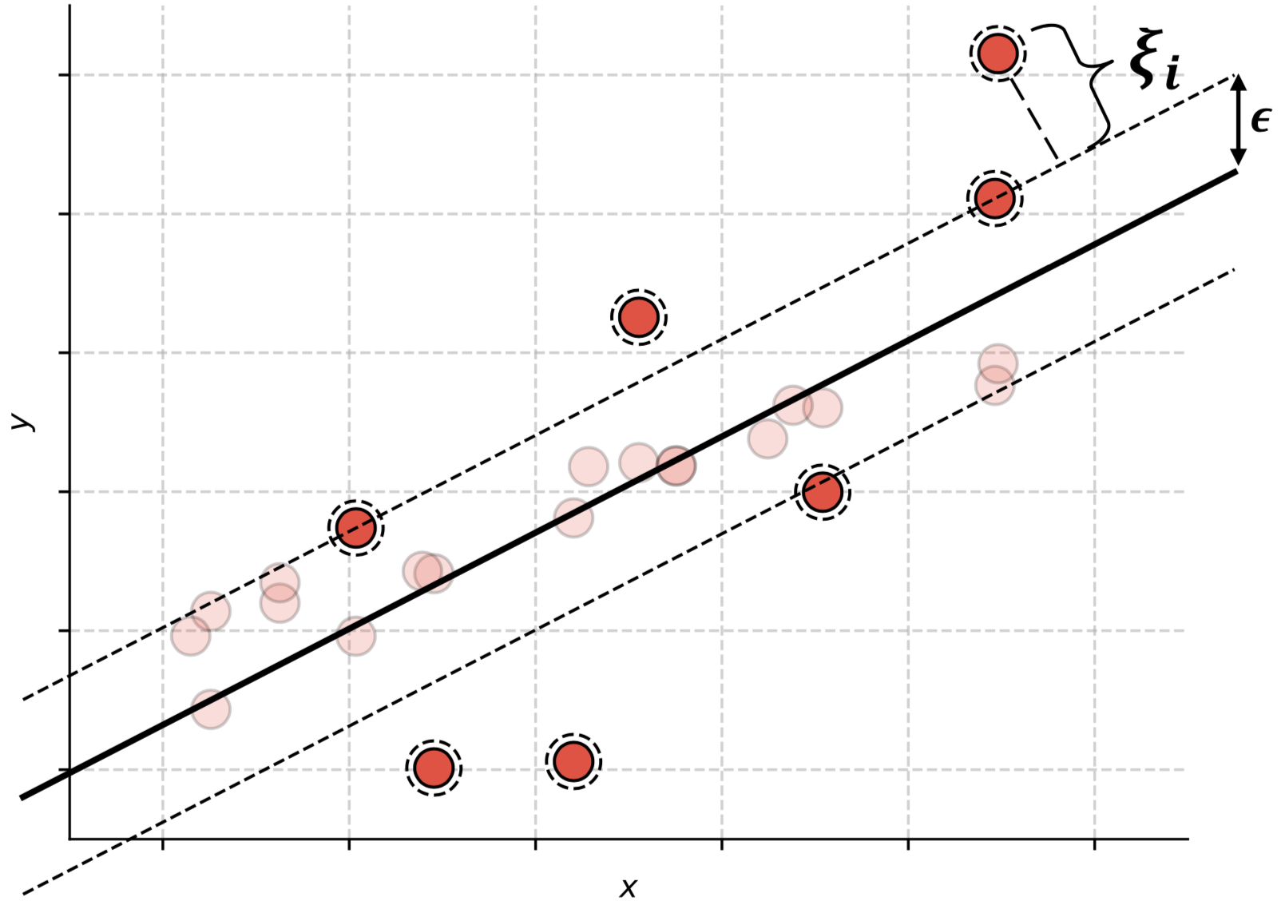
SVR (Soft Margin)
Training: find the flattest function that can fit the training data inside a tube of radius $ε$
Inference: prediction is based on: $\hat{y}=\left\langle w,x\right\rangle +b$
Sometimes it is not reasonable to find a function that fits all training samples inside a tube of radius $ε$
We introduce slack variables$:$
$$min{\left\|w\right\|}^{2}+C\sum_{i}{ξ_{i} }$$
$$subject to \left|y_{i}−\left(\left\langle w,x_{i}\right\rangle +b\right)\right|≤ε+ξ_{i}$$
We define the $ε$-insensitive loss:
$$L\left(x_{i}\right)=\max\left(0,\left|y_{i}−\left(\left\langle w,x_{i}\right\rangle +b\right)\right|−ε\right)$$
And the optimization becomes:
$$min\left(C\sum_{i}{L\left(x_{i}\right)+{\left\|w\right\|}^{2}}\right)$$

Slide 42
How do we solve many class problems?
Schemes for combining multiple binary classifiers:
1) One-versus-one
2) One-versus-all

Slide 43
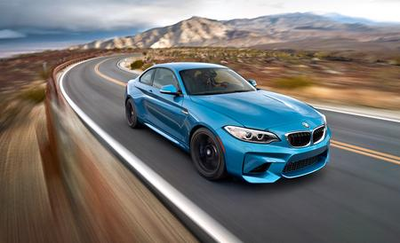
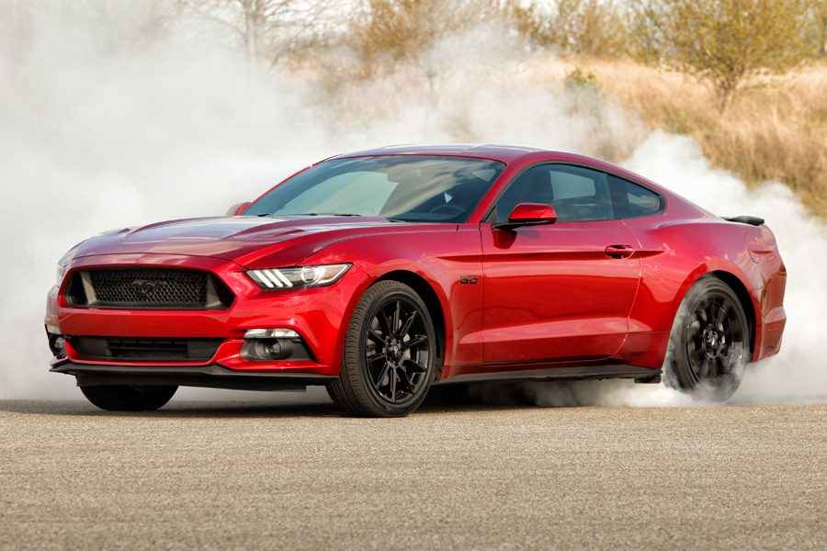
One-versus-one

Slide 44
One-versus-all

Slide 45
How do we solve many class problems?
Using classification methods able to handle the multi-class problem directly:
1) Linear (Fisher) Discriminant Analysis
2) Neural Networks (Lectures 7, 8, 9)
3) Random forests (Lecture 5)

Slide 46
Linear Discriminant Analysis
Each class is approximated with a multinomial Gaussian distribution
The optimization algoritm is based on finding a hyperplane to project the data points such that:
The distance among class means is maximized
The variance of each class is minimized

Slide 47
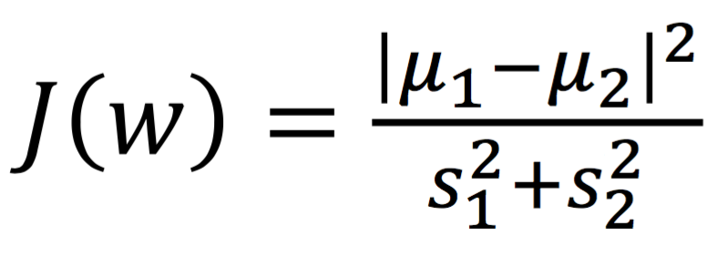
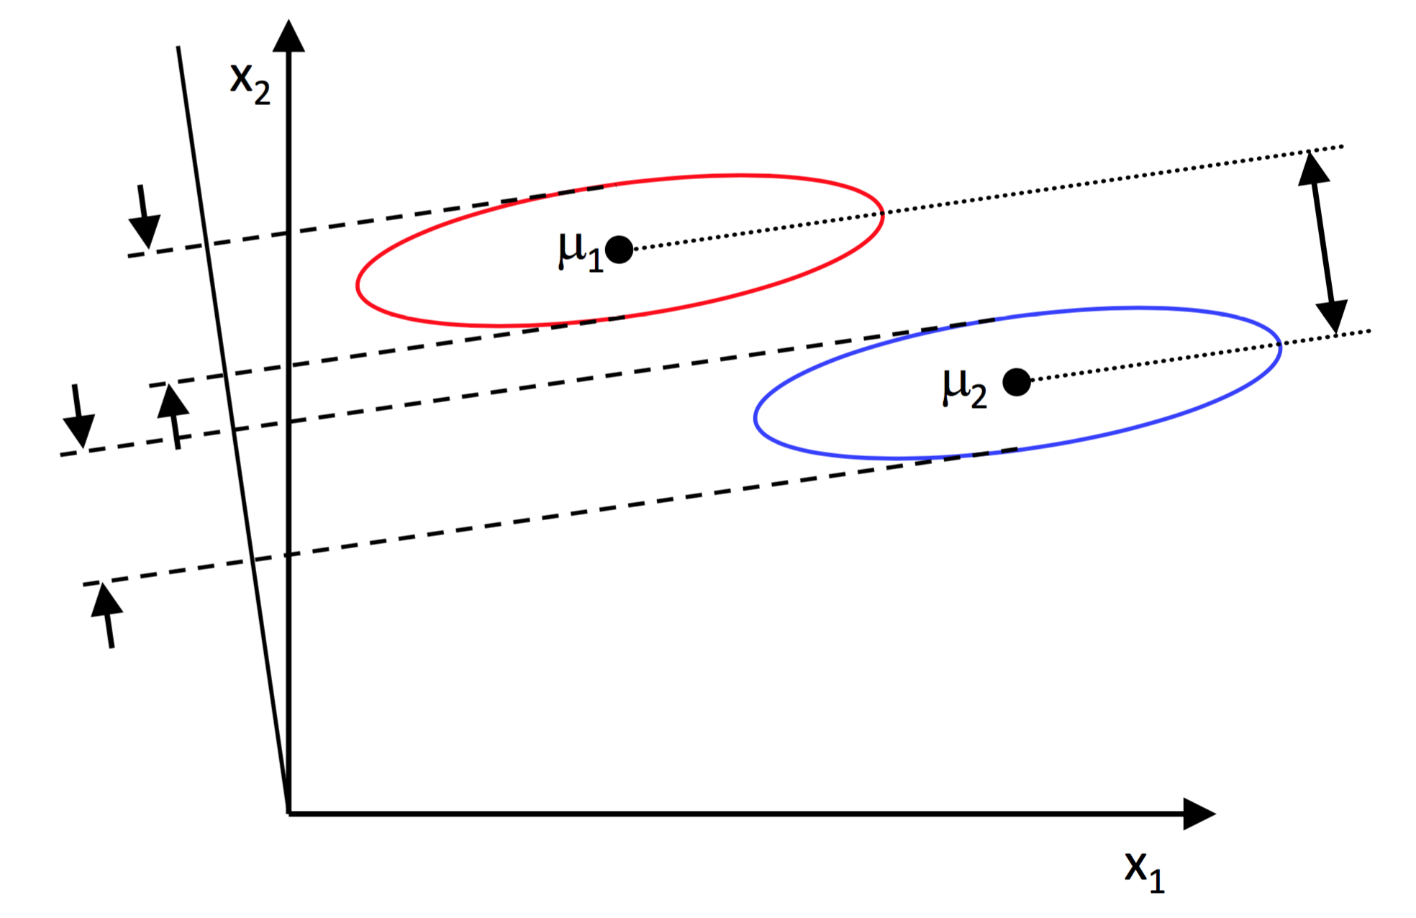
Linear Discriminant Analysis

Slide 48
Linear Discriminant Analysis (Python)
Scikit-learn:
https://scikit-learn.org/stable/modules/generated/sklearn.discriminant_analysis.LinearDiscriminantAnalysis.html#sklearn.discriminant_analysis.LinearDiscriminantAnalysis
from sklearn.discriminant_analysis
import LinearDiscriminantAnalysis
clf = LinearDiscriminantAnalysis()
clf.fit(X_train, T_train)
Y_test = clf.predict(X_test)

Slide 49
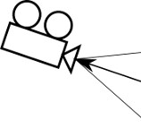
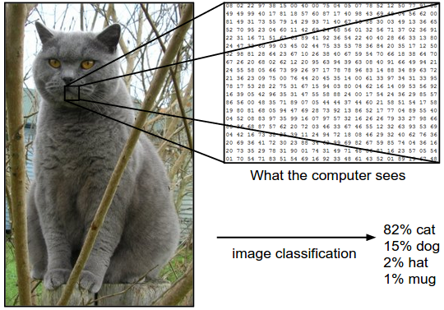
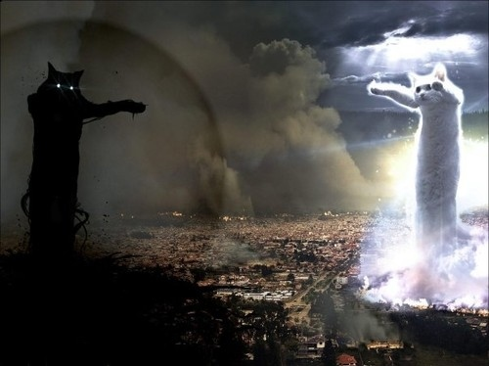
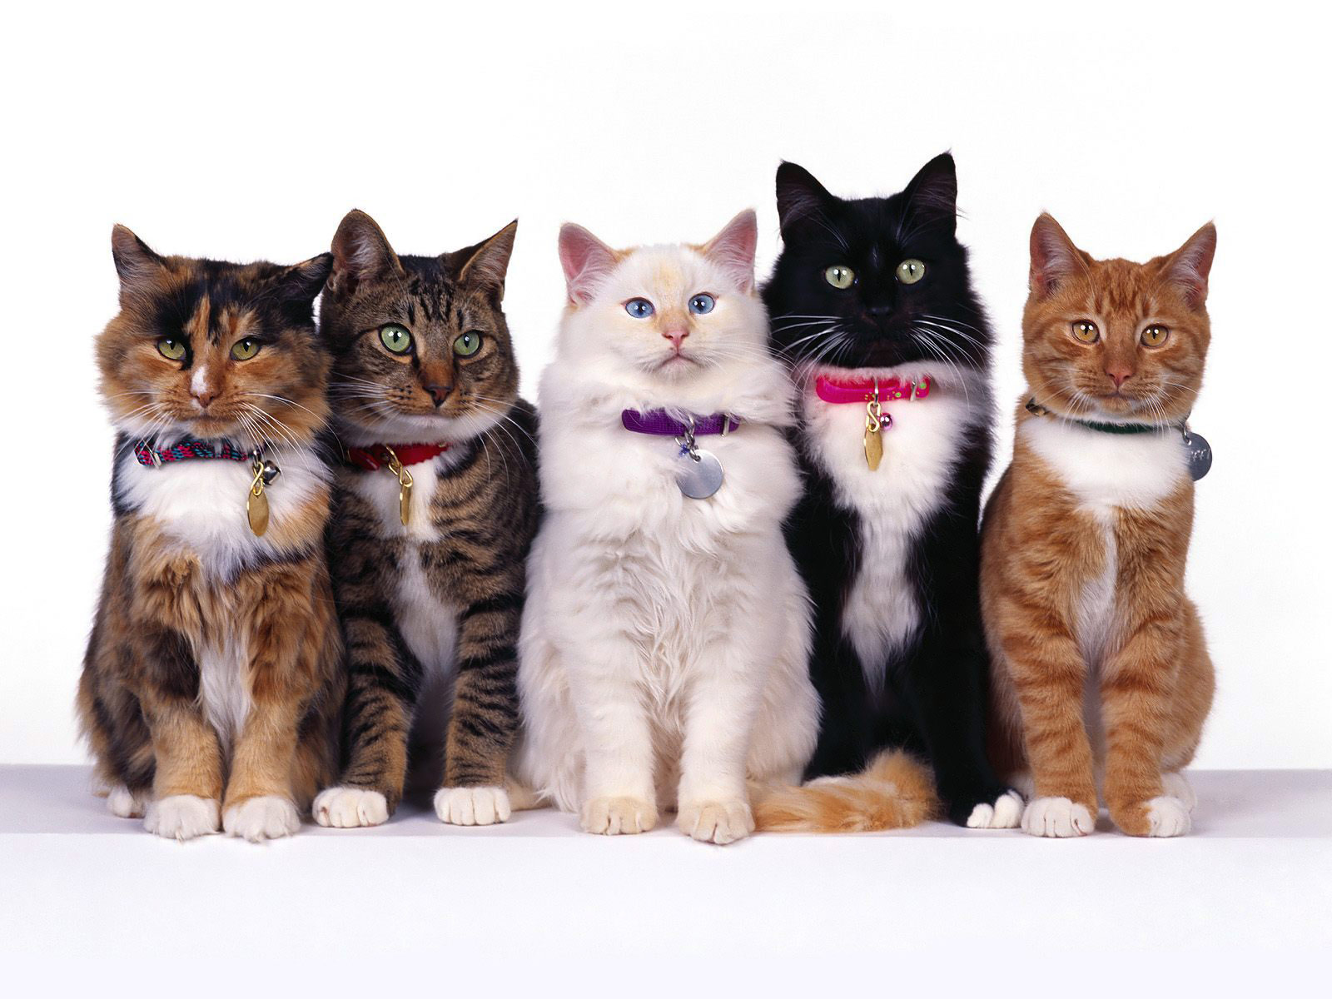
Intra-class variation
Camera angle
Illumination
Deformation
Occlusion
Confusing background
Intra-class variation

Slide 50
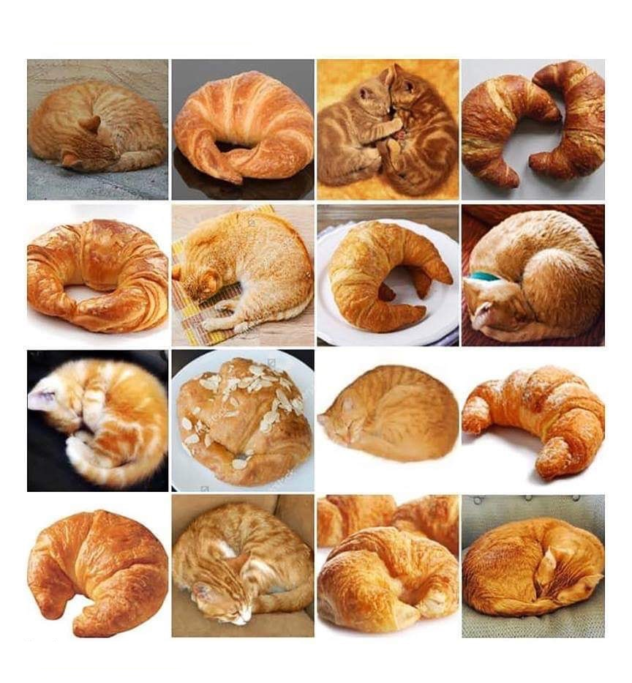
Inter-class similarity

Slide 51
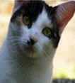
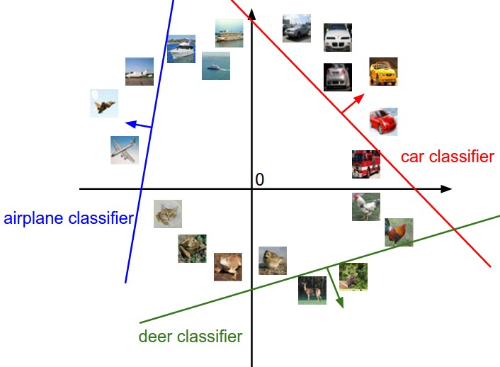
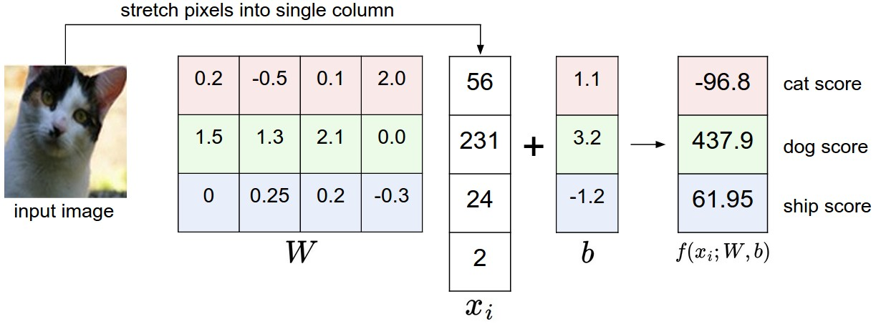
Linear classifier for the multi-class problem
features
parameters
f(x,W)
N values that indicate the scores for each class
Feature vector

Slide 52
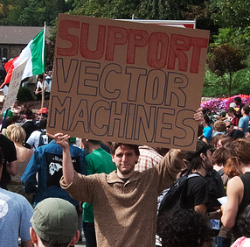
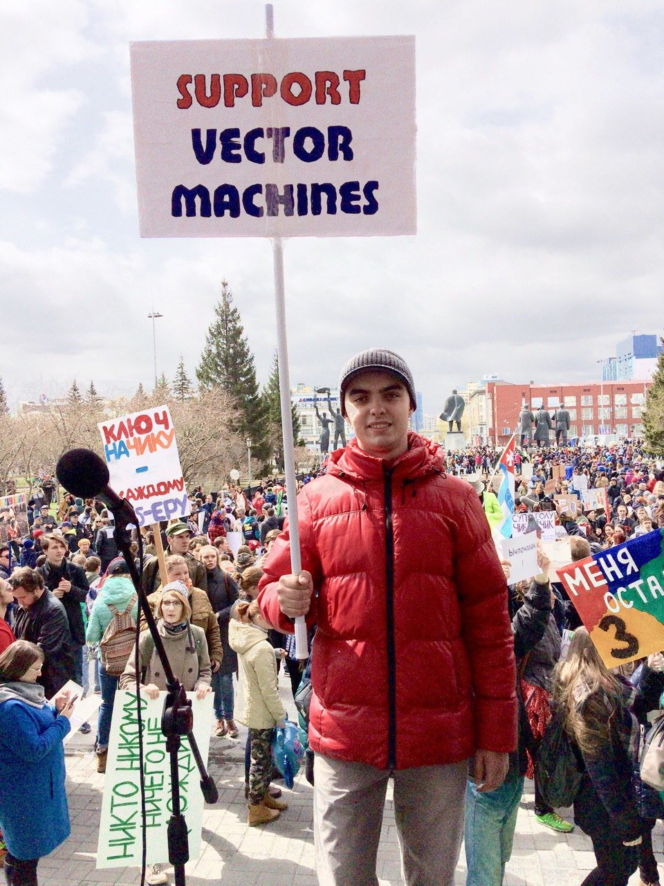
Linear classifier for the multi-class problem

Slide 53
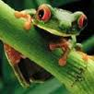
Suppose: 3 training examples, 3 classes.
With some W the scores $f\left(x,W\right)=Wx$ are:
Multiclass SVM loss:
Given an example $\left(x_{i},y_{i}\right)$,
where $x_{i}$is the image and
where $y_{i}$is the (integer) label,
and using the shorthand for the scores vector:
the SVM loss has the form:
cat
3.2
1.3
2.2
car
5.1
4.9
2.5
frog
-1.7
2.0
-3.1

Slide 54
Suppose: 3 training examples, 3 classes.
With some W the scores $f\left(x,W\right)=Wx$ are:
Multiclass SVM loss:
Given an example $\left(x_{i},y_{i}\right)$,
where $x_{i}$is the image and
where $y_{i}$is the (integer) label,
and using the shorthand for the scores vector:
the SVM loss has the form:
cat
3.2
1.3
2.2
car
5.1
4.9
2.5
frog
-1.7
2.0
-3.1
= max(0, 5.1 - 3.2 + 1)
+max(0, -1.7 - 3.2 + 1)
= max(0, 2.9) + max(0, -3.9)
= 2.9 + 0
= 2.9
Losses:
2.9

Slide 55
Suppose: 3 training examples, 3 classes.
With some W the scores $f\left(x,W\right)=Wx$ are:
Multiclass SVM loss:
Given an example $\left(x_{i},y_{i}\right)$,
where $x_{i}$is the image and
where $y_{i}$is the (integer) label,
and using the shorthand for the scores vector:
the SVM loss has the form:
cat
3.2
1.3
2.2
car
5.1
4.9
2.5
frog
-1.7
2.0
-3.1
= max(0, 1.3 - 4.9 + 1)
+max(0, 2.0 - 4.9 + 1)
= max(0, -2.6) + max(0, -1.9)
= 0 + 0
= 0
Losses:
2.9
0

Slide 56
Suppose: 3 training examples, 3 classes.
With some W the scores $f\left(x,W\right)=Wx$ are:
Multiclass SVM loss:
Given an example $\left(x_{i},y_{i}\right)$,
where $x_{i}$is the image and
where $y_{i}$is the (integer) label,
and using the shorthand for the scores vector:
the SVM loss has the form:
cat
3.2
1.3
2.2
car
5.1
4.9
2.5
frog
-1.7
2.0
-3.1
= max(0, 2.2 - (-3.1) + 1)
+max(0, 2.5 - (-3.1) + 1)
= max(0, 6.3) + max(0, 6.6)
= 6.3 + 6.6
= 12.9
Losses:
2.9
0
12.9

Slide 57
Suppose: 3 training examples, 3 classes.
With some W the scores $f\left(x,W\right)=Wx$ are:
Multiclass SVM loss:
Given an example $\left(x_{i},y_{i}\right)$,
where $x_{i}$is the image and
where $y_{i}$is the (integer) label,
and using the shorthand for the scores vector:
the SVM loss has the form:
cat
3.2
1.3
2.2
car
5.1
4.9
2.5
frog
-1.7
2.0
-3.1
L = (2.9 + 0 + 12.9)/3
= 5.27
Losses:
2.9
0
12.9

Slide 58
Softmax (Multinomial Logistic Regression)
scores = unnormalized log probabilities of the classes
Want to maximize the log likelihood, or (for a loss function)
to minimize the negative log likelihood of the correct class:
where
Softmax function
cat
3.2
car
5.1
frog
-1.7
In summary:

Slide 59
Softmax (Multinomial Logistic Regression)
Q: What is the min/max possible loss L_{i}?
unnormalized probabilities
cat
3.2
24.5
0.13
L_{i} = -log(0.13)
= 0.89
exp
normalize
car
5.1
164.0
0.87
frog
-1.7
0.18
0.00
unnormalized log probabilities
probabilities

Slide 60
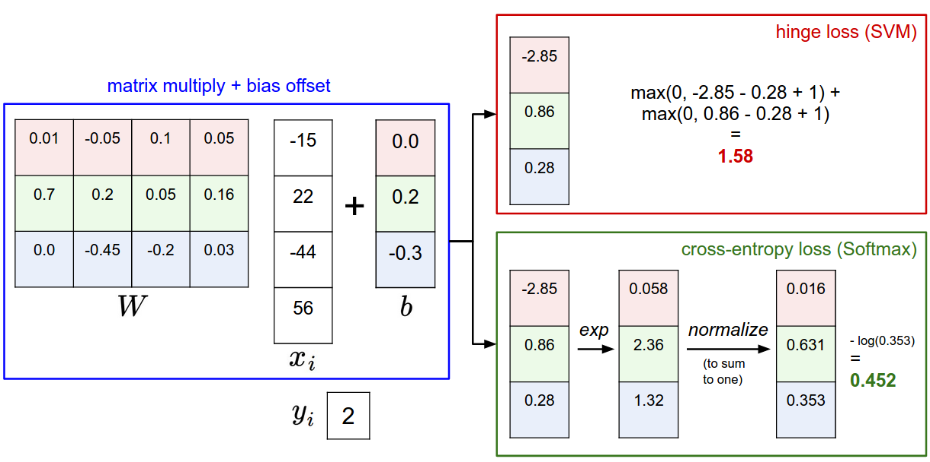

Slide 61
Softmax vs. SVM
Assume scores:
[10, -2, 3]
[10, 9, 9]
[10, -100, -100]
and
Q: Suppose we take a datapoint and we add some small perturbations (changing its score slightly). What happens to the loss in both cases?

Slide 62
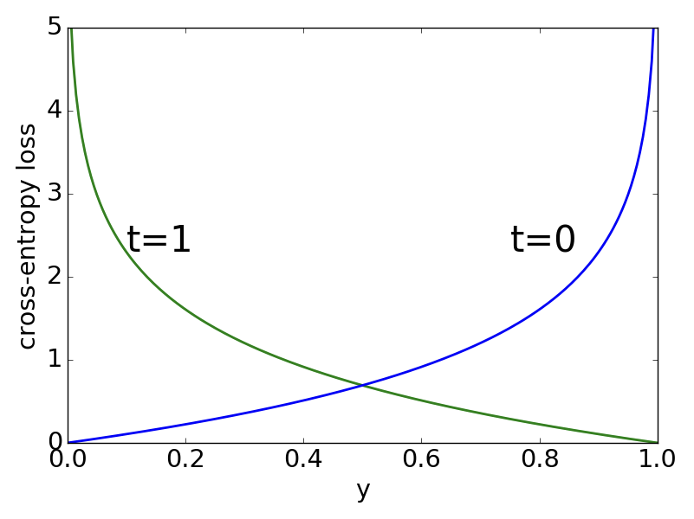
Binary cross-entropy loss
Binary cross-entropy (logistic) loss:
$$L_{i}=−\left(t_{i}∙log\left(y_{i}\right)+(1−t_{i})∙log(1−y_{i})\right)$$
where $t_{i}$ is the ground-truth binary label (0 or 1) of sample $x_{i}$,
and${ y}_{i}$ is the prediction for the same sample

Slide 63
What is the best classification method?
“No free lunch” theorem:
Any two algorithms are equivalent when their (average) performance is measured on all possible tasks
It follows that there is no shortcut in choosing the right algorithm for you task
Usually, you have to try several and see which one works best
Intuition and experience will be useful

Slide 64
Bibliography

Slide 66
