Slide 1
Neural Networks.
Introduction to Deep Learning.
Radu Ionescu, Prof. PhD.
raducu.ionescu@gmail.com
Faculty of Mathematics and Computer Science
University of Bucharest

Slide 2
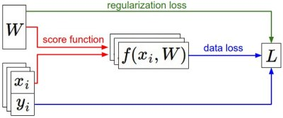
From previous lecture:
We have some dataset of (x,y)
We have a score function:
We have a loss function:
e.g.
Softmax
SVM
Full loss

Slide 3
Gradient Descent Algorithm

Slide 4
Gradient Evaluation
1) Numerical approach
We choose a small positive h and apply the formula:
We obtain an approximate value
Very slow to compute
2) Analytic approach
We use calculus to determine the gradient’s formula as a function of X and W

Slide 5
In summary:
Numerical gradient: approximate, slow, easy to write
Analytic gradient: exact, fast, error-prone
=>
In practice: Always use analytic gradient, but check implementation with numerical gradient. This is called a gradient checking.

Slide 6
Gradient Descent (Python)
def GD(W0, X, goal, learningRate):
perfGoalNotMet = true
W = W0
while perfGoalNotMet:
gradient = eval_gradient(X, W)
W_old = W
W = W – learningRate * gradient
perfGoalNotMet = sum(abs(W - W_old)) > goal

Slide 7
From feature extract to end-to-end learning
vector describing various image statistics
f
Feature Extraction
N numbers, indicating class scores
training
[32x32x3]
f
N numbers, indicating class scores
training
[32x32x3]

Slide 8
Computational Graph
x
*
s (scoruri)
Hinge loss
+
L
W
R

Slide 9
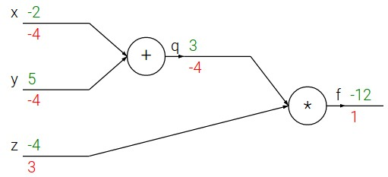
e.g. x = -2, y = 5, z = -4
Chain rule:
vrem:

Slide 10
Gradient propagation using chain rule
activations
f
“local gradient”
gradients

Slide 11
From previous lecture…
Neural nets will be very large: no hope of writing down gradient formula by hand for all parameters
Backpropagation = recursive application of the chain rule along a computational graph to compute the gradients of all inputs / parameters / intermediates
Implementations maintain a graph structure, where the nodes implement the forward() / backward() API
Forward: compute result of an operation and save any intermediates needed for gradient computation in memory
Backward: apply the chain rule to compute the gradient of the loss function with respect to the inputs

Slide 12
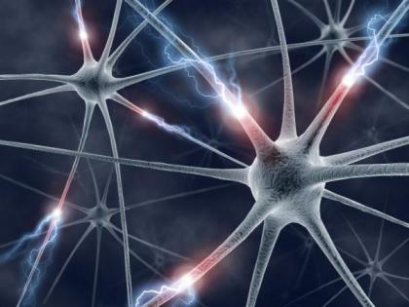

Slide 13
Neural Network: without the brain stuff
(Before) Linear score function:
(Now) 2-layer Neural Network
x
h
W1
W2
s
3072
100
10

Slide 14
Neural Network: without the brain stuff
(Before) Linear score function:
(Now) 2-layer Neural Network
or 3-layer Neural Network

Slide 16
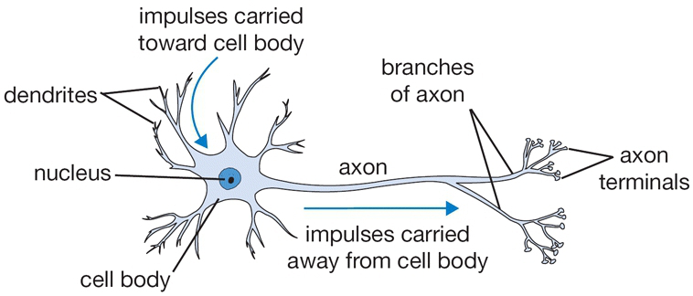
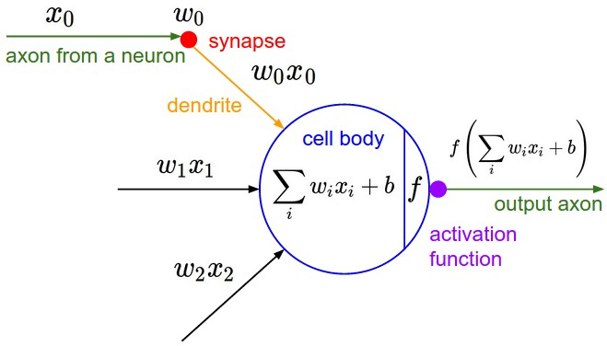
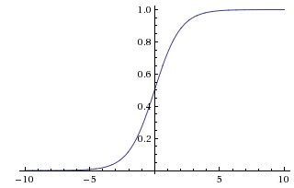
sigmoid activation

Slide 17
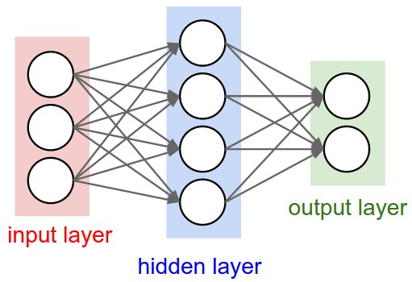
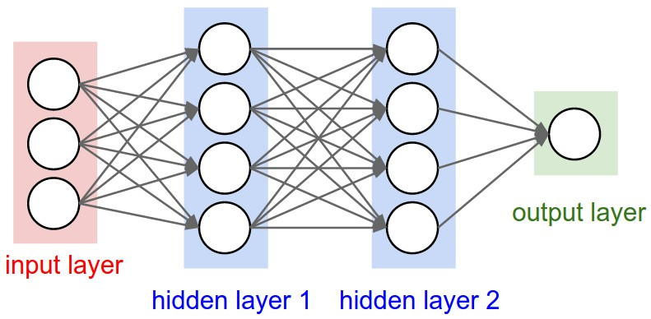
Neural Networks: Architectures
2-layer Neural Net
(1-hidden-layer Neural Net)
3-layer Neural Net
(2-hidden-layer Neural Net)
“Fully-connected” layers

Slide 18
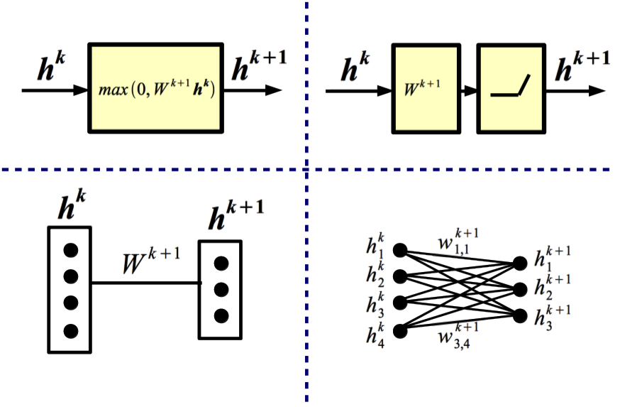
Equivalent Representations

Slide 19
Training a 2-layer Neural Network needs ~11 lines (Python)
X = np.array([[0,0,1],[0,1,1],[1,0,1],[1,1,1]])
Y = np.array([[0,1,1,0]]).T
W0 = 2 * np.random.random((3,4)) - 1
W1 = 2 * np.random.random((4,1)) - 1
for i in range(5000):
# forward pass
l1 = 1 / (1 + np.exp(-np.matmul(X, W0)))
l2 = 1 / (1 + np.exp(-np.matmul(l1, W1)))
# backward pass
delta_l2 = (Y - l2) * (l2 * (1 - l2))
delta_l1 = np.matmul(delta_l2, W1.T) * (l1 * (1 - l1))
# gradient descent
W1 = W1 + np.matmul(l1.T, delta_l2)
W0 = W0 + np.matmul(X.T, delta_l1)

Slide 20
The 2-layer neural network implemented in the previous slide
w_{1,1}
$$Σ$$
w_{2,1}
w_{1,1}
x_{i,1}
w_{3,1}
b_{1,1}
$$Σ$$
w_{2,1}
x_{i,2}
$$Σ$$
y
b_{1,2}
w_{3,1}
$$Σ$$
b_{1,1}
x_{i,3}
w_{2,4}
w_{1,4}
w_{4,1}
b_{1,3}
w_{3,4}
$$Σ$$
w_{1,1}
w_{2,1}
w_{3,1}
w_{4,1}
w_{1,1} w_{1,2} w_{1,3} w_{1,4}
w_{2,1} w_{2,2} w_{2,3} w_{2,4}
w_{3,1} w_{3,2} w_{3,3} w_{3,4}
W₁ =
W₀ =
b_{1,4}

Slide 21
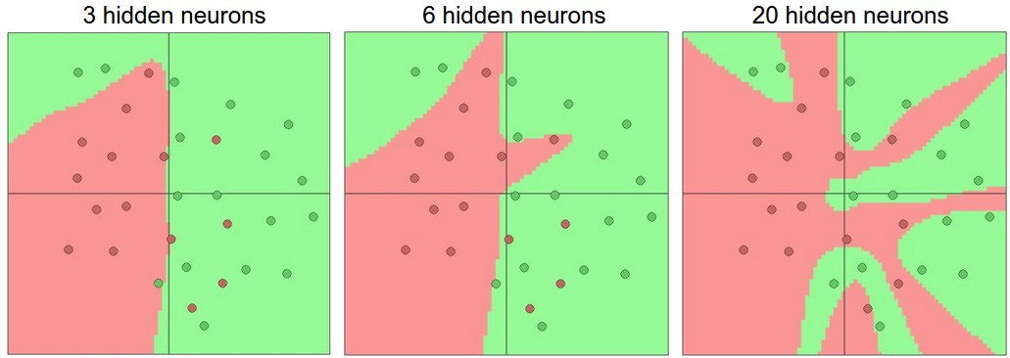
Setting the number of layers and their sizes
more neurons = more capacity

Slide 22
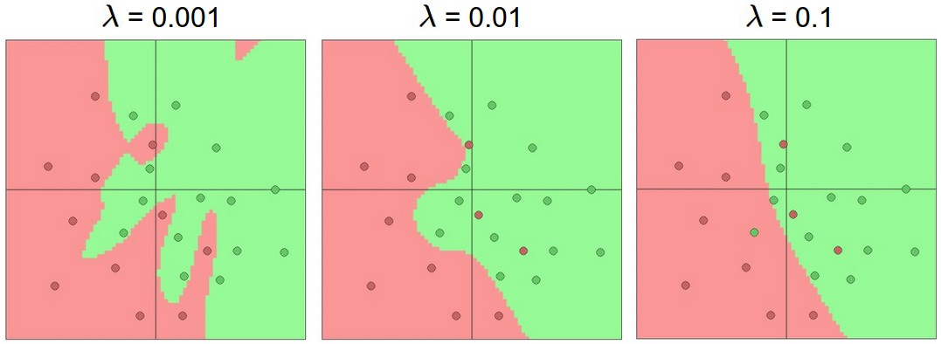
Do not use size of neural network as a regularizer. Use stronger regularization instead:
Practical advice: In general, it is better to use stronger regularization than reducing the model’s capacity

Slide 23
Choosing the right architecture
We arrange neurons into fully-connected layers
The abstraction of a layer has the nice property that it allows us to use efficient vectorized code (e.g. matrix multiplies)
neural networks: bigger = better (but might have to regularize more strongly)

Slide 24
Training Neural Networks

Slide 25
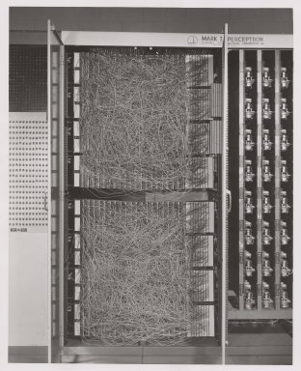
A bit of history
The Mark I Perceptron machine was the first implementation of the perceptron algorithm.
The machine was connected to a camera that used 20×20 cadmium sulfide photocells to produce a 400-pixel image.
Recognized
letters of the alphabet.
Update rule:
Frank Rosenblatt, ~1957: Perceptron

Slide 26
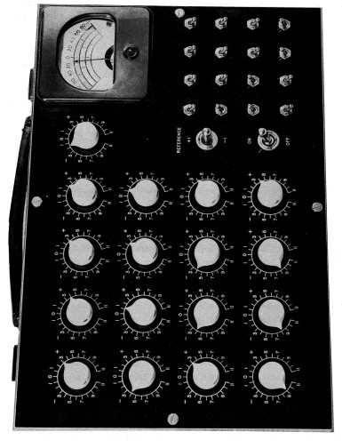
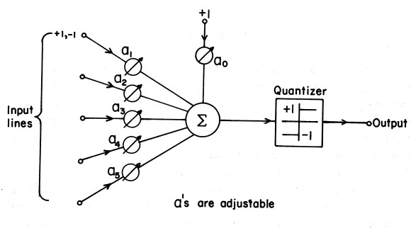
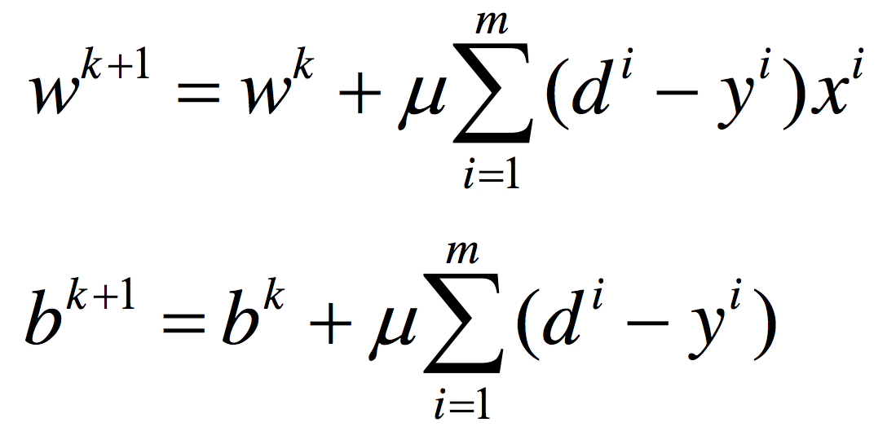
A bit of history
The ADALINE machine is based on memistors capable of executing logical operations and storing information.
Loss (sum squared error):
Update rule:
Widrow and Hoff, ~1960: Adaline

Slide 27
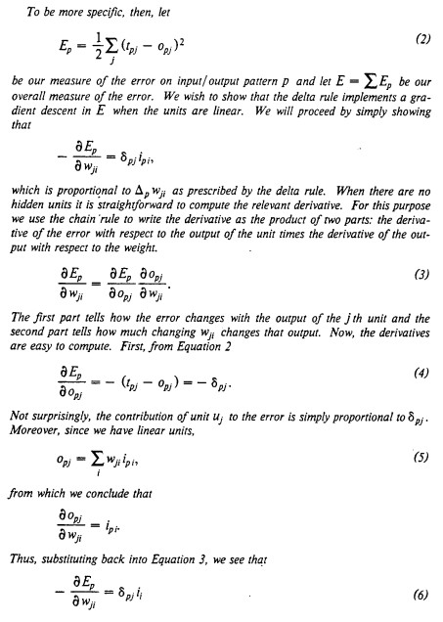
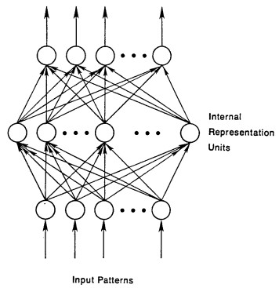
A bit of history
recognizable maths
Hinton et al. 1986: First time back-propagation became popular

Slide 28
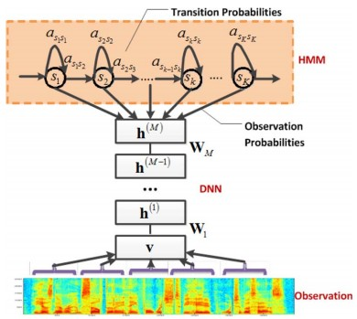
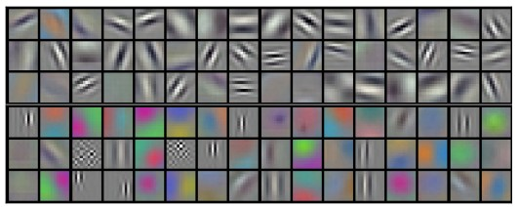
First strong results with deep learning
Context-Dependent Pre-trained Deep Neural Networks
for Large Vocabulary Speech Recognition
George Dahl, Dong Yu, Li Deng, Alex Acero, 2010
Imagenet classification with deep convolutional
neural networks
Alex Krizhevsky, Ilya Sutskever, Geoffrey E Hinton, 2012

Slide 29
Overview
1. One time setup
activation functions, preprocessing, weight initialization, regularization, gradient checking
2. Training dynamics
babysitting the learning process,
parameter updates, hyperparameter optimization
3. Evaluation
model ensembles

Slide 30
Activation Functions

Slide 31
Activation Functions

Slide 32
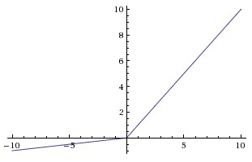
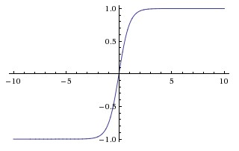
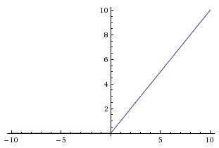
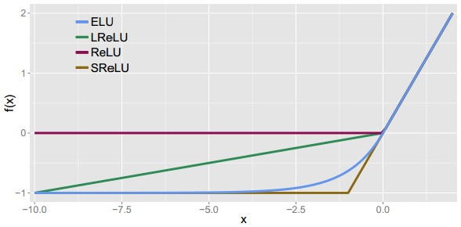
Activation Functions
Leaky ReLU
max(0.1x, x)
sigmoid
Maxout
tanh tanh(x)
ELU
ReLU max(0,x)

Slide 33
Activation Functions
Squashes numbers to range [0,1]
Historically popular since they have nice interpretation as a saturating “firing rate” of a neuron
3 problems:
Saturated neurons “kill” the gradients
sigmoid

Slide 34
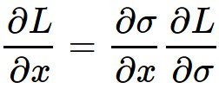
sigmoid
gate
x
What happens when x = -10?
What happens when x = 0?
What happens when x = 10?

Slide 35
Activation Functions
Squashes numbers to range [0,1]
Historically popular since they have nice interpretation as a saturating “firing rate” of a neuron
3 problems:
Saturated neurons “kill” the gradients
Sigmoid outputs are not zero-centered
sigmoid

Slide 36
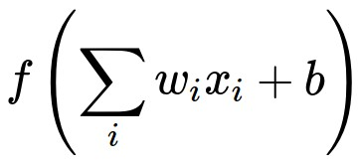
Consider what happens when the input to a neuron (x)
is always positive:
What can we say about the gradients on w?

Slide 37
Consider what happens when the input to a neuron is always positive...
allowed gradient update directions
zig zag path
allowed gradient update directions
hypothetical optimal w vector
What can we say about the gradients on w?
Always all positive or all negative :(
Note: this is also why you want zero-mean data!

Slide 38
Activation Functions
Squashes numbers to range [0,1]
Historically popular since they have nice interpretation as a saturating “firing rate” of a neuron
3 problems:
Saturated neurons “kill” the gradients
Sigmoid outputs are not zero-centered
exp() is a bit computationally expensive
sigmoid

Slide 39
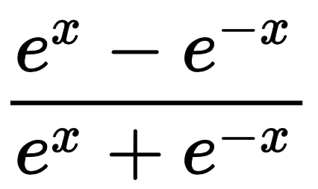
Activation Functions
Squashes numbers to range [-1,1]
zero centered (nice)
still kills gradients when saturated :(
tanh(x)
[LeCun et al., 1991]

Slide 40
Activation Functions
Does not saturate (in +region)
Very computationally efficient
Converges much faster than sigmoid/tanh in practice (e.g. 6x)
Not zero-centered output
An annoyance: what is the gradient when x < 0?
ReLU
(Rectified Linear Unit)
f(x) = max(0,x)
[Krizhevsky et al., 2012]

Slide 41
ReLU
gate
x
What happens when x = -10?
What happens when x = 0?
What happens when x = 10?

Slide 42
DATA CLOUD
active ReLU
People like to initialize ReLU neurons with slightly positive biases (e.g. 0.01)
dead ReLU
will never activate
=> never update

Slide 43
Activation Functions
Does not saturate
Computationally efficient
Converges much faster than sigmoid/tanh in practice! (e.g. 6x)
will not “die”
Parametric Rectifier (PReLU)
Leaky ReLU
backprop into $α$
(parameter)
[Mass et al., 2013]
[He et al., 2015]

Slide 44
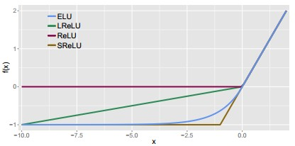
Activation Functions
Exponential Linear Units (ELU)
All benefits of ReLU
Does not die
Closer to zero mean outputs
Computation requires exp()
[Clevert et al., 2015]

Slide 45
Maxout “Neuron”
Does not have the basic form of dot product -> nonlinearity
Generalizes ReLU and Leaky ReLU
Linear Regime! Does not saturate! Does not die!
Problem: doubles the number of parameters/neurons :(
[Goodfellow et al., 2013]

Slide 46
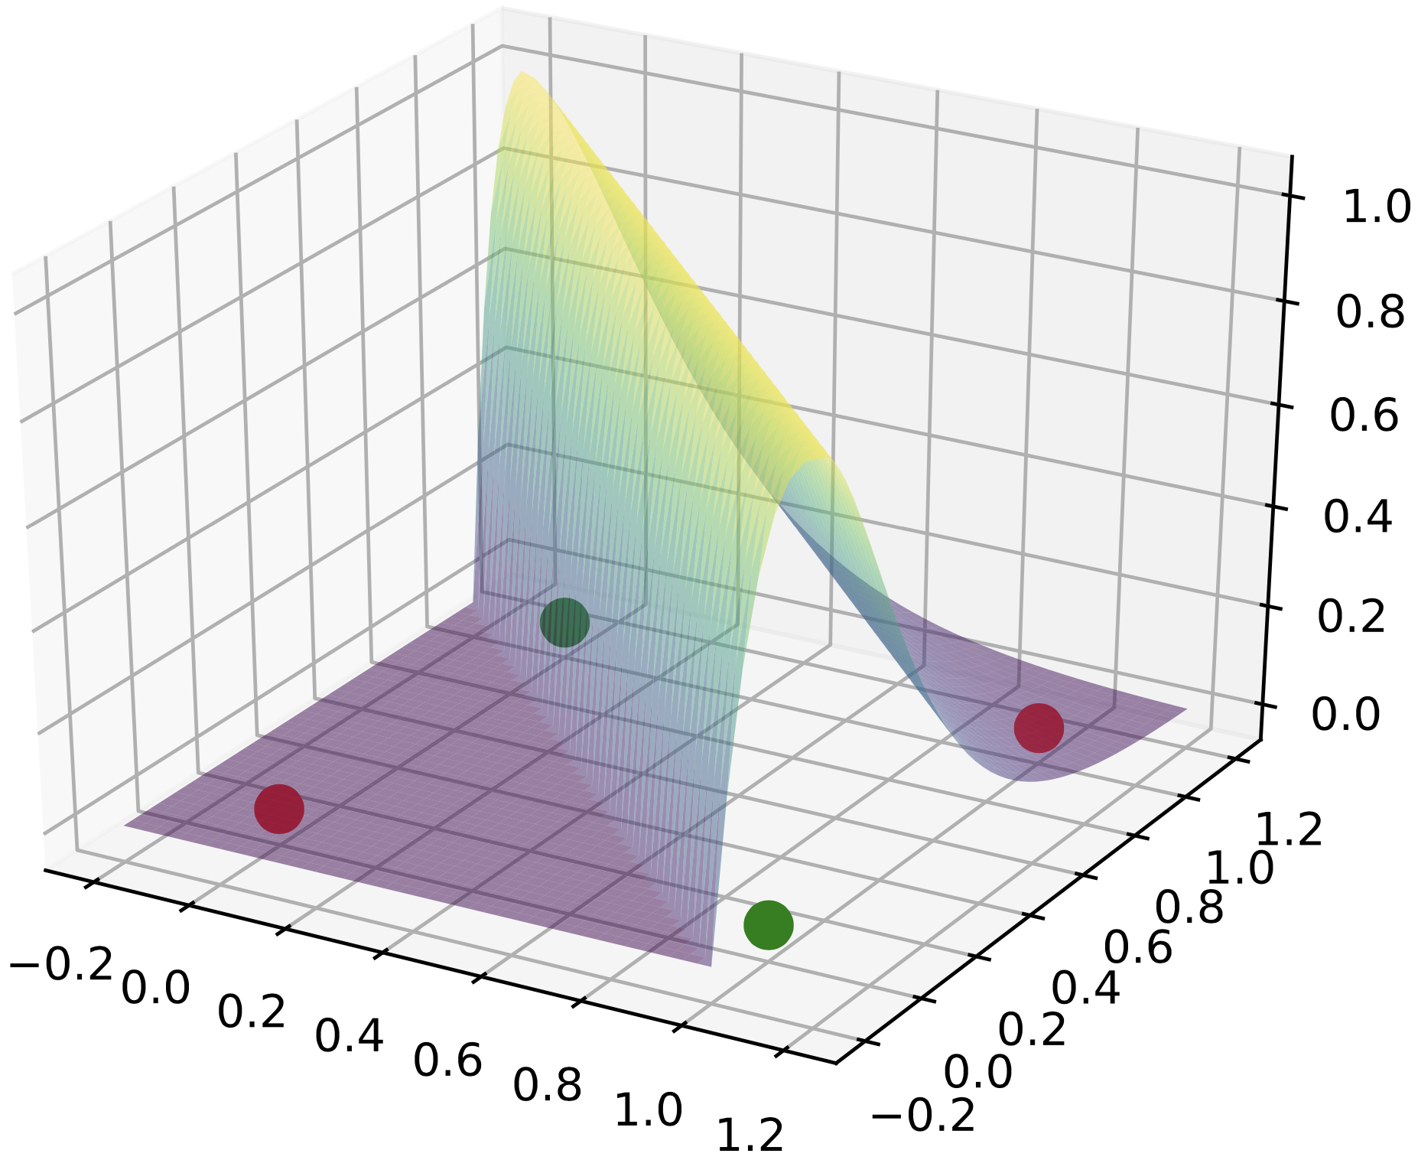
Apical Dendrite Activation (ADA)
Similar complexity to sigmoid
Enables one neuron to solve non-linear problems, e.g. XOR
$l∙\min\left(0,x\right)+max⁡(0,x)∙e^{−x∙α+c}$
Uses learnable hyperparameters (controllable saturation)
[Georgescu et al., 2023]

Slide 47
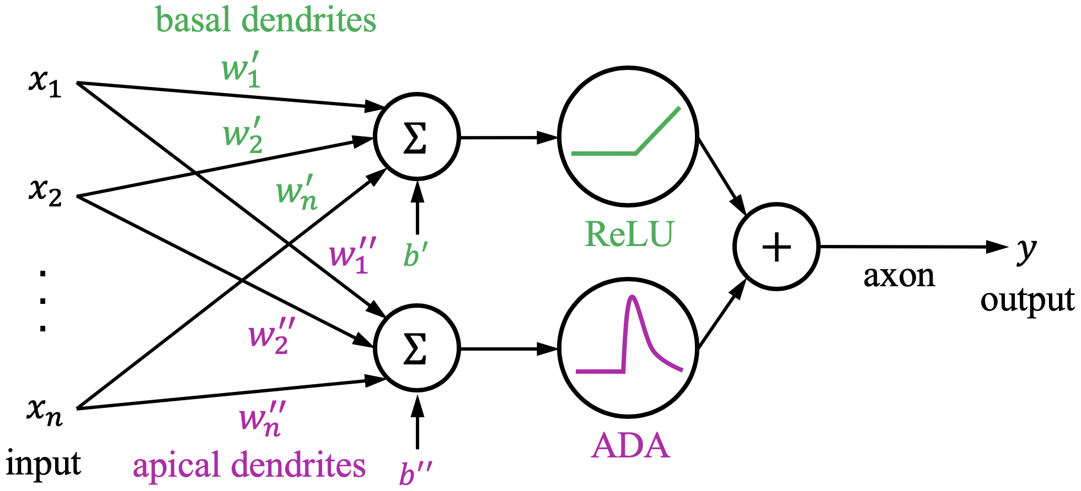
Pyramidal Neuron with ADA
Similar complexity to maxout
Problem: doubles the number of parameters/neurons :(
[Georgescu et al., 2023]

Slide 48
TLDR: In practice:
Use ReLU. Be careful with your learning rates
Try out Leaky ReLU / Maxout / ELU / ADA
Try out tanh but don’t expect much
Avoid using sigmoid

Slide 49
Data Preprocessing

Slide 50
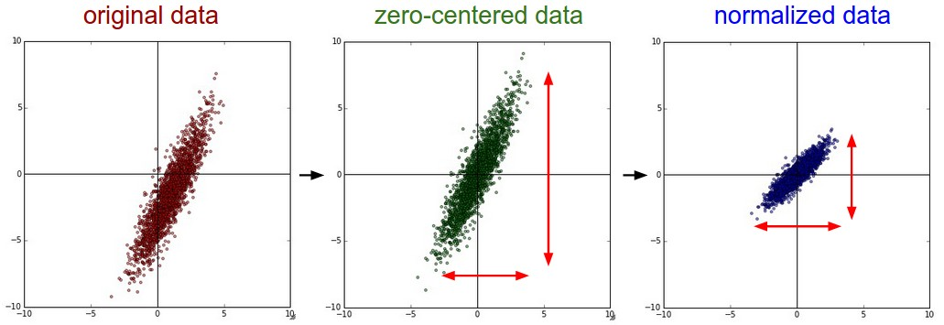
Step 1: Preprocess the data
X = X – np.mean(X, axis=0, keepdims=True)
X = X / np.std(X, axis=0, keepdims=True))
(Assume X [NxD] is data matrix, each example in a row)

Slide 51
TLDR: In practice for images: center only
Consider CIFAR-10 example with [32,32,3] images:
Subtract the mean image (e.g. AlexNet)
(mean image = [32,32,3] array)
Subtract per-channel mean (e.g. VGGNet)
(mean along each channel = 3 numbers)
It is not mandatory to normalize data for deep networks

Slide 52
Weight Initialization

Slide 53
Q: what happens when W=0 init is used?

Slide 54
First idea: Small random numbers
W = np.random.normal(0, 0.01, (N,D))
(gaussian with zero mean and 0.01 standard deviation)
Works ~okay for small networks, but can lead to non-homogeneous distributions of activations across the layers of a network.

Slide 55
Second idea: Xavier Initialization
Problems with choosing the initial weights:
- If they are too small, the signal strength propagating in the network drops with each level until it becomes too small to be useful
- If they are too big, the signal strength propagating in the network grows with each level until it becomes too big to be useful
Xavier initialization ensures that the weight have the right magnitude, keeping the signal strength in a reasonable interval.
The initial weights come from a normal distribution of mean 0 and standard deviation given by the number of perceptrons in previous/next layer:
[Glorot and Bengio, 2010]

Slide 56
Proper initialization is an active area of research…
Understanding the difficulty of training deep feedforward neural networks
by Glorot and Bengio, 2010
Exact solutions to the nonlinear dynamics of learning in deep linear neural networks
by Saxe et al, 2013
Random walk initialization for training very deep feedforward networks
by Sussillo and Abbott, 2014
Delving deep into rectifiers: Surpassing human-level performance on ImageNet classification by He et al., 2015
Data-dependent Initializations of Convolutional Neural Networks
by Krähenbühl et al., 2015
All you need is a good init
by Mishkin and Matas, 2015
…

Slide 57
Batch Normalization
“you want unit Gaussian activations?
just make them so.”
Consider a batch of activations at some layer. To make each dimension unit gaussian, apply:
[Ioffe and Szegedy, 2015]

Slide 58
Batch Normalization
“you want unit Gaussian activations?
just make them so.”
1. Compute the empirical mean and variance independently for each dimension.
X
N
2. Normalize
D
[Ioffe and Szegedy, 2015]

Slide 59
Batch Normalization
FC
Usually inserted after fully-connected or convolutional layers, and before nonlinearity.
BN
tanh
FC
BN
tanh
...
[Ioffe and Szegedy, 2015]

Slide 60
Batch Normalization
Normalize:
Note, the network can learn:
And then allow the network to squash
the range if it wants to:
to recover the identity mapping.
[Ioffe and Szegedy, 2015]

Slide 61
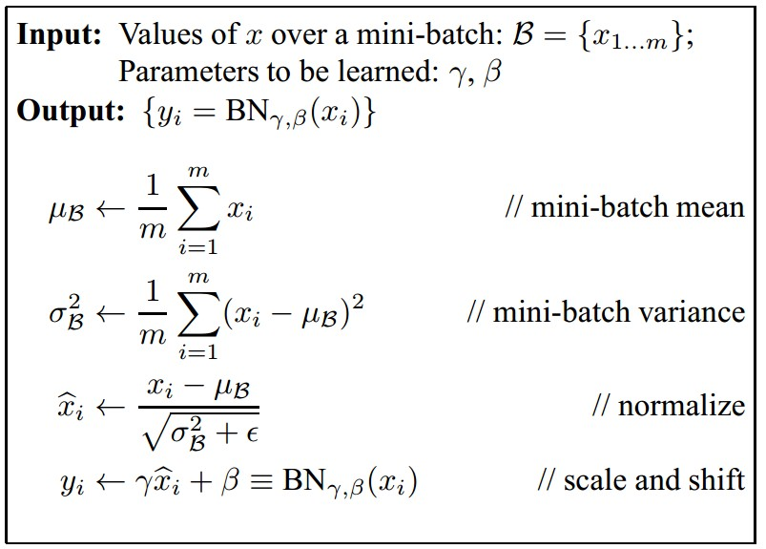
Batch Normalization
Improves gradient flow through the network
Allows higher learning rates
Reduces the strong dependence on initialization
Acts as a form of regularization in a funny way, and slightly reduces the need for dropout, maybe
[Ioffe and Szegedy, 2015]

Slide 62
Batch Normalization
Note: at test time BatchNorm layer functions differently:
The mean/std are not computed based on the batch. Instead, a single fixed empirical mean of activations during training is used.
(e.g. can be estimated during training with running averages)
[Ioffe and Szegedy, 2015]

Slide 63
Babysitting the Learning Process

Slide 64
Step 2: Choose the architecture
Say we start with one hidden layer of 50 neurons, then we gradually add more layers
50 hidden neurons
10 output neurons, one per class
output layer
CIFAR-10 images, 3072 numbers
input layer
hidden layer

Slide 65
Practical Advice
Turn off regularization and check that the loss has a reasonable value (~2.5 for 10 classes is ok)
Turn on regularization and make sure that the value of the loss function grows, e.g. 3.2
Make sure that we can do overfitting on a small subset of the training data (e.g. 20 samples)
Start with small regularization and find learning rate that makes the loss go down

Slide 66
Hyperparameter Optimization

Slide 67
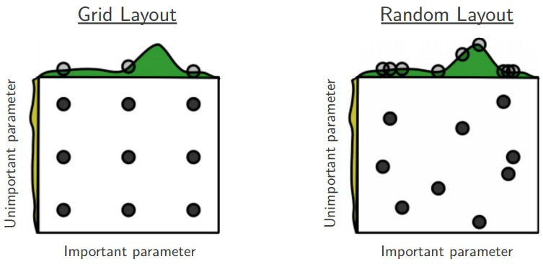
Random Search vs. Grid Search
Random Search for Hyper-Parameter Optimization
[Bergstra and Bengio, 2012]

Slide 68
Hyperparameters to play with
Network architecture
Learning rate, its decay schedule, update type
Algorithm: SGD, SGD with momentum, Adam
Regularization (L2 / Dropout strength)
Neural networks practitioner
music = loss function

Slide 69
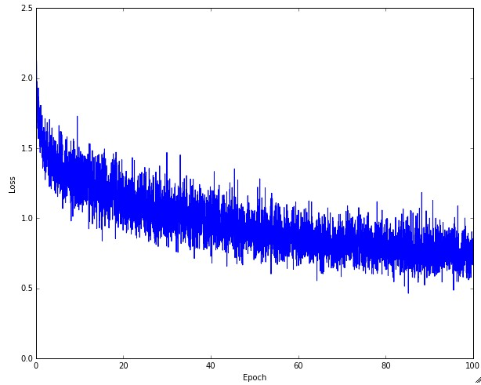
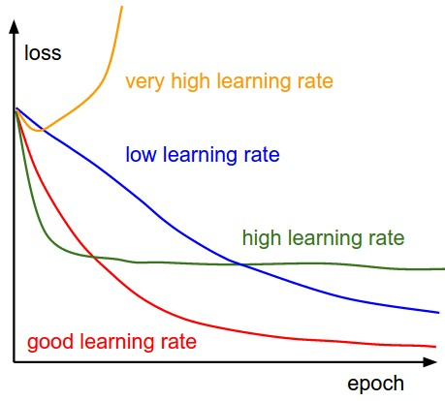
Monitor and visualize the loss curve

Slide 70
Loss
Bad initialization
a prime suspect
time

Slide 71
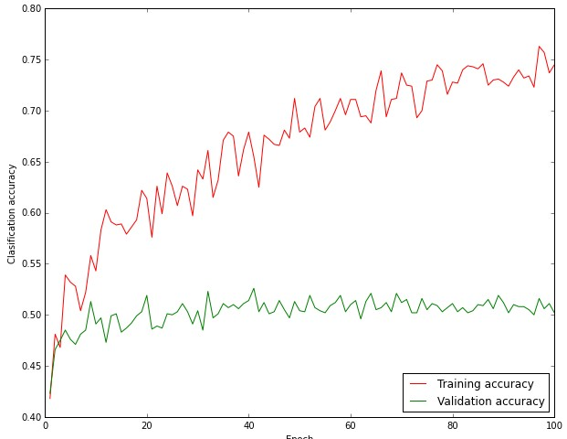
Monitor and visualize the accuracy
big gap = overfitting
=> increase regularization strength?
no gap
=> increase model capacity?

Slide 72
TLDRs
Summary
We looked in detail at:
Activation Functions (use ReLU)
Data Preprocessing (images: subtract mean)
Weight Initialization (use Xavier init)
Batch Normalization (use)
Babysitting the Learning process
Hyperparameter Optimization
(random sampling, in log space when appropriate)

Slide 73
Training Algorithm

Slide 74
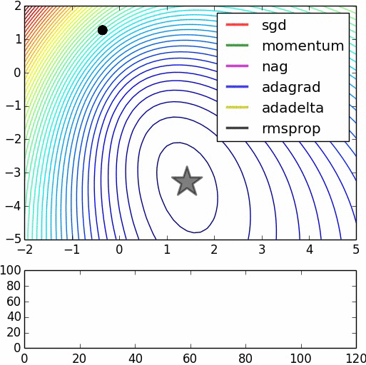
There are multiple training algorithms
Image credits: Alec Radford

Slide 75
Gradient Descent (Python)
def GD(W0, X, goal, learningRate):
perfGoalNotMet = true
W = W0
while perfGoalNotMet:
gradient = eval_gradient(X, W)
W_old = W
W = W – learningRate * gradient
perfGoalNotMet = sum(abs(W - W_old)) > goal

Slide 76
Suppose loss function is steep vertically but shallow horizontally:
Q: What is the trajectory along which we converge towards the minimum with SGD?

Slide 77
Suppose loss function is steep vertically but shallow horizontally:
Q: What is the trajectory along which we converge towards the minimum with SGD? Very slow progress along flat direction, jitter along steep one

Slide 78
SGD with momentum (Python)
def GD(W0, X, goal, learningRate, mu):
perfGoalNotMet = true
W = W0
V = 0
while perfGoalNotMet:
gradient = eval_gradient(X, W)
W_old = W
V = mu * V – learningRate * gradient
W = W + V
perfGoalNotMet = sum(abs(W - W_old)) > goal

Slide 79
SGD with momentum
- Physical interpretation as ball rolling down the loss function + friction (mu coefficient)
- mu = usually ~0.5, 0.9, or 0.99 (sometimes annealed over time, e.g. from 0.5 -> 0.99)
Allows a velocity to “build up” along shallow directions
Velocity becomes damped in steep direction due to quickly changing sign

Slide 80
SGD vs. SGD with momentum
Notice momentum
overshooting the target, but overall getting to the minimum much faster.

Slide 81
SGD, SGD+Momentum, Adagrad, RMSProp, Adam all have learning rate as a hyperparameter.
Q: Which one of these learning rates is best to use?

Slide 82
SGD, SGD+Momentum, Adagrad, RMSProp, Adam all have learning rate as a hyperparameter.
=> Learning rate decay over time!
step decay:
e.g. decay learning rate by half every few epochs
exponential decay:
1/t decay:

Slide 83
Evaluation:
Model Ensembles

Slide 84
Model Ensembles
Train multiple independent models
At test time average their results
Enjoy 2% extra performance

Slide 85
Tips & Tricks
Can also get a small boost from averaging multiple model checkpoints of a single model
Keep track of (and use at test time) a running average parameter vector

Slide 86
Regularization with
Dropout

Slide 87
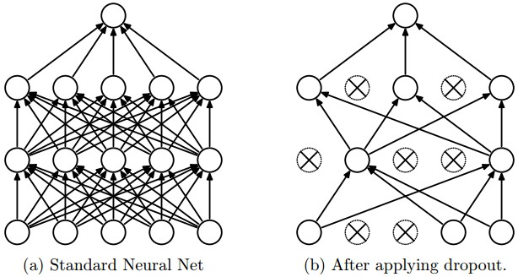
Regularization: Dropout
“randomly set some neurons to zero in the forward pass”
[Srivastava et al., 2014]

Slide 88
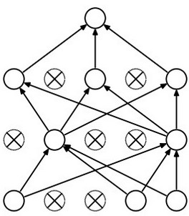
Waaaait a second…
How could this possibly be a good idea?
Forces the network to have a redundant representation.
has an ear
X
has a tail
is furry
X
cat
score
has claws
mischievous
look
X

Slide 89
Waaaait a second…
How could this possibly be a good idea?
Another interpretation:
Dropout is training a large ensemble of models (that share parameters).
Each binary mask is one model, gets trained on only ~one datapoint.

Slide 90
At test time….
Ideally:
We want to integrate out all the noise
Monte Carlo approximation:
Do many forward passes with different dropout masks, average all predictions

Slide 91
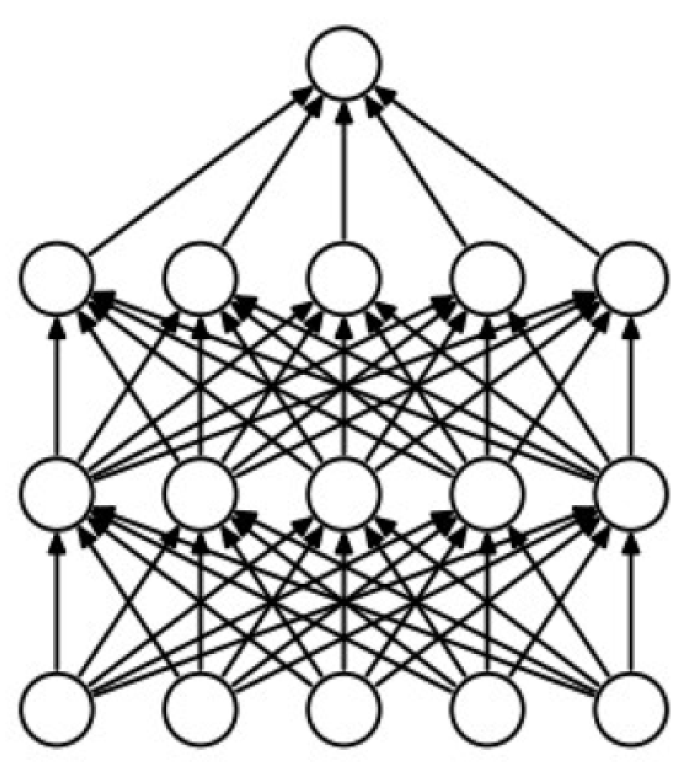
At test time….
Can in fact do this with a single forward pass! (approximately)
Leave all input neurons turned on (no dropout).
(this can be shown to be an approximation to evaluating the whole ensemble)

Slide 92
Bibliography

Slide 94
